Slide 1


Slide 2


Presented by

Slide 3
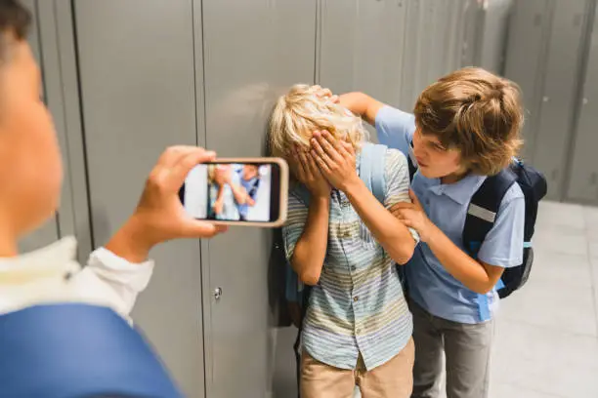

Slide 4


Slide 5


Slide 6


Slide 7


Slide 8


Slide 9


Slide 10


Slide 11

Unit-9
Lesson-4
Say No to Bullying

Slide 12
Learning Objectives
Define Bullying
Categorize Physical Bullying
Identify Verbal and Social Bullying
Recognize Cyberbullying
Analyze Psychological Effects
Differentiate Between Physical and Social Harm

Slide 13
What is Bullying?
Bullying is repeated aggressive behavior intended to hurt another person, either physically, Mentally, emotionally and Socially.

Slide 14


Slide 15
Types of Bullying
Physical bullying – hitting, kicking, pinching, pushing, damaging property, Spitting, Taking or breaking someone's things, Making mean facial or hand gestures
Verbal bullying – name-calling, insults, teasing, threats, Inappropriate sexual comments, Taunting, threatening to cause harm
Social bullying – spreading rumors, excluding someone, embarrassing them in public, Leaving someone out on purpose, Telling other children not to be friends with someone,
Cyberbullying – using digital platforms to harass, threaten, or humiliate.

Slide 16
Effects of Bullying
Low self-esteem
Anxiety or depression
Poor academic or work performance
Physical health problems
Self-Harm or Suicidal thoughts
Fear & Insecurity
Dropouts from School or College
Lack of Participation
Sleep Disturbances or insomnia
Criminal Tendencies
Aggressive Behavior

Slide 17


Slide 18
Solution of Bullying
Implementing Anti-Bullying Policies
Raising Awareness
Teacher and Staff Training
Encouraging Student Participation
Strengthening Disciplinary Action
Engaging Parents and Guardians
Promoting a Positive School Culture
Utilizing Media and Technology
Legal and Institutional Support
Research and Monitoring

Slide 19
Conclusion
Bullying is not just “harmless fun” — it has long-term consequences for individuals and society. Addressing it in Bangladesh requires awareness, education, strong school policies, and mental health support.

Slide 20


Slide 21


Slide 22
Home Work
1. What are some of the probable effects of bullying on students?
2. Make a list of initiatives that can be done to prevent bullying in college.
3. What can you do in your college to stop bullying?

Slide 23
NEXT Class
Adolescence

Slide 24


