Slide 1




WELCOME TO ALL IN TODAY’S
ENGLISH LESSON

Slide 2


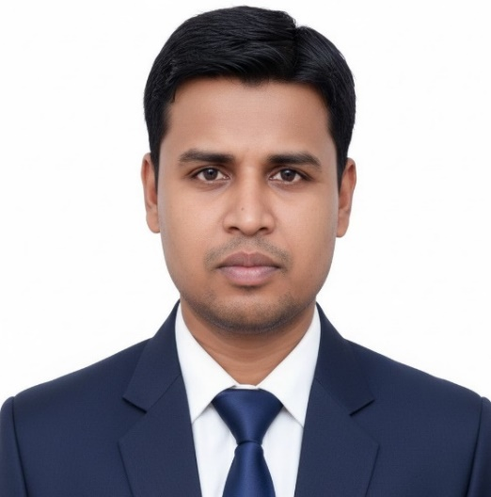

Presented By
Rajib Dutta
Assistant teacher
Bhingrol Govt.Primary School
Anowara, Chottogram
Email: rajibduttaat@gmail.com

Slide 3

Introduction of the lesson
Class : FIVE
Subject : English
Unit : 13
Lesson : 1 (Page- 70)
Lesson Title : Quality time togather
TIME :

Slide 4
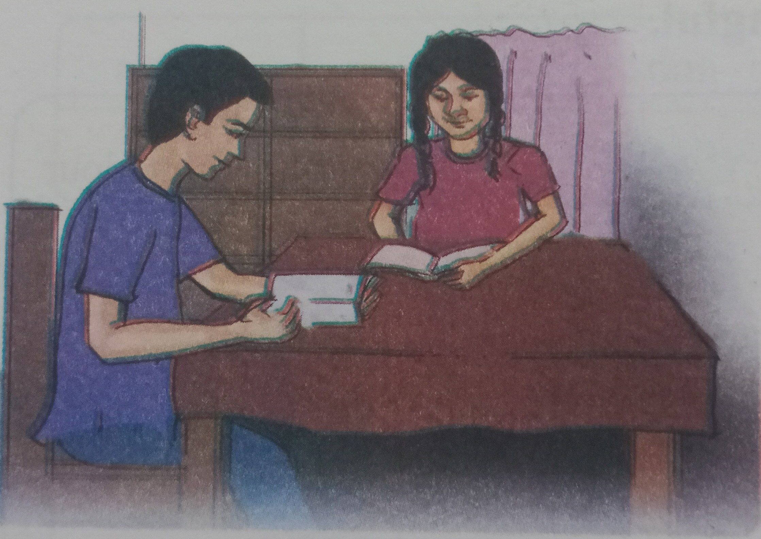
Todays lesson
Quality Time Togather

Slide 5

YouTube
An online video sharing platform.

Slide 6
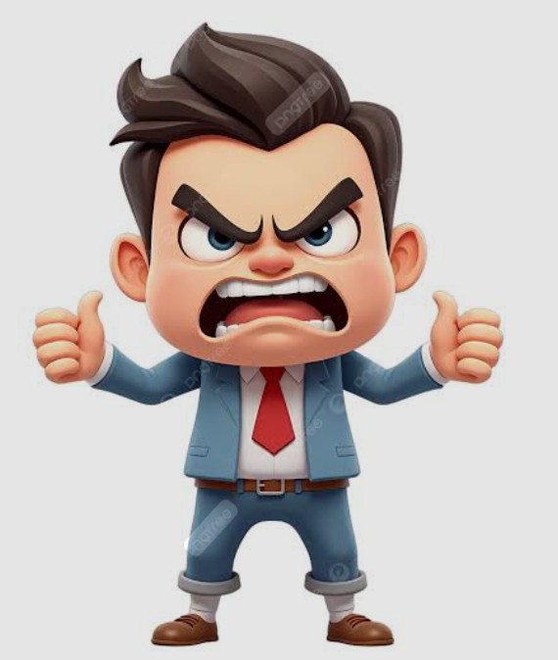
Grumpy
Easily annoyed or unhappy

Slide 7
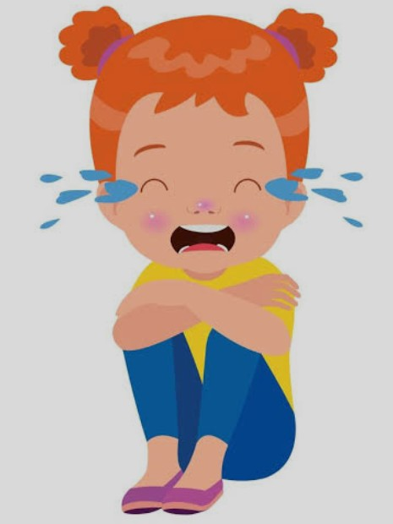
Unhappy
Not happy

Slide 8
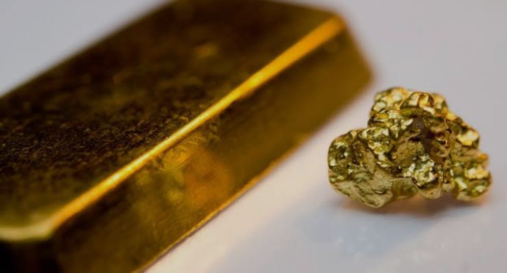
precious
Something of high value

Slide 9
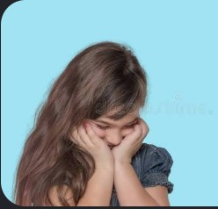
Ashamed
To feel embarrassed about something

Slide 10
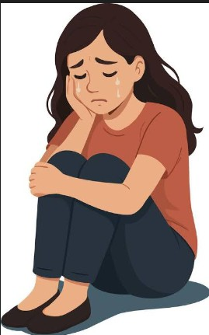
Sadness
In a dark or unhappy mood

Slide 11
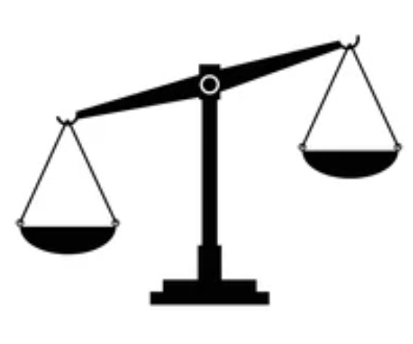
Unfair
Marked by injustice

Slide 12
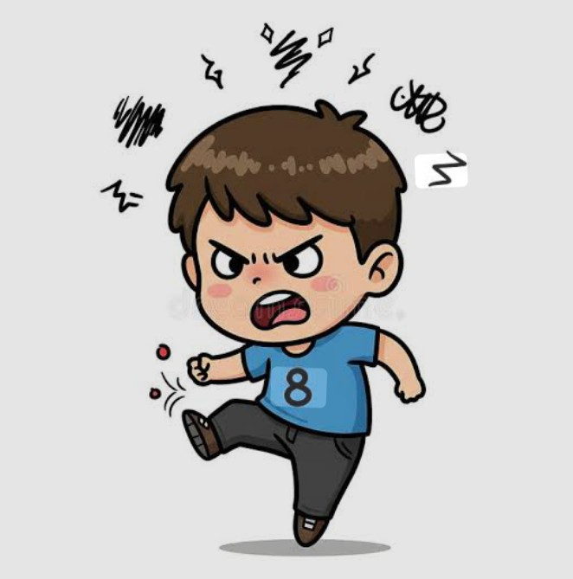
Annoying
Feeling slightly angry or impatient

Slide 13

Promise
To tell someone that definitely do something

Slide 14
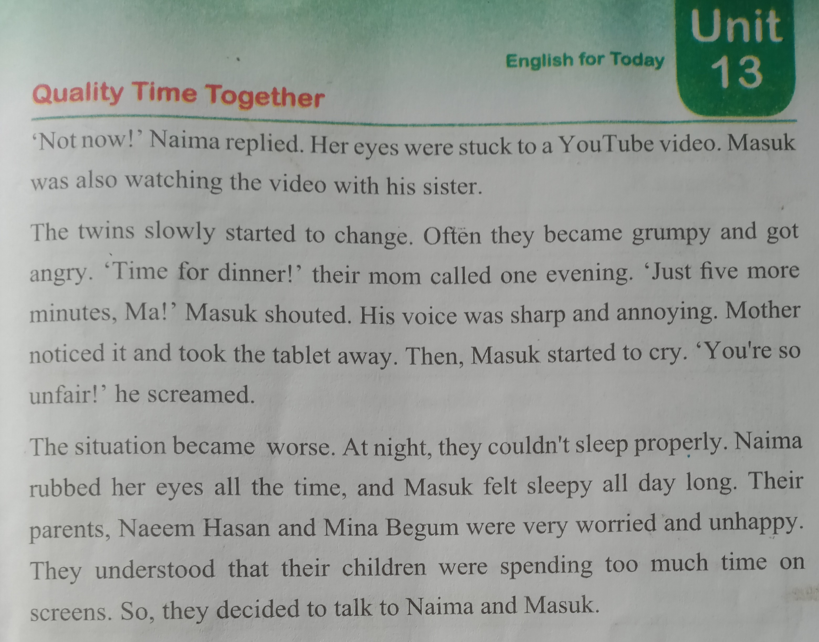
Teacher read text with proper pronounciation two times

Slide 15
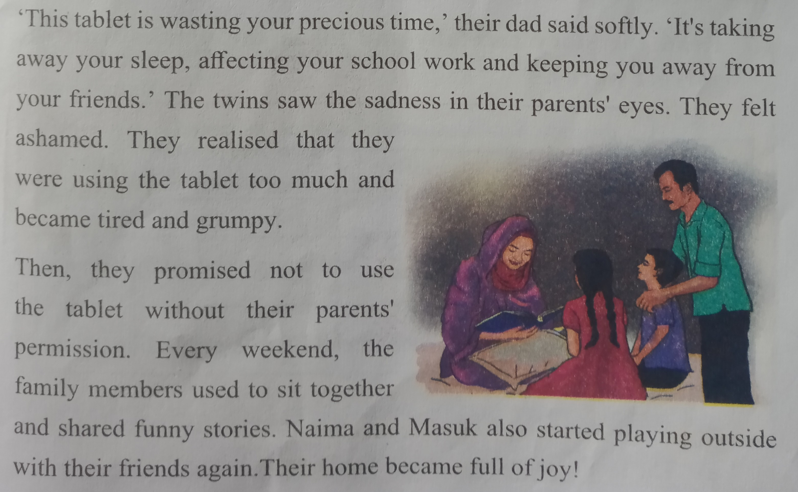
Teacher read text with proper pronounciation two times

Slide 16
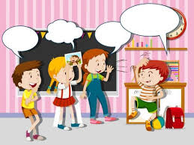
Students activities
1.Students will read the text with pair proper pronounciation.
2Students read the text alone with proper pronounciation.
3.Advanced students help to weaker students.

Slide 17

Match the words with their meaning
1. Grumpy marked by injustice.
2. Precious feeling embarrassed about something
3. Promise easily annoyed or unhappy
4. Unfair having a high value
5. Ashamed to definitely do something

Slide 18
Students activities
Students will read the text proper pronunciation with missingwords
The twins slowly started to …… . Often they became …… and got …… .’Time for ……!” their mom called one …… . “Just …… more minutes, Ma!” Masuk shouted. His voice was…… and…… Mother noticed it and took the …… away.
The situation became …… At night, they couldn’t ……. Properly. Naima rubbed her ……. All the time, and Masuk felt …… all day long.Their parents, ……. And …… were very …… and …… . They understood that their ……. Were spending too much time on ………. So, they …… to talk to Naima and Masuk.

Slide 19
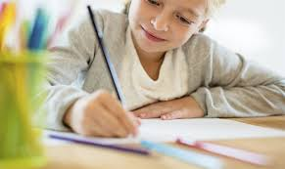
Home work
Write five sentences about ‘Bad effect of much using the Tablet.’.

Slide 20

