Slide 1
English With Anisur Rahman
🌸 Greeting
Good morning!
How are you today?
I hope you are all fine.
Welcome to our English class.
📚 English With Anisur Rahman | Learn English with Bangla Explanation

Slide 2
English With Anisur Rahman
Revision
Add your lesson content here...
What did we learn in our previous class?
I learnt numbers from 71 - 90
📚 English With Anisur Rahman | Learn English with Bangla Explanation

Slide 3
English With Anisur Rahman
Cover
Subject: English
Unit 4: Let's Play with Sounds and Numbers
Lesson 1
Page 48
Topic: Middle Sound /æ/
📚 English With Anisur Rahman | Learn English with Bangla Explanation

Slide 4
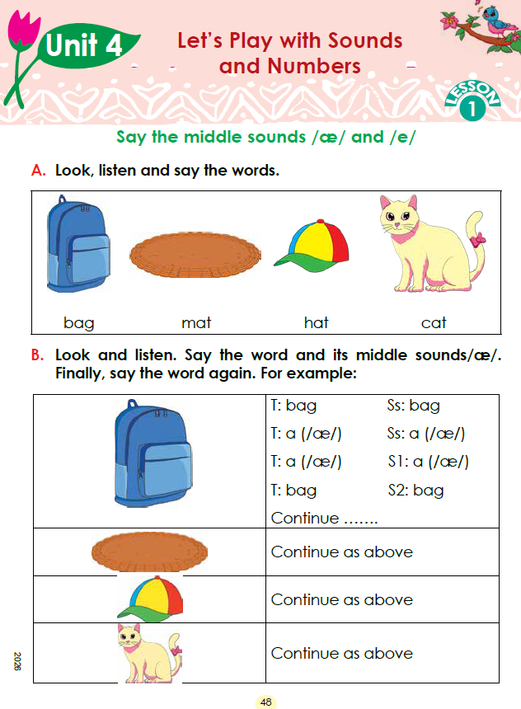
English With Anisur Rahman
Cover
📚 English With Anisur Rahman | Learn English with Bangla Explanation

Slide 5
English With Anisur Rahman
Learning Outcomes
By the end of this lesson, students will be able to—
✅ Recognise the middle sound /æ/
✅ Pronounce familiar words correctly.
✅ Say the difference between the sounds /æ/ and /e/.
📚 English With Anisur Rahman | Learn English with Bangla Explanation

Slide 6



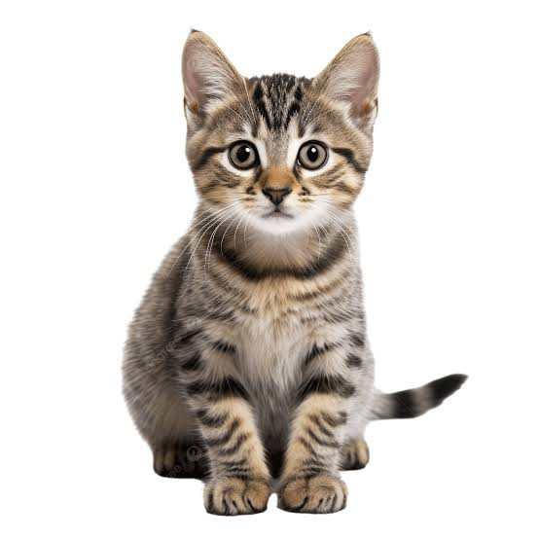
English With Anisur Rahman
Warm-up
What is this?
What is this?
It is a bag.
It is a hat.
What is this?
What is this?
It is a bag.
It is a cat.
📚 English With Anisur Rahman | Learn English with Bangla Explanation

Slide 7
English With Anisur Rahman
Vocabulary
Add your lesson content here...
Word | Bangla Meaning
Bag | ব্যাগ
Mat | মাদুর
Hat | টুপি
Cat | বিড়াল
📚 English With Anisur Rahman | Learn English with Bangla Explanation

Slide 8
English With Anisur Rahman
Activity A
Add your lesson content here...
Look at the pictures.
Say with me.
📚 English With Anisur Rahman | Learn English with Bangla Explanation

Slide 9
English With Anisur Rahman
Activity B
Repeat with me.
Follow me.
Be aware about
the middle sound.
📚 English With Anisur Rahman | Learn English with Bangla Explanation

Slide 10
English With Anisur Rahman
Pair Work
tudent A
bag
Student B
/æ/
Student A
bag
tudent A
bag
Student B
/æ/
Student A
bag
Then they change roles.
Repeat with
mat
hat
cat
📚 English With Anisur Rahman | Learn English with Bangla Explanation

Slide 11
English With Anisur Rahman
Practice
Add your lesson content here...
Chain Drill (TG Assessment)
Teacher starts.
Teacher
Bag
Student 1
Mat
Student 2
Hat
Student 3
Cat
Student 4
Bag
📚 English With Anisur Rahman | Learn English with Bangla Explanation

Slide 12
English With Anisur Rahman
Assessment
Add your lesson content here...
Summary
Teacher asks
Today what did we learn?
Expected answers
We learned
Bag
Mat
Hat
Cat
We learned the sound
/æ/
📚 English With Anisur Rahman | Learn English with Bangla Explanation

Slide 13
English With Anisur Rahman
Homework
Add your lesson content here...
Read these words five times.
bag
mat
hat
cat
Circle the letter
"a"
in every word.
📚 English With Anisur Rahman | Learn English with Bangla Explanation

Slide 14
English With Anisur Rahman
Thank You
Add your lesson content here...
Thank you everyone.
See you in the next class.
Assalamu Alaikum.
📚 English With Anisur Rahman | Learn English with Bangla Explanation

