Slide 1




WELCOME TO ALL IN TODAY’S
ENGLISH LESSON

Slide 2




Presented By
Rajib Dutta
Assistant teacher
Bhingrol Govt.Primary School
Anowara, Chottogram
Email: rajibduttaat@gmail.com

Slide 3

Introduction of Subject
Class: Two
Subject:English For Today
Unit : Five
Lesson: 5 (How does a plant grow)
Time: 40 minutes

Slide 4
Learning outcomes
Students will be able to
8.1 : Recognising and using words frequently used in the
texts for participating in everyday conversations.

Slide 5
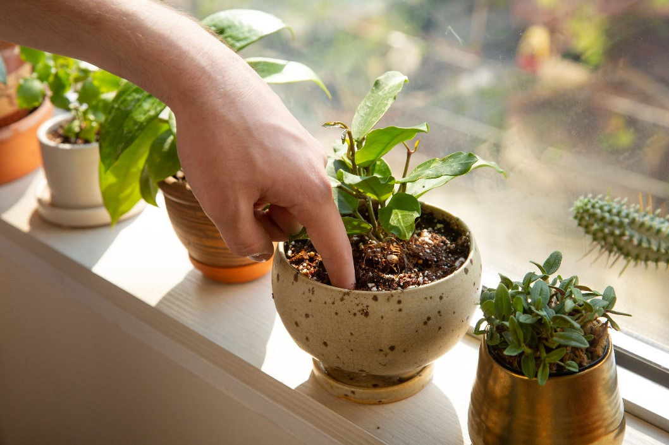
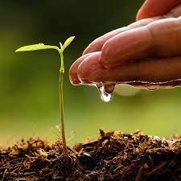
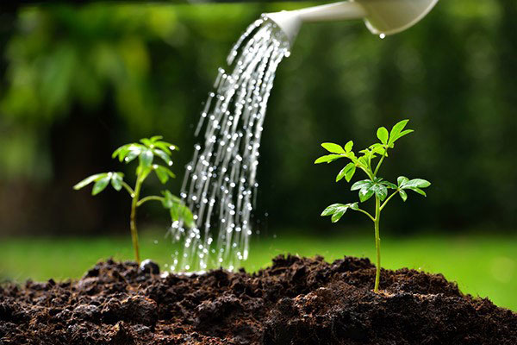
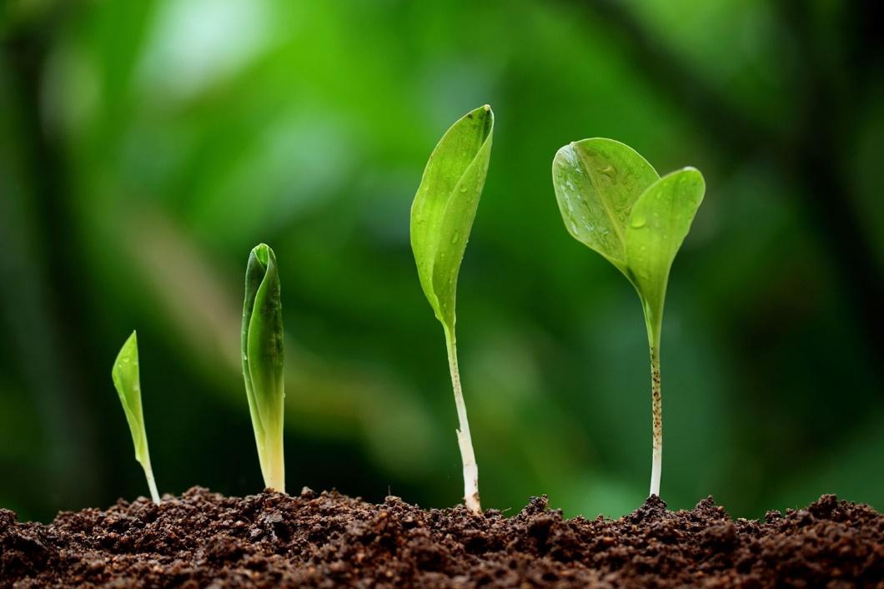
Now we will see some pictures

Slide 6
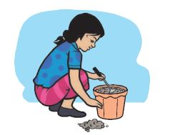
Lesson declaration
“Rima and the seed”

Slide 7
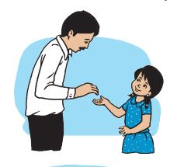
Rima’s father
seed
Rima
Rima’s father gives her a seed.

Slide 8
Rima
soil
Rima puts soil in a pot.

Slide 9
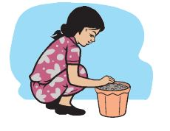
Puts the seed
She then puts the seed into the soil.

Slide 10
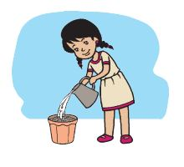
waters
Rima waters the seed on Tuesday.

Slide 11
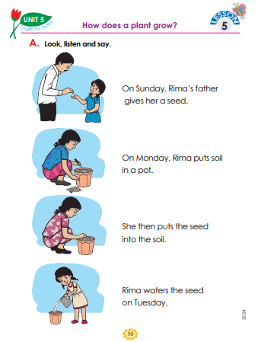
Now open your English book and page 49

Slide 12
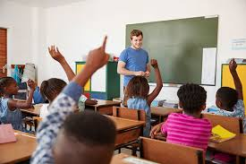
Now make some groups
Look at your book and see what does Rima and his father.

Slide 13
Assessing learning
Individual work

Slide 14
Assessing learning
English to Bangla
Bangla to English
Father
বাবা
পাত্র
Pot
Give
দেওয়া
রাখা
Put
পানি
Water
Seed
বীজ
মধ্যে
In
Soil
মাটি

Slide 15


G o o d b y e
Thanks to all
See you again…

