Slide 1




WELCOME TO ALL IN TODAY’S
ENGLISH LESSON

Slide 2


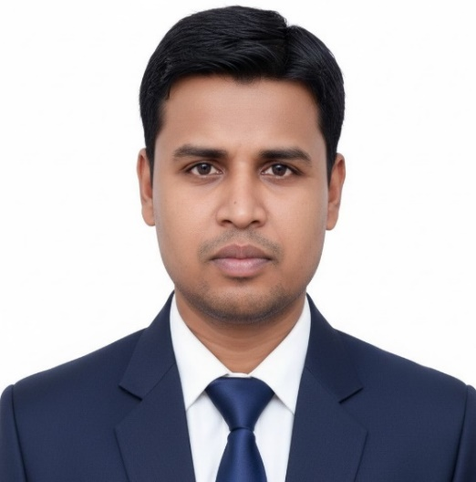

Presented By
Rajib Dutta
Assistant teacher
Bhingrol Govt.Primary School
Anowara, Chottogram
Email: rajibduttaat@gmail.com

Slide 3

Introduction of Subject
Class: Two
Subject:English For Today
Unit : Five
Lesson: 3 (what day is today)
date:

Slide 4
Attainable competency (ies)
LEARNING OUTCOMES
By end of the lesson students will be able to-------
2.1 Listening to rhymes, cartoons and digital contents in English for enjoyment.

Slide 5
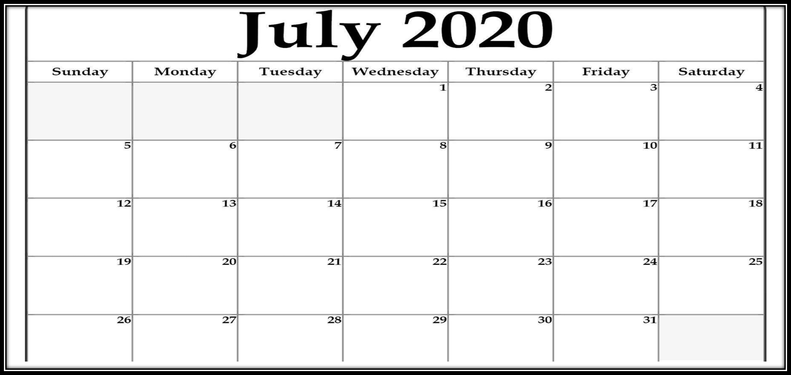
What day is today?
Today is ........... .
Look at the picture.
This is a calendar.
What is this?

Slide 6
Our today’s lesson is ….
what day is today

Slide 7
Look, listen and say.
Sunday
Monday
Tuesday
Wednesday
Thursday
Friday
Saturday

Slide 8
Sunday
রবিবার
Sun/day
Sunday
Sunday

Slide 9
Monday
সোমবার
Mon/ day
Monday
Monday

Slide 10
Tuesday
মঙ্গলবার
Tues/ day
Tuesday
Tuesday

Slide 11
Wednesday
বুধবার
Wed/nes/day
Wednesday
Wednesday

Slide 12
Thursday
বৃহস্পতিবার
Thurs/ day
Thursday
Thursday

Slide 13
Friday
শুক্রবার
Fri/ day
Friday
Friday

Slide 14
Saturday
শনিবার
Sa/ tur/ day
Saturday
Saturday

Slide 15
Fill in the gaps.
Wed_esday
S_nday
F_iday
Th_rsday
n
u
r
u

Slide 16
Find out the letters which are used to make the word - Sunday
S
T
M
W
u
e
n
d
F
s
r
i
a
e
y
o
Sunday

Slide 17
Find out the letters which are used to make the word - Tuesday
S
M
W
u
e
n
d
F
s
r
i
a
e
y
o
T
Tuesday

Slide 18

Open your EFT Book at page 47

Slide 19
Evaluation
Re-arrange the words
1. Tesuday
- Tuesday
2. Firday
- Friday
3. Wdesenday
- Wednesday

Slide 20
HOME WORK
Write the words 5 times on your notebook –
Tuesday - মঙ্গলবার
Wednesday – বুধবার

Slide 21


Good bye every one
Thanks to all
See you again…

