Slide 1




Welcome
To Our
Today’s Lesson

Slide 2






Introducing
Mubarak Hossain
Assistant Teacher
Faridpur Alalpur GPS
Kuliarchar, Kishoreganj.
E-mail: mhossainmsc@gmail.com
Class : One
Subject: English
Lesson: 11
Unit: 2
Date: 14.07.2026

Slide 3
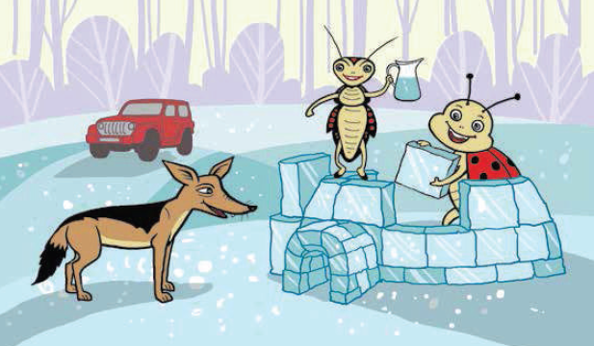
Look at the picture.
Jug
Jeep
Ice
Jackal
Insect
Say the names of the animals.

Slide 4

Today's lesson
Ii,Jj
Class-1
Subject-English
Lesson-11
Unit-2
Alphabet (Ii , Jj)

Slide 5

Learning outcomes:
Students will be able to-
1.1.1 -recognize the sounds of the alphabet in familiar words.
3.1.1 - say proper sounds of the letters in familiar words.
4.1.1 - read the pictures of familiar objects and events.

Slide 6
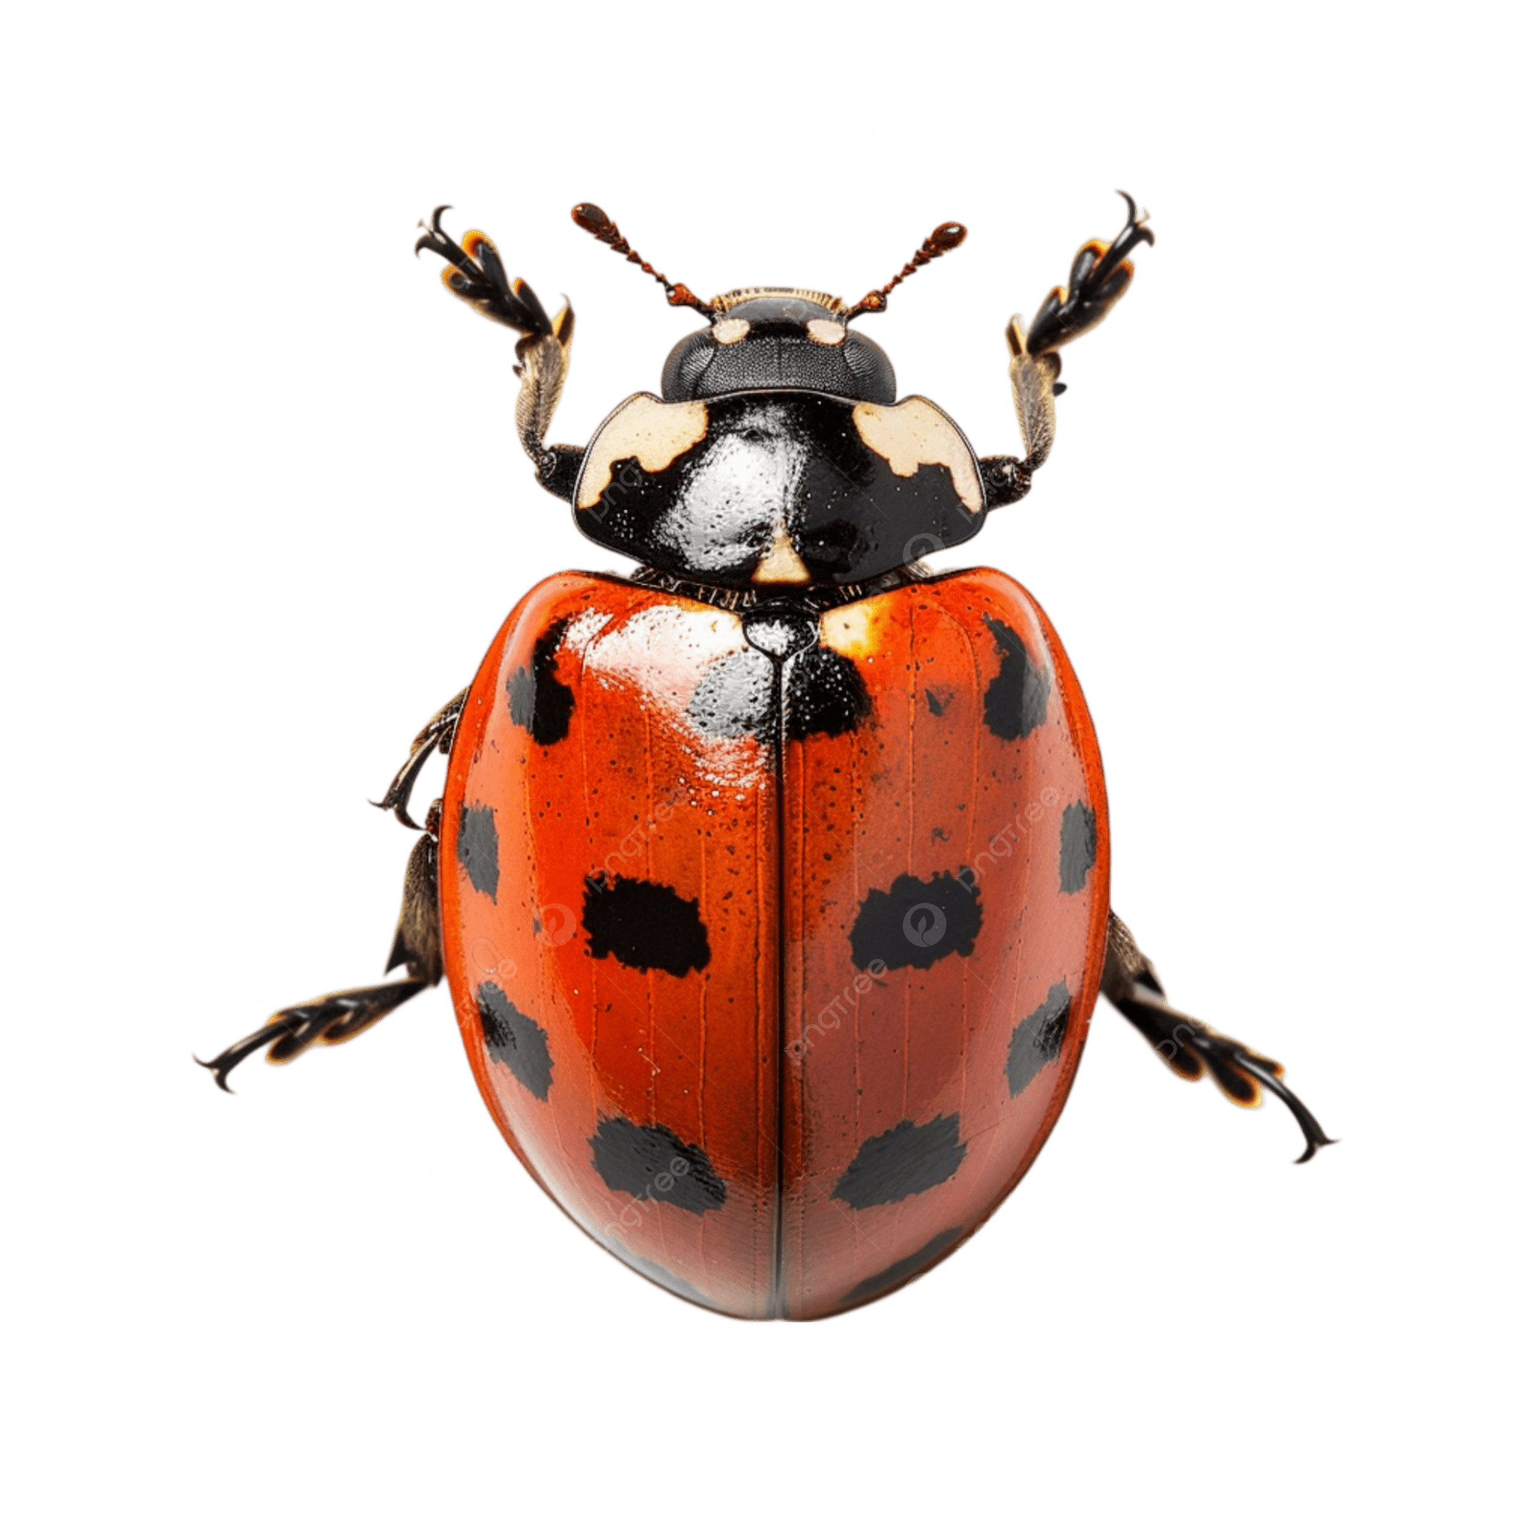
Look, listen and say.
I
i
insect
Insect

Slide 7
Look, listen and say.
insect
i
I
Capital letter
Small letter

Slide 8
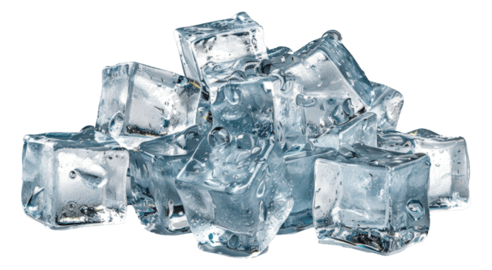
I
Look, listen and say.
i
ice
Ice

Slide 9
Look, listen and say.
ice
i
I
Capital letter
Small letter

Slide 10

I
Look, listen and say.
ink
i
Ink

Slide 11

Look, listen and say.
i
ink
I
Small letter
Capital letter

Slide 12

J
Look, listen and say.
j
jug
Jug

Slide 13
Look, listen and say.
j
jug
J
Capital letter
Small letter

Slide 14
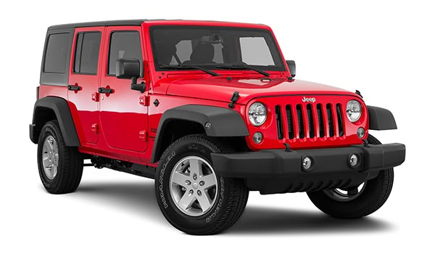
Look, listen and say.
jeep
J
j
Jeep

Slide 15

Look, listen and say.
j
jeep
J
Small letter
Capital letter

Slide 16
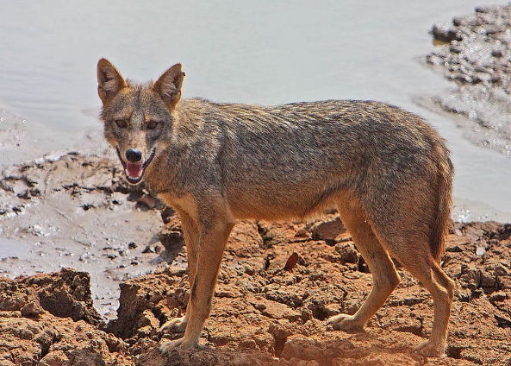
Look, listen and say.
J
j
jackel
Jackel

Slide 17
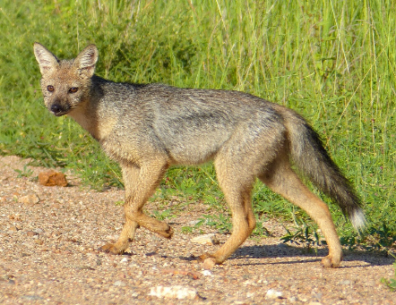
Look, listen and say.
j
jackal
J
Capital letter
Small letter

Slide 18

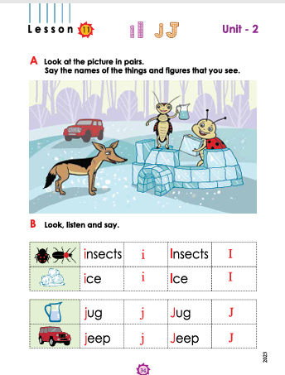
Now open your book page no 34

Slide 19
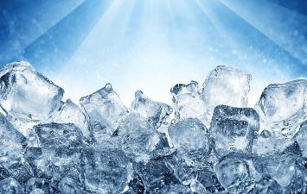
Loud reading by the teacher
WCW
i
ice
I
Ice

Slide 20
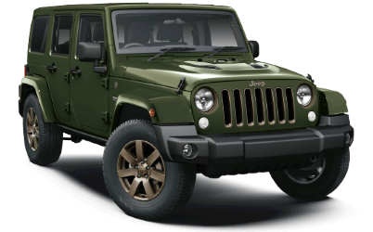
Loud reading by the teacher
WCW
J
Jeep
j
jeep

Slide 21
Evaluation
Say the letter name “ I ”.
Say the letter name “ J ”.

Slide 22
Evaluation
Say the letter name “ i ”.
Say the letter name “ j ”.

Slide 23
Match the letters by word ?
Evaluation
I
ice
J
jeep
i
Ice
j
Jeep

Slide 24
Evaluation
Read and match the small and capital letters
i
F
h
j
G
g
I
H
J
f

Slide 25
Evaluation
Read and match the small and capital letters
I
i
j
J
F
f
g
G
H
h

Slide 26

Home work
Trace and write.
I
I
I
J
J
J
i
i
i
j
j
j

Slide 27



Good Bye

