Slide 2
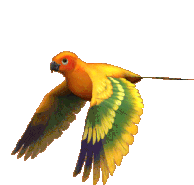
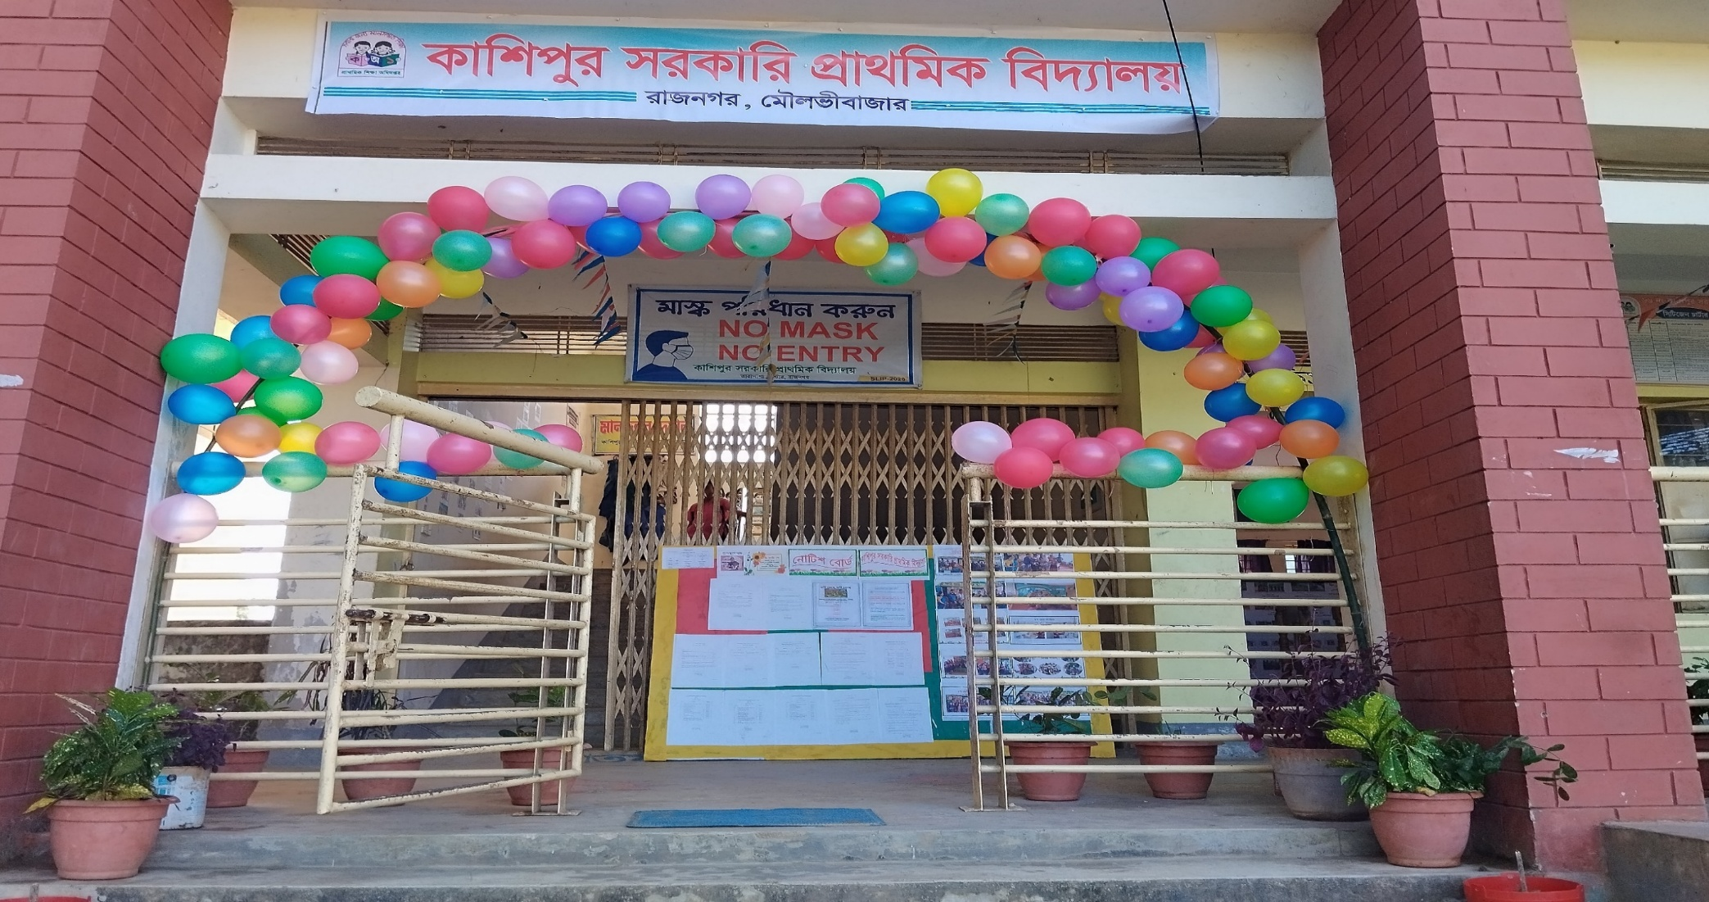









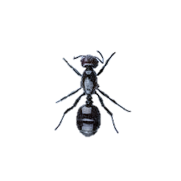

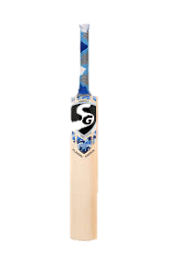
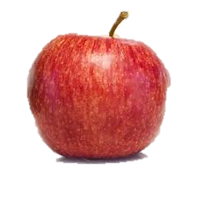



H
E
L
O
L

Slide 3


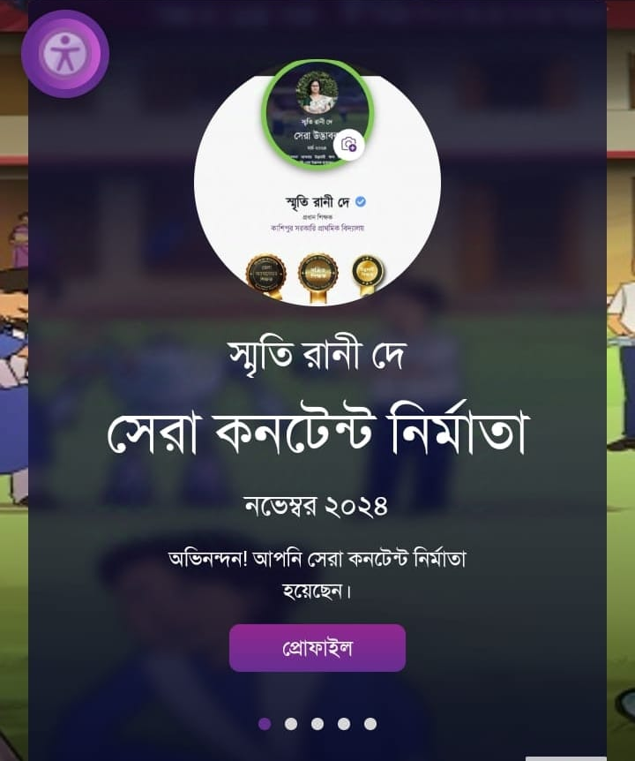

Presented by
Smriti Rani Dey
Head Teacher
Kashipur GPS.
Rajnagar ,Moulvibazar
Best Teacher 2024 ,Sylhet Division
smritidey2011@gmail.com

Slide 4



Introduction
Class one
Unit 2
Lesson 2(Aa,Bb)
Page 14

Slide 5
LISTENING:
1.1.1 recognize the sounds of the alphabet in familiar words .
1
SPEAKING:
3.1.1 say proper sounds of the letters in familiar words .
2
READING:
4.1.1 read the pictures of familiar objects and events.
3

Slide 6
Let’s sing.

Slide 7
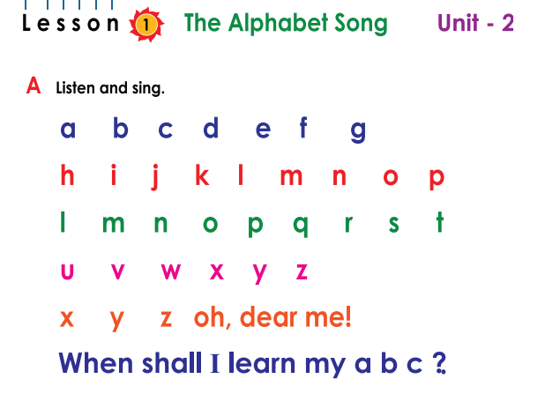
What did we learn yesterday ?

Slide 8

We are going to learn some English letters today ,
Aa,Bb

Slide 9
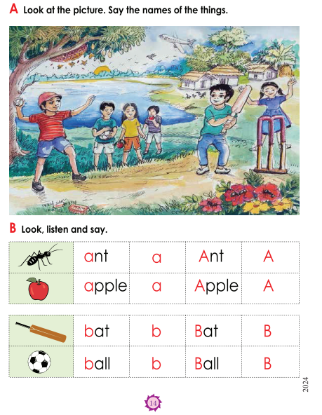
Open your book at page : 14
What can you see in the picture?

Slide 10
What can you see in the picture?
ant
boy
plane
bat
ball
apple

Slide 11
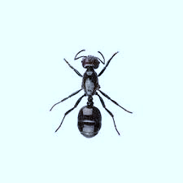
What’s this?
How do we say that in English?

Slide 12
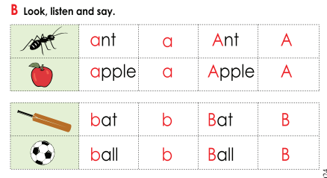
Listen to me and repeat after me
ant
a
Ant
A

Slide 13
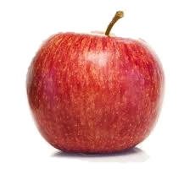
What’s this?
How do we say that in English?

Slide 14
Listen to me and repeat after me
apple
a
Apple
A

Slide 15
Listen to me and repeat after me
capital A
A
Small a
a

Slide 16
The letter name of A is /ei/

Slide 17
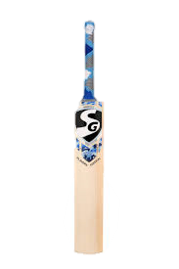
What’s this?
How do we say that in English?

Slide 18
Listen to me and repeat after me
bat
b
Bat
A

Slide 19
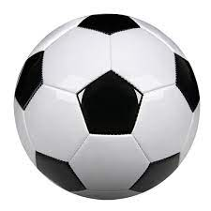
What’s this?
How do we say that in English?

Slide 20
Listen to me and repeat after me
ball
b
Ball
B

Slide 21
Listen to me and repeat after me
capital B
B
Small b
b

Slide 22
The letter name of B is /bi/

Slide 23

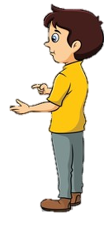

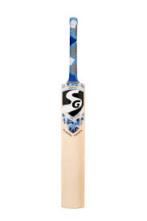
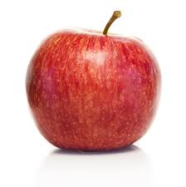



What’s this?
Pair Wotk
ant
ball
apple
bat

Slide 24
Say the sound of letter
Pair work
a
b
/ei/
A
/bi/
B

Slide 25
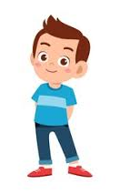
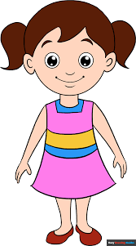
When I say the word(ant,apple,bat,ball)you will touch the picture .
Whoever touches first get 1 Point
Group 1
Group 2
1+1+ | 1+1+
Group 1
Group 2
Let’s play touch the board.

Slide 26

Matching letter with picture.
Group 1
Group 2
a
b
a
b
Group work

Slide 27

Lets play a game (kims game).
Close your eyes
Open your eyes
Which word have I covered

Slide 28
Assessing learning
What’s this?
ant
apple
bat
ball

Slide 29


Assessing learning
Listen to the audio and round the correct letter.
g
e
k
f
/ei/
a
b
c
d

Slide 30
Assessing learning
Listen to the audio and round the correct letter.
a
e
k
f
/bi/
g
d
b
c

Slide 31
Assessing learning
b
bat
ant
ball
apple
a
b
Say the first letter ..
a

Slide 32

Draw and colour an apple.

Slide 33

o
d
G
o
b
e
y

