Slide 2
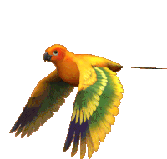



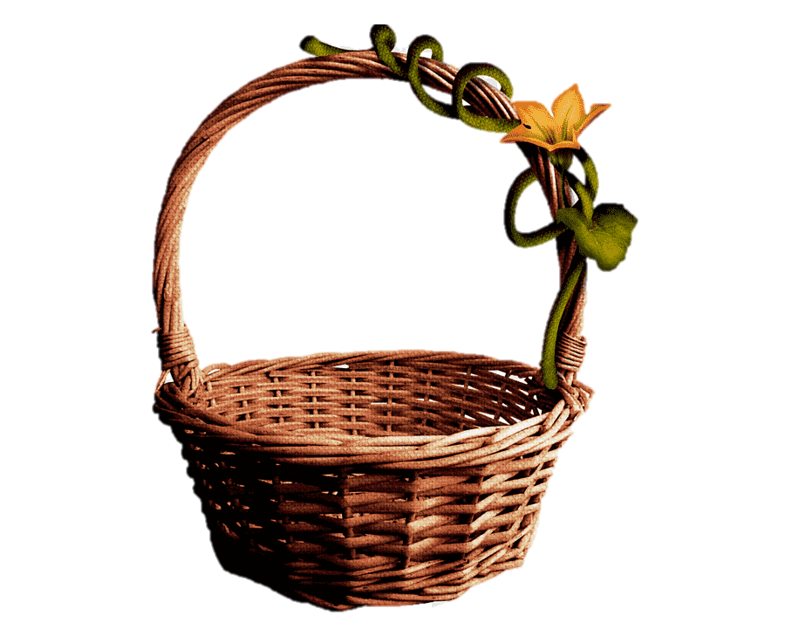




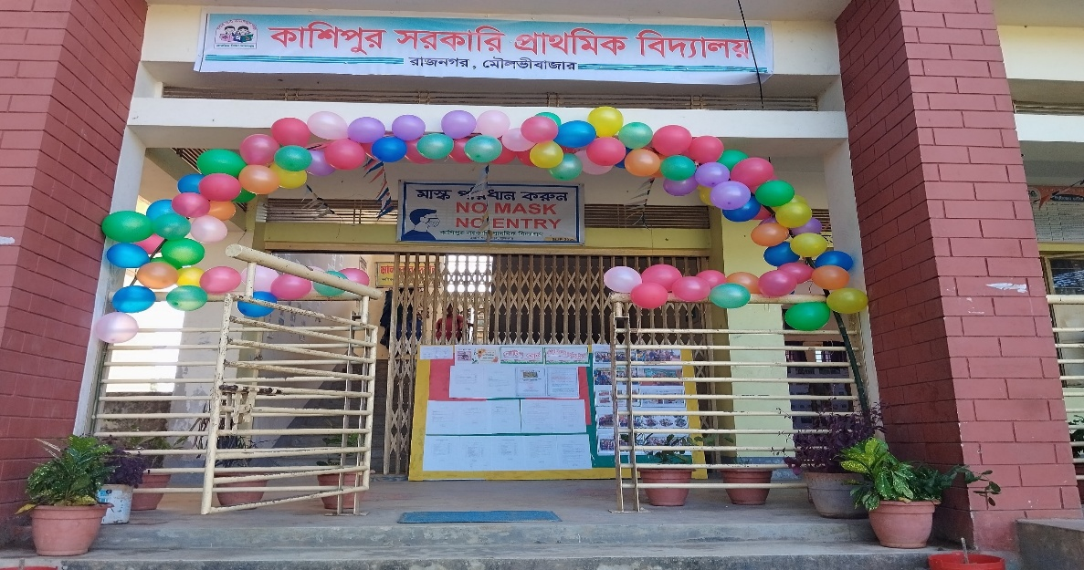

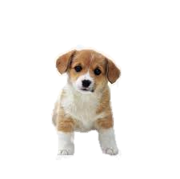

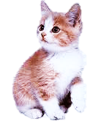
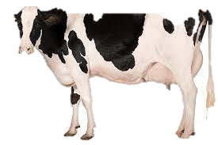

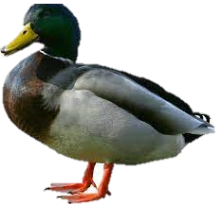
H
O
E
L
L

Slide 3




Presented by ,,
Smriti Rani Dey
Head Teacher
Kashipur GPS.
Rajnagar ,Moulvibazar
Best Teacher 2024 ,Sylhet Division
smritidey2011@gmail.com

Slide 4


Introduction
Class one
Unit 2
Lesson 3(Cc,Dd)
Page 17

Slide 5
LISTENING:
1.1.1 recognize the sounds of the alphabet in familiar words .
1
SPEAKING:
3.1.1 say proper sounds of the letters in familiar words .
2
READING:
4.1.1 read the pictures of familiar objects and events.
3

Slide 6
Let’s sing.

Slide 7

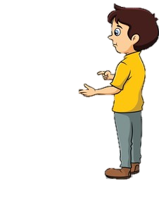
What did we learn yesterday ?
Aa
Bb

Slide 8
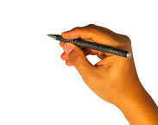
We are going to learn some English letters today ,
Cc,Dd

Slide 9
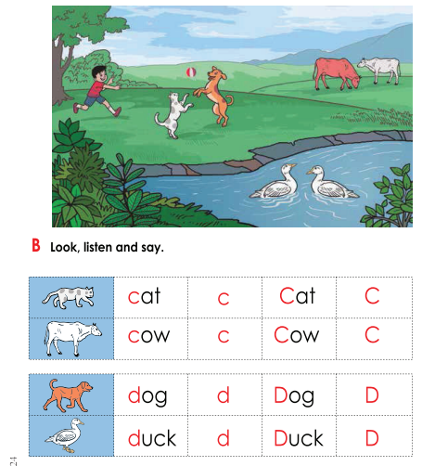
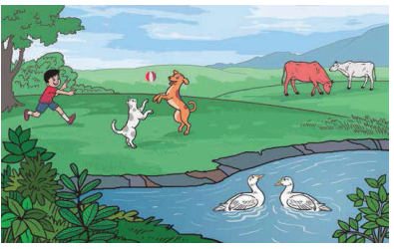
Open your book at page : 17
What can you see in the picture?

Slide 10
What can you see in the picture?
ball
boy
cow
duck
dog
cat

Slide 11
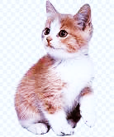
What’s this?
How do we say that in English?

Slide 12
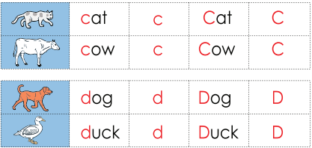
Listen to me and repeat after me
cat
c
Cat
C

Slide 13
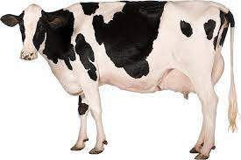
What’s this?
How do we say that in English?

Slide 14
Listen to me and repeat after me
cow
c
Cow
C

Slide 15
Listen to me and repeat after me
Small c
c
capital C
C

Slide 16
The letter name of C is /si/

Slide 17
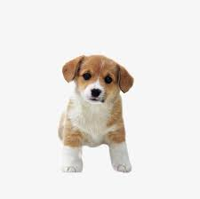
What’s this?
How do we say that in English?

Slide 18
Listen to me and repeat after me
dog
d
Dog
D

Slide 19
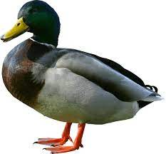
What’s this?
How do we say that in English?

Slide 20
Listen to me and repeat after me
duck
d
Duck
D

Slide 21
Listen to me and repeat after me
capital D
D
Small d
d

Slide 22
The letter name of D is
/di/

Slide 23




What’s this?
Pair Work
cat
duck
cow
dog

Slide 24

Say the sound of letter
Pair work
c
d
/si/
C
/di/
D

Slide 25
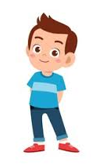
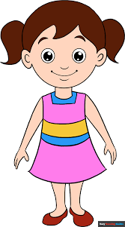
When I say the word(cat,cow,dog,duck)you will touch the picture .
Whoever touches first get 1 Point
Group 1
Group 2
1+1+ | 1+1+
Group 1
Group 2
Let’s play touch the board.

Slide 26


Matching letter with picture.
Group 2
d
Group 1
c
d
c
Group work

Slide 27

Lets play a game (kims game).
Close your eyes
Open your eyes
Which word have I covered

Slide 28

Assessing learning
What’s this?
dog
cat
cow
duck

Slide 29

Assessing learning
Listen to the audio and round the correct letter.
g
f
k
h
/si/
e
c
d
m

Slide 30
Assessing learning
Listen to the audio and round the correct letter.
g
f
k
h
/di/
e
b
c
d

Slide 31
Assessing learning
d
cow
cat
duck
dog
c
d
Say the first letter ..
c

Slide 32

Draw and colour a cat.

Slide 33


A
K
T
H
N
O
Y
U

