Slide 2

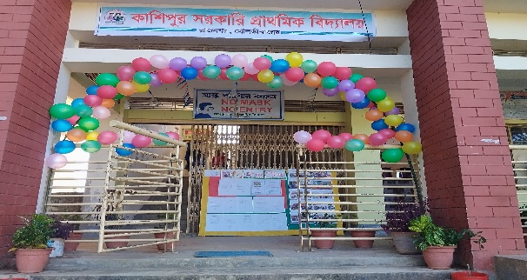





O
H
L
E
L

Slide 3


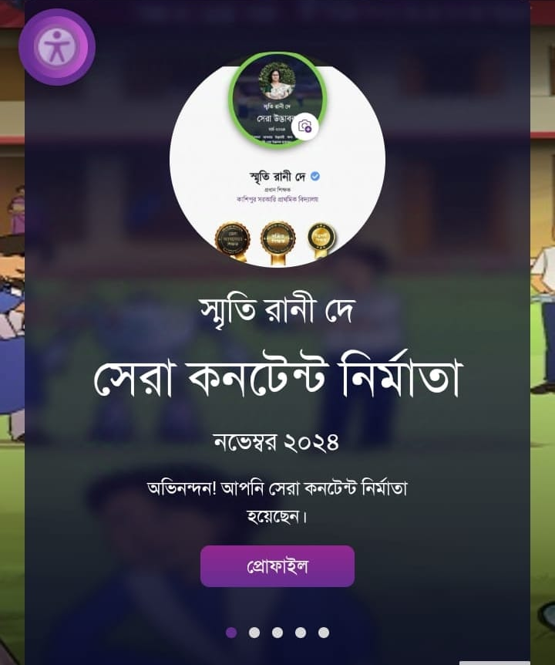

Presented by
Smriti Rani Dey
Head Teacher
Kashipur GPS.
Rajnagar ,Moulvibazar
Best Teacher 2024 ,Sylhet Division
smritidey2011@gmail.com

Slide 4

Introduction of the lesson
Class one
Unit 2
Lesson 4(numbers 1-2)
Page 20

Slide 5

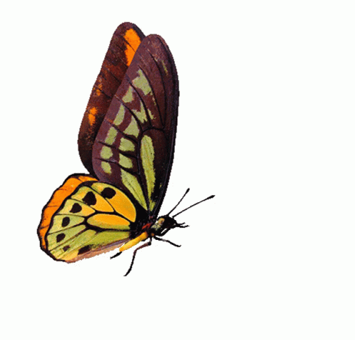
Learning outcomes:
By the end of the lesson the students will be able to-
4.1.4 Read aloud cardinal numbers in figures properly

Slide 6

Let’s listen a song
1 2 3 4 5
Count the fish from 1 to 5.
6 7 8 9 10
Count the fish from 1 to 10!

Slide 7
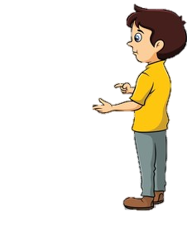


“What did we learn yesterday?”
What is the name of it?”
c, C, d, D
/di/
/si/

Slide 8
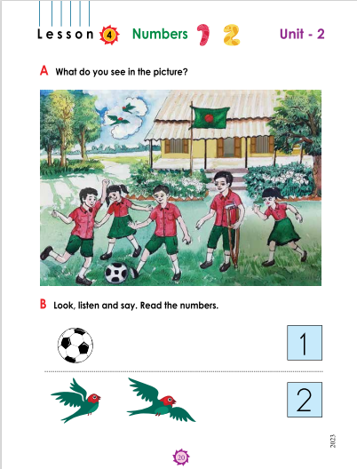
“What can you see in the picture?”
bird
flag
boy
ball

Slide 9

Open your English book and page 20

Slide 10


Look at the picture carefully
1 ball
Count the objects in the picture
2 birds
2 flags

Slide 11

Today we are going to learn how to count and read the numbers of 1 and 2.”
1,2

Slide 12


“What’s this?
What are these?”
ball
birds

Slide 13
“How many ball is ?
How many birds are?”
1 ball
2 birds

Slide 14
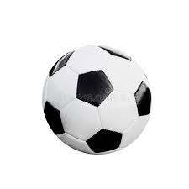


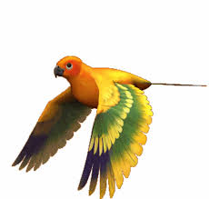


How many flowers are ?
PW
How many ball is ?
How many birds are ?
2 birds
1 ball
2 flowers

Slide 15
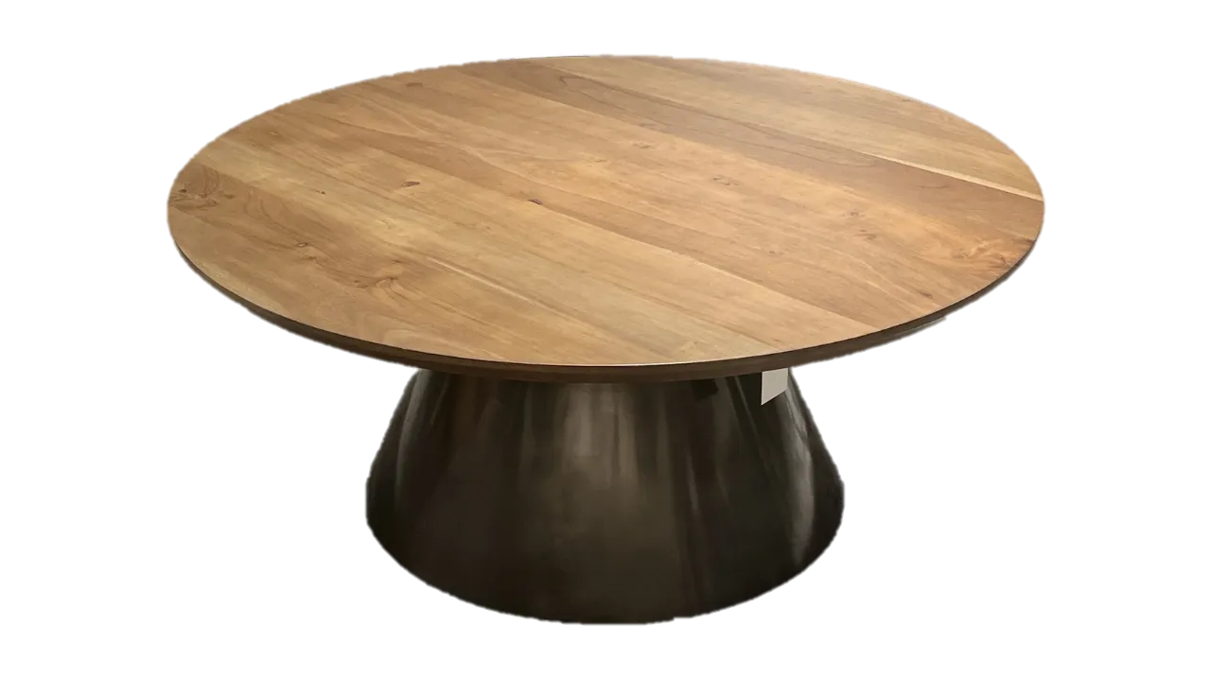


Group 1
GW
Group 2
2
1
How many balls are?
How many car is ?
How many ball is ?
How many cars are ?
1
2

Slide 16
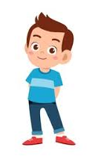
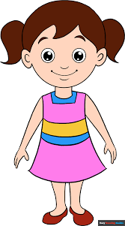
When I say (1 ball,2 birds,2 flowers)you will touch the picture .Whoever touches first get 1 Point
Group 1
Group 2
1+1+ | 1+1+
Group 1
Group 2
Let’s play touch the board.
1
2
2

Slide 17
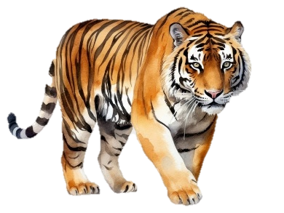
How many tiger is ?
IW
2 tigers
1 tiger

Slide 18
How many flowers are ?
IW
2 flowers
1 flower

Slide 19

Assessing learning:
“Listen to the sound of numbers and then point to that numbers"
2
5
4
1
6
3

Slide 20
Assessing learning:
“Listen to the sound of numbers and then point to that numbers"
2
5
4
1
6
3

Slide 21
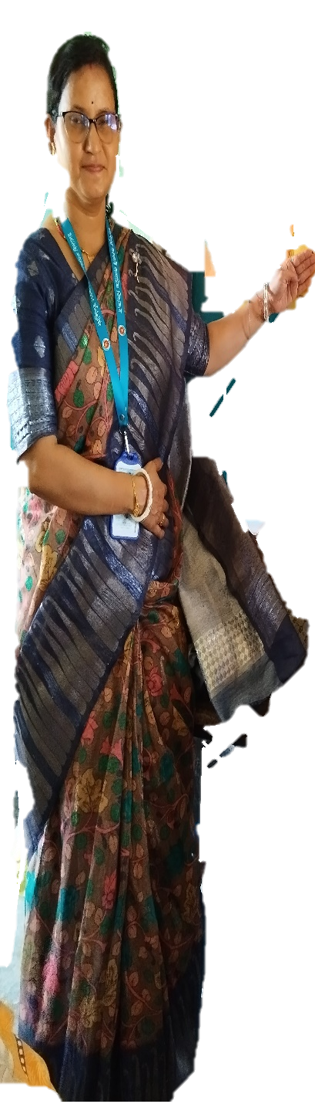

What have we learnt today?
Today we have learnt numbers

Slide 22


Goodbye all.
See you in the next class

