Slide 1
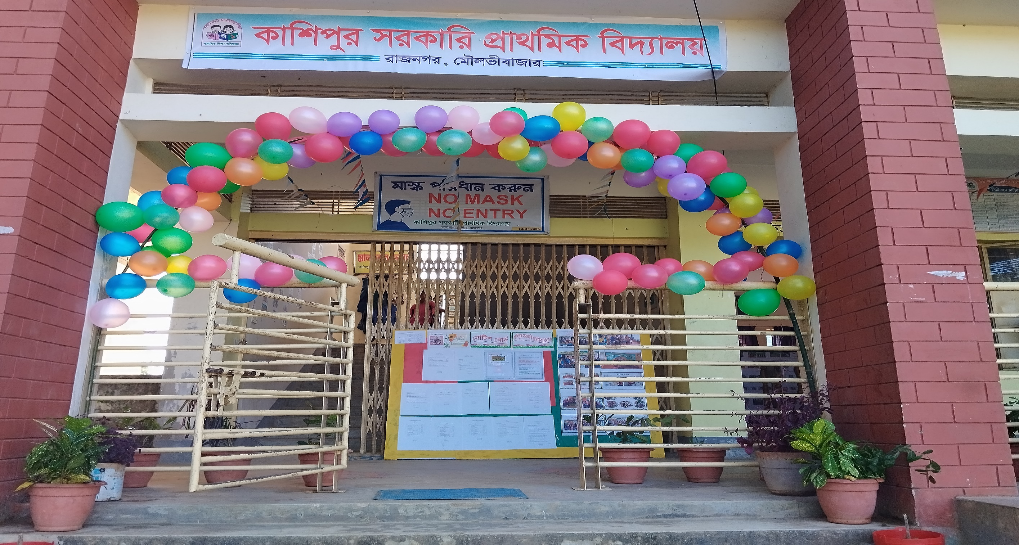

Slide 2


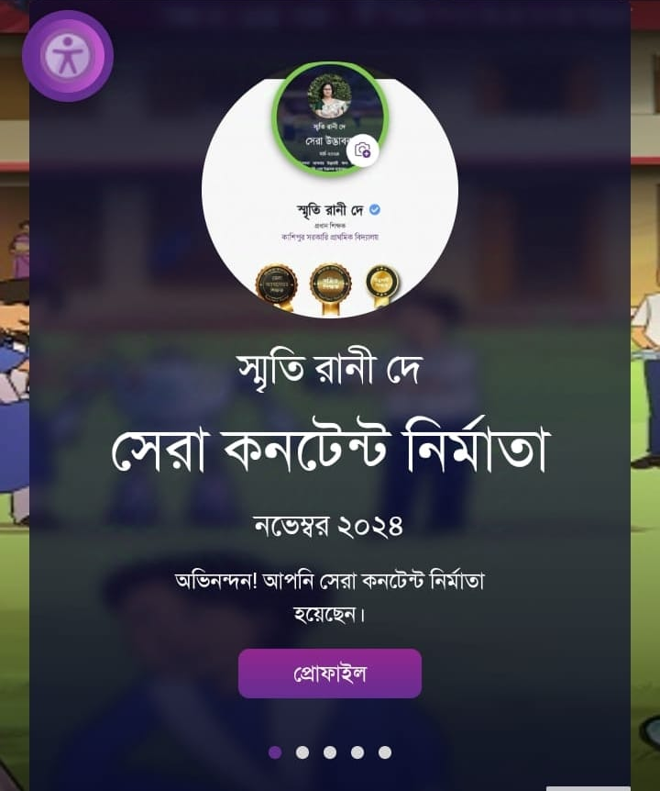

Presented by
Smriti Rani Dey
Head Teacher
Kashipur GPS.
Rajnagar ,Moulvibazar
Best Teacher 2024 ,Sylhet Division
smritidey2011@gmail.com

Slide 3


Introduction of the lesson
Class one
Unit 2
Lesson 7(numbers 3-4)
Page 26

Slide 4

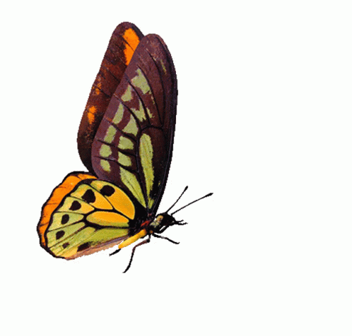
Learning outcomes:
By the end of the lesson the students will be able to-
4.1.4 Read aloud cardinal numbers in figures properly.

Slide 5

Let’s listen a song
1 2 3 4 5
Count the fish from 1 to 5.
6 7 8 9 10
Count the fish from 1 to 10!

Slide 6
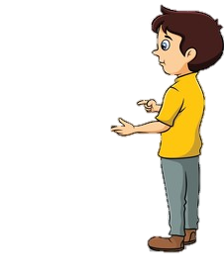


“What did we learn yesterday?”
What is the name of it?”
e,E,f,F
/ef/
/i/

Slide 7
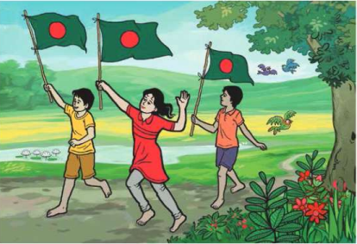


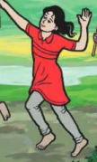

“What can you see in the picture?”
flag
boy
bird
girl

Slide 8

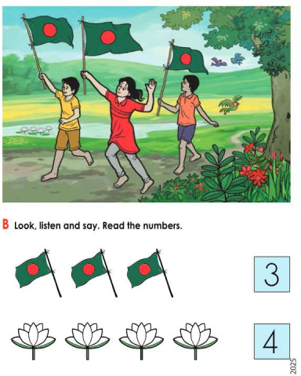
Open your English book and page 26

Slide 9


Look at the picture carefully
3 birds
Count the objects in the picture
3 flags
4 flawers

Slide 10

Today we are going to learn how to count and read the numbers of 3 and 4.”
3,4

Slide 11


What are these?”
flowers
flags

Slide 12
How many flowers are ?
4 flowers
3 flags
How many flags are?”

Slide 13




How many flags are ?
PW
How many flowers are ?
3 flags
4 flowers

Slide 14
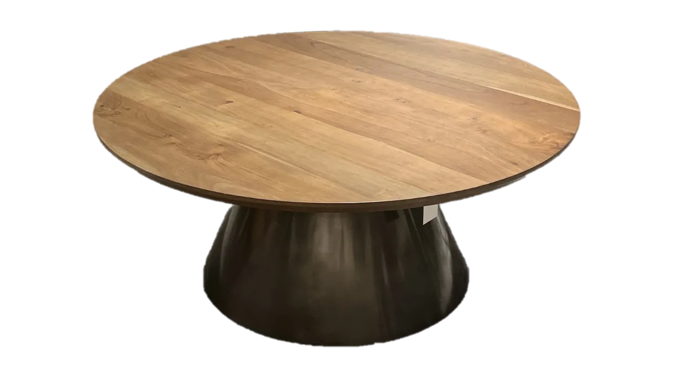



Group 1
GW
Group 2
3
4
How many flags are?
How many flowers are ?
How many flags are?
How many flowers are ?
4
3

Slide 15
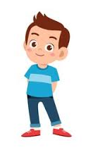
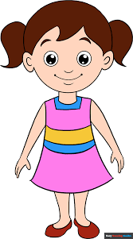
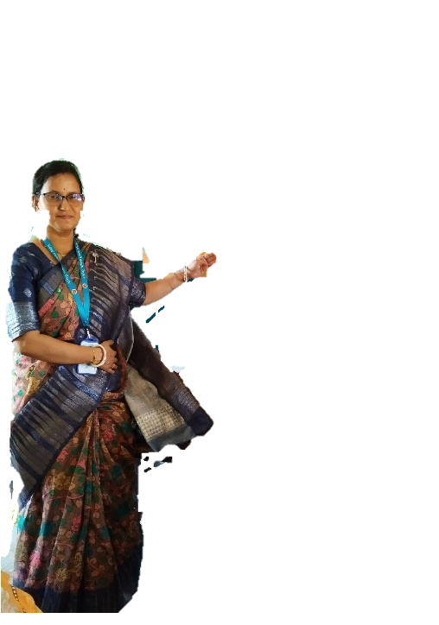

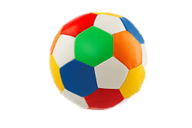
When I show (2 balls,3 flags,4 flowers)you will say the numbers .Whoever says first get 1 Point
Group 1
Group 2
1+1+ | 1+1+
Group 1
Group 2
Let’s play back to the board.

Slide 16
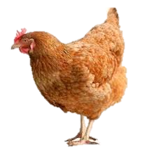
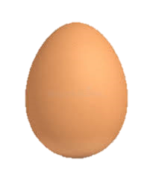
How many eggs are ?
IW
2 eggs
3 eggs

Slide 17
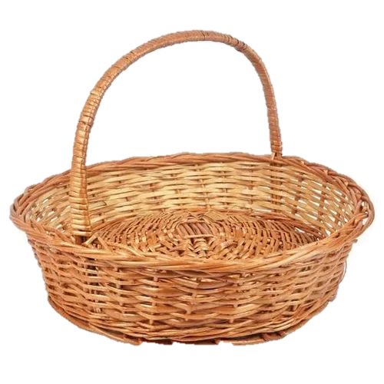
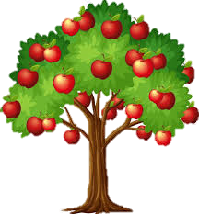
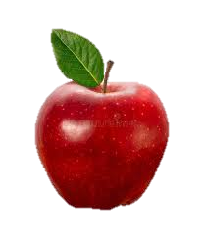

How many apples are ?
4 apples
3 apples

Slide 18


Assessing learning:
“Listen to the sound of numbers and then point to that numbers"
2
5
4
3
6
7

Slide 19
Assessing learning:
“Listen to the sound of numbers and then point to that numbers"
4
5
7
1
6
3

Slide 20
What have we learnt today?
Today we have learnt numbers
3
4

