Slide 2
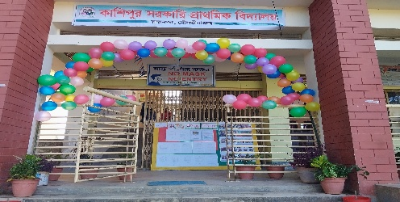








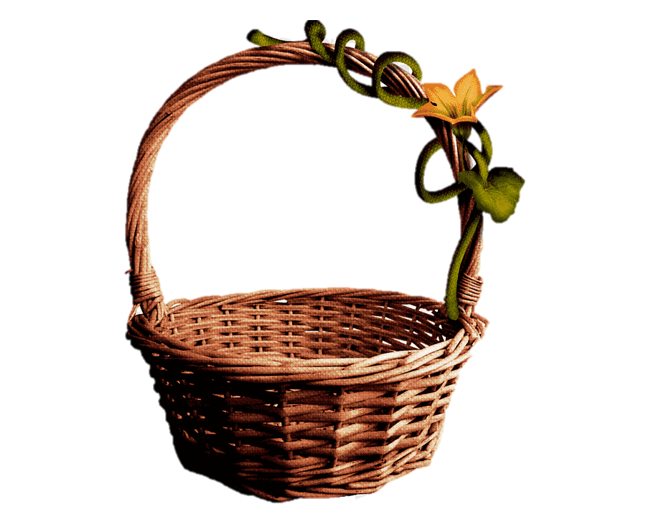


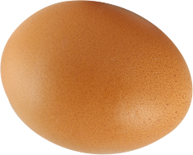

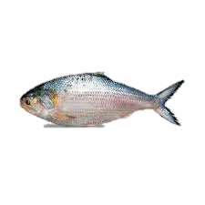

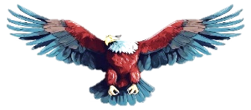






H
L
O
E
L

Slide 3



Presented by ,,
Smriti Rani Dey
Head Teacher
Kashipur GPS.
Rajnagar ,Moulvibazar
Best Teacher 2024 ,Sylhet Division
smritidey2011@gmail.com

Slide 4

Introduction
Class one
Unit 2
Lesson 6 (Ee,Ff)
Page 23

Slide 5
LISTENING:
1.1.1 recognize the sounds of the alphabet in familiar words .
1
SPEAKING:
3.1.1 say proper sounds of the letters in familiar words .
2
READING:
4.1.1 read the pictures of familiar objects and events.
3

Slide 6
Let’s sing.
A, B, C, D, E, F, G
H, I, J, K, L, M, N, O, P
Q, R, S, T, U, V
W, X, Y, and Z
Now I know my ABCs
Next time won't you sing with me?

Slide 7
What did we learn yesterday ?
Cc
Dd

Slide 8

We are going to learn some English letters today ,
Ee,Ff

Slide 9
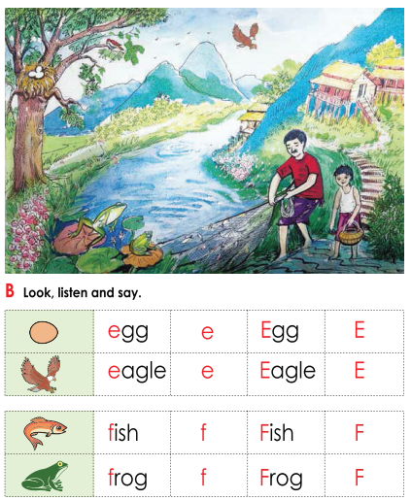
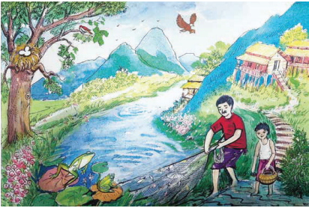
Open your book at page : 23
What can you see in the picture?

Slide 10
What can you see in the picture?
fish
frog
eagle
egg
bird
boy

Slide 11
What’s this?
How do we say that in English?

Slide 12
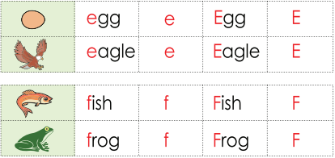
Listen to me and repeat after me
egg
e
Egg
E

Slide 13

What’s this?
How do we say that in English?

Slide 14
Listen to me and repeat after me
eagle
e
Eagle
E

Slide 15
Listen to me and repeat after me
Small e
e
capital E
E

Slide 16
The letter name of E is /i/

Slide 17
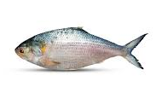
What’s this?
How do we say that in English?

Slide 18
Listen to me and repeat after me
fish
f
Fish
F

Slide 19

What’s this?
How do we say that in English?

Slide 20
Listen to me and repeat after me
frog
f
Frog
F

Slide 21
Listen to me and repeat after me
capital F
F
Small f
f

Slide 22
The letter name of F is /ef/

Slide 23





Pair Work
What’s this?
egg
fish
eagle
frog

Slide 24
Say the sound of letter
Pair work
e
f
/i/
E
/ef/
F

Slide 25
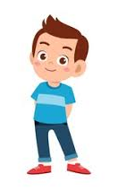
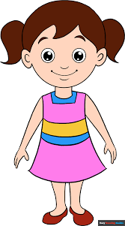

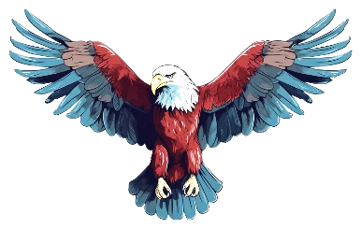
When I say the word(fish.frog,egg,eagle)you will touch the picture .
Whoever touches first get 1 Point
Group 1
Group 2
1+1+ | 1+1+
Group 1
Group 2
Let’s play touch the board.

Slide 26



Matching letter with picture.
Group 1
Group 2
f
e
f
e
Group work

Slide 27


Lets play a game (kims game).
Close your eyes
Open your eyes
Which word have I covered

Slide 28

Assessing learning
What’s this?
egg
eagle
frog
fish

Slide 29

Assessing learning
Listen to the audio and round the correct letter.
g
f
k
h
/i/
e
b
c
d

Slide 30
Assessing learning
Listen to the audio and round the correct letter.
g
a
k
h
/ef/
f
b
c
d

Slide 31
Assessing learning
e
egg
frog
fish
eagle
f
f
Say the first letter ..
e

Slide 32

Draw and colour a fish.

Slide 33

Goodbye all.
See you in the next class

