Slide 1


Slide 2

Welcome to my English Class

Slide 3

Teacher’s identity
Golam Mawla
BA (Hons), MA (English) B.ed (First class) MA.MAEd
Assistant Teacher (English)
Charbhabsur Shahabuddin High School
Dewanganj Jamalpur.
Email-gmawla38@gmail.com
Mobile 01911710334

Slide 4
Conditional Sentence
When any result depends on any condition is called a conditional

Slide 5

Let’s have a look
If + Subject +V₁ +, + subject + will + V₁
If you come, I will go.
Main Focus
V₁
will
1st Conditional
Structure :
If + Present Future/Present modal
First conditional describes a particular situation.
Notes:
Detail description of First conditional. Please go on with animation accordingly.

Slide 6
If you read more, you will be first.
Condition
Result
If you ate lemon , you would got vitamin C.
Condition
Result
If you had done the work, I would have given you money.
Condition
Result
When any result depends on any condition is called a conditional.
Notes:
Definition of conditional is described in this slide.

Slide 7
Four conditionals sentences
Zero conditionals
1st conditionals
2nd conditionals
3rd conditionals

Slide 8
The zero conditional formula is:
If + [simple present], [simple present].
If you mix blue and yellow, you get green.
If it’s a weekday, I go to work.
If you don’t eat, you get hungry.
If it rains, I take an umbrella with me to work.
If I wake up early, I always read in bed.

Slide 9
1st conditionals
If + simple present, will + base verb
If you study hard, you will pass the exam.
If I see her, I will say hello.
If they don’t hurry, they will miss the train.
If I see you later, I will say hello.
If I don’t see you later, I won’t be able to say hello.

Slide 10
2nd conditionals
If + simple past, modal + base verb
If I were you, I would take the job.
If it snowed in the Sahara, it would be a miracle.
If they knew the truth, they would be shocked.
If I had a million dollars, I would buy a large vacation home.
If I were you, I wouldn’t wait to study for the test.

Slide 11
3rd conditionals
If + past perfect, modal + present perfect
If she had seen the sign, she wouldn’t have parked there.
If we had left earlier, we would have caught the train.
If he hadn’t forgotten his wallet, he would have paid the bill.
If it had rained last week, the plants would not have died.
If I had finished college, I would have become a doctor.

Slide 12
Pair work
1)If you have done the work,________________
2)If you have opened the door,__________________
3) Take the bag__________________________
4) If you come here_____________________
Notes:
Present perfect tense in First conditional.

Slide 13
Answers are
1)you can go home.
2) you will see a pond.
3) If you want to buy vegetables,
4) I will go.

Slide 14
Group work.
If she plays,____________
(b) If I phone him, ___________
(c) If I have a car,____________
(d) I will eat rice,_____________
(e) _________They will play.
Notes:
Class activities to test first conditional.

Slide 15
Answers
a) I will give him a ball.
b)He will not receive.
c) I'll go to Dhaka..
d) If you will give me a pen.
e) If they get a change
Notes:
Answer of the questions

Slide 16
Practice at home
1. If he walks slowly .........................
2. If you take regular exercise ............
3. She won’t be able to understand.....
4. Your achievement will be spoiled ..........

Slide 17
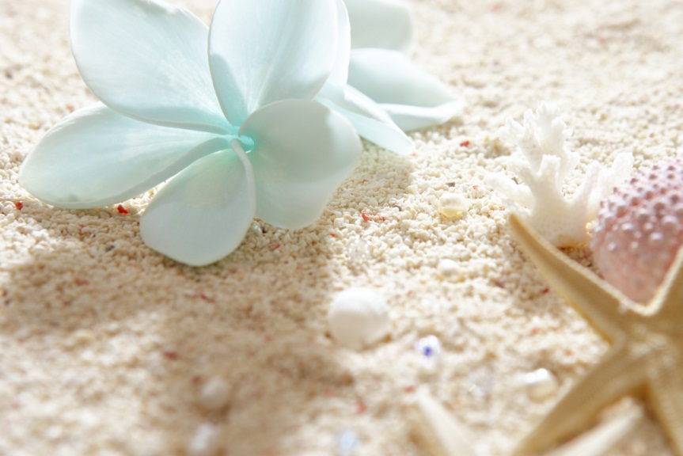
If I see you later,
I will say hello

Slide 18
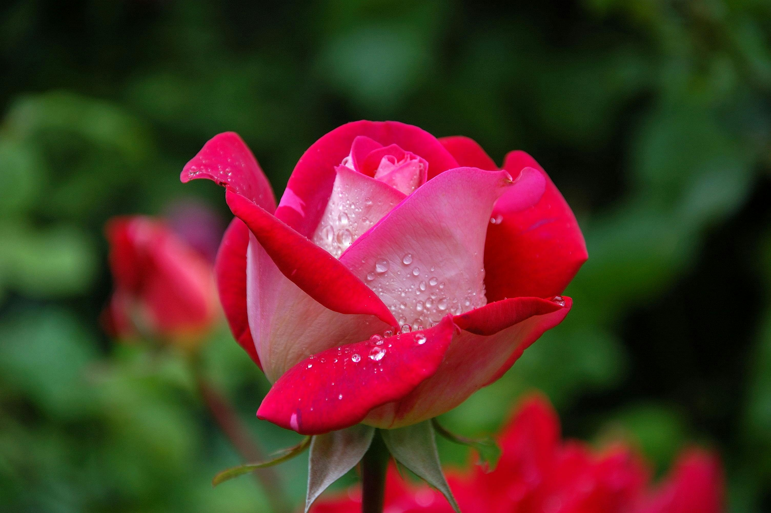
Thank you very much

