Slide 1


Slide 2

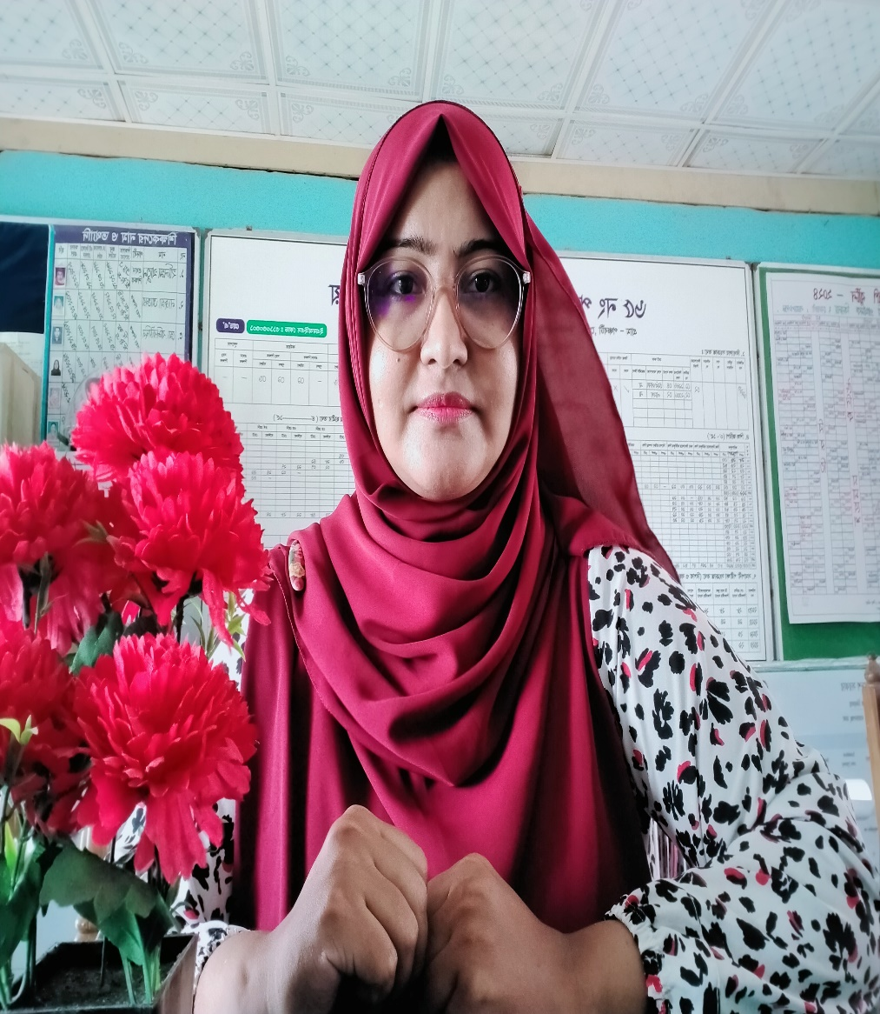
Teacher’s Identification
Sharmin Islam
(Assistant Teacher)
Ponchoboti GPS
Sonargaon, Narayanganj.
msa.sharminliza@gmail.com

Slide 3

English For Today
Unit 9: Nouns Study
Countable and Uncountable Nouns! Let's learn with pictures, fun games, and interactions!

Slide 4




What are Nouns?
Naming Words
Two Big Families
Nouns are the names of people, places, animals, or things around us.
Nouns from our text book unit 9 can be divided into two big families:
Example: spade, tub, nursery, leaf, butterfly, tomato, water
1. Countable Nouns (1, 2, 3...)
2. Uncountable Nouns (Cannot count!)

Slide 5


Countable Nouns!
We can count them!
Countable nouns are things that we can count with numbers! We can have one, two, three, or many of them.
They have Singular (only one) and Plural (more than one) forms!
Example: 1 Tomato → 3 Tomatoes!

Slide 6



Singular vs Plural
Singular Form
Plural Form
Singular means there is only ONE thing.
Plural means there are MORE THAN ONE (2, 3, 4, or many!).
a spade
spades
a pot
pots
a seed
seeds

Slide 7


Rule 1: Just Add -S!
For most countable nouns, we usually just add an "s" to the end to make them plural!
book → books
table → tables
key → keys
kite → kites

Slide 8






Rule 2: Add -es!
When a noun ends in ch, sh, x, or z, we must add -es to the end to make it plural!
Ends with -ch / -sh
Ends with -x
Ends with -z
branch → branches
box → boxes
fez → fezzes
dish → dishes
fox → foxes
quiz → quizzes

Slide 9
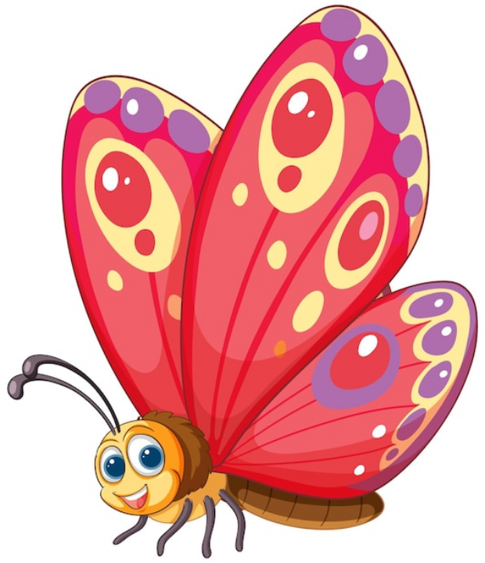
Rule 3: Tricky Endings
Y and F / FE rules!
Change 'y' to 'i' and add 'es':
nursery → nurseries
butterfly → butterflies
Change 'f' or 'fe' to 'v' and add 'es':
leaf → leaves
knife → knives

Slide 10
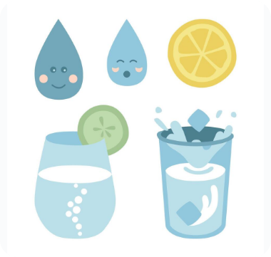
Uncountable Nouns!
No Plural Forms!
Uncountable nouns are things we **cannot count** with numbers. They do not have plural forms (no -s or -es!).
Examples from our textbook unit 9:
water, air, land, furniture, rice, leisure

Slide 11




Which is Which?
Noun | Can We Count It? | Plural Form? | Type of Noun
Spade / Pot | Yes! (1 spade, 2 spades) | Yes (spades, pots) | Countable
Tomato / Butterfly | Yes! (1 tomato, 2 tomatoes) | Yes (tomatoes, butterflies) | Countable
Water / Rice | No! (cannot say "one water") | No (always "water", "rice") | Uncountable
Land / Leisure | No! (it is a concept/area) | No (no plurals) | Uncountable

Slide 12









Interactive Plural Game!
Can you change these nouns to plural? Let's check together!
1. box
2. leaf
3. butterfly
Ends with **x**! What is the plural?
Ends with **f**! What is the plural?
Ends with **y**! What is the plural?

Slide 13




Interactive Noun Sort!
Is it Countable or Uncountable? Say out loud!
Class Challenge 1
Class Challenge 2
"RICE & WATER"
"POT & SEED"
Can you count individual grains or drops without a cup?
Can you count them? "Look! I have 5 seeds!"

Slide 14

Great Job, Students!
Now you are the masters of Countable and Uncountable Nouns!

