Slide 1


Slide 2
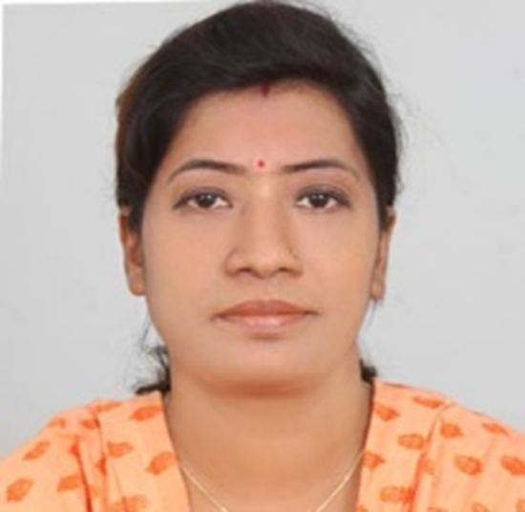
Teachers’ Identity
SUMI DAS
Assistant Teacher
Purba ziri Amania Lokman Hakim Model Govt. Primary School.
Patiya , Chattogram.

Slide 3
Lesson Introduction
Class :5
Unit :14
Title : The Champion Girl (1.2,1.3)
Page : 74,75

Slide 4
Learning Outcome:
3.4.1 – Ask simple questions on familiar topics.
3.4.2 -Answer simple questions appropriately and confidently.
4.2.1- Read aloud texts with proper stress, intonation.

Slide 5
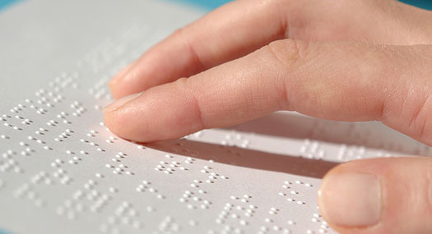
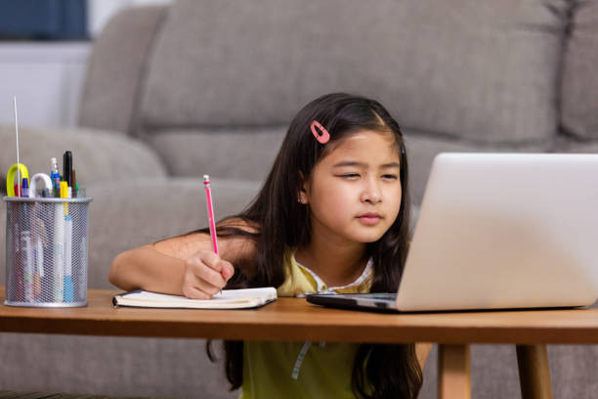
Used by visually impaired
Used by short- sighted

Slide 6
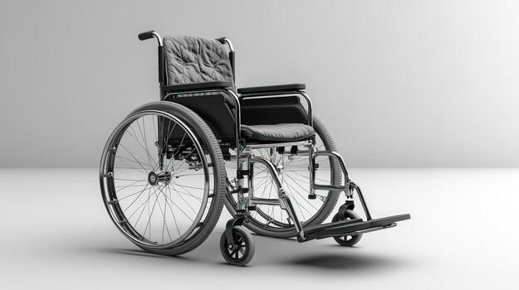
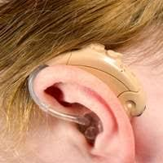
Used by lame or physically unfit
Used by deaf

Slide 7
a) Have you seen these things before?
b) Do you anyone who uses any of them?
c) Why do people use these things?

Slide 8
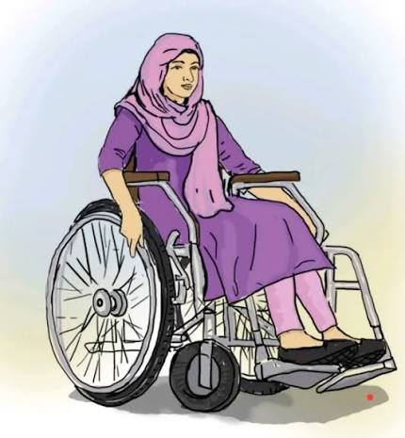
The champion Girl

Slide 9

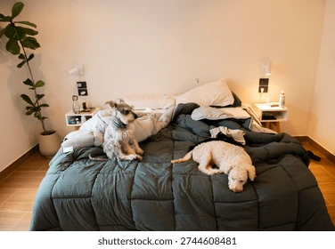
Neighbourhood – a district or community within a town or city.
Comfortable – something providing ease and relaxation.-

Slide 10
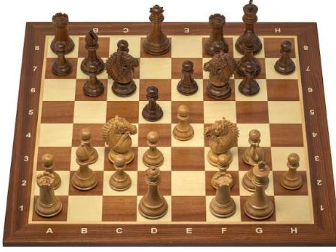

Chess- a board game for two players
Focus- particular attention paid for something

Slide 11

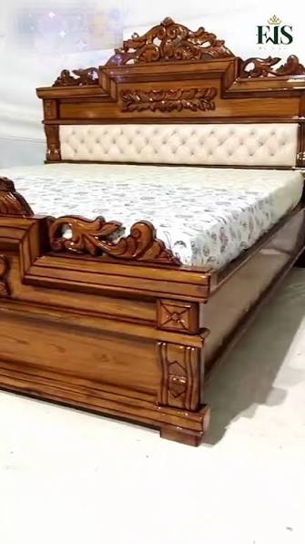
Cheer- shout for joy
Wooden- made of wood

Slide 12
Lipi lives with her grandparents in a small village. She studies in a nearby primary school. She has a bright smile and a heart full of dreams. She talks nicely and wins everyone’s heart. She is a lot like any other girls in her neighbourhood . But, Lipi cannot walk like her friends. Instead, she uses a wheelchair to move.
Every morning, Lipi wakes up early, gets dressed and takes her breakfast on time. Lipi’s mother helps her put books in the school bag. Lipi’s classmates help her to sit at the front bench of the class. They also help her to move around the school. Whenever her classmates play, they invite Lipi to join them. Their class teacher Ms. Anita makes sure that Lipi feels comfortable in the class. Her teacher arranges Lipi’s table so that she can see the blackboard clearly.
Lipi cannot move as quickly as her classmates, but she remains happy. School is her favourite place. Lipi loves to go to school on time. She loves listening to stories, drawing pictures, and learning about the world. She also loves playing chess. While her classmates play football or cricket,

Slide 13
Lipi becomes busy with her chessboard.
One day , the school arranged a chess competition. Her opponent welcomes her warmly. She remained focused and attentive throughout the game and finally won. The whole school cheered. Ms. Anita congratulated her. The school arranged a price giving ceremony. Lipi received a crest and a set of beautiful wooden chess.
Lipi wants to be a teacher. Ms. Anita is her inspiration. Lipi dreams of setting up a school for the local children. She believes that people with special needs can achieve amazing things in their lives.

Slide 14


