Slide 1


Slide 2
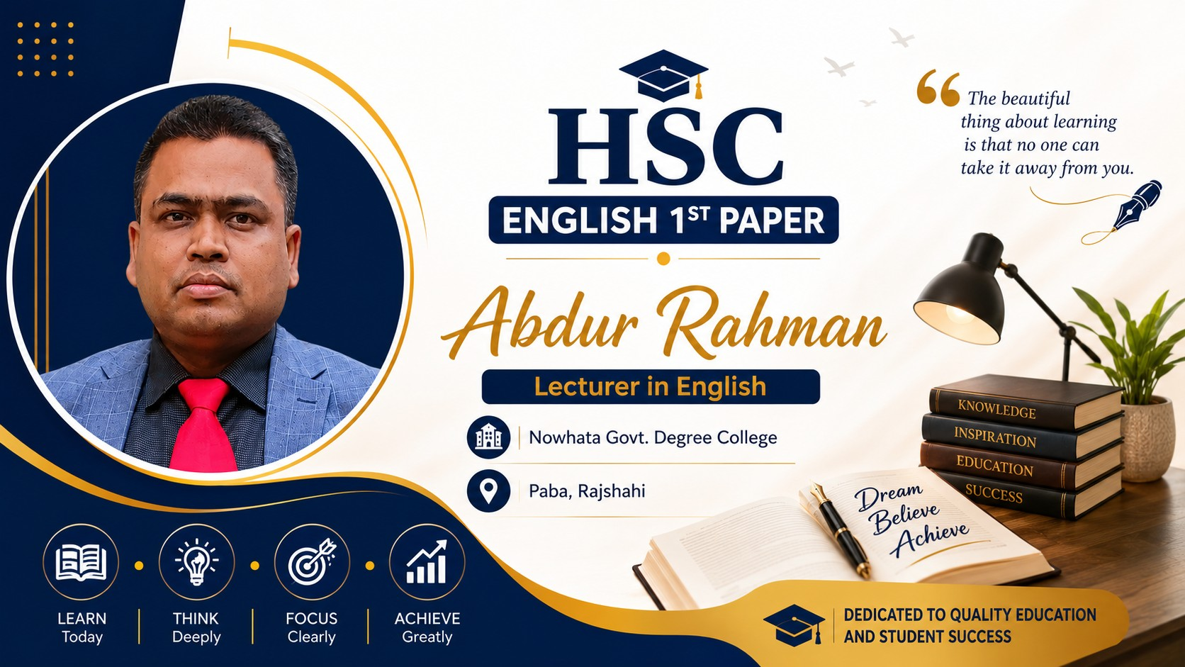

Slide 3
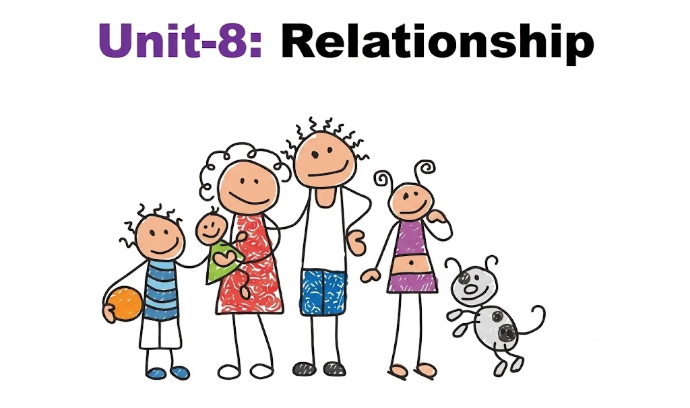

Slide 4


Slide 5
Learning Outcomes
Explain the concept and importance of family and social relationships in human life.
Identify different types of relationships, including familial, social, and professional relationships.
Describe how trust, respect, and love help build and maintain healthy relationships.
Analyze the emotional benefits of sharing joy and sorrow with family and others.
Demonstrate positive attitudes and values by avoiding selfishness, possessiveness, and conflict in relationships.

Slide 7
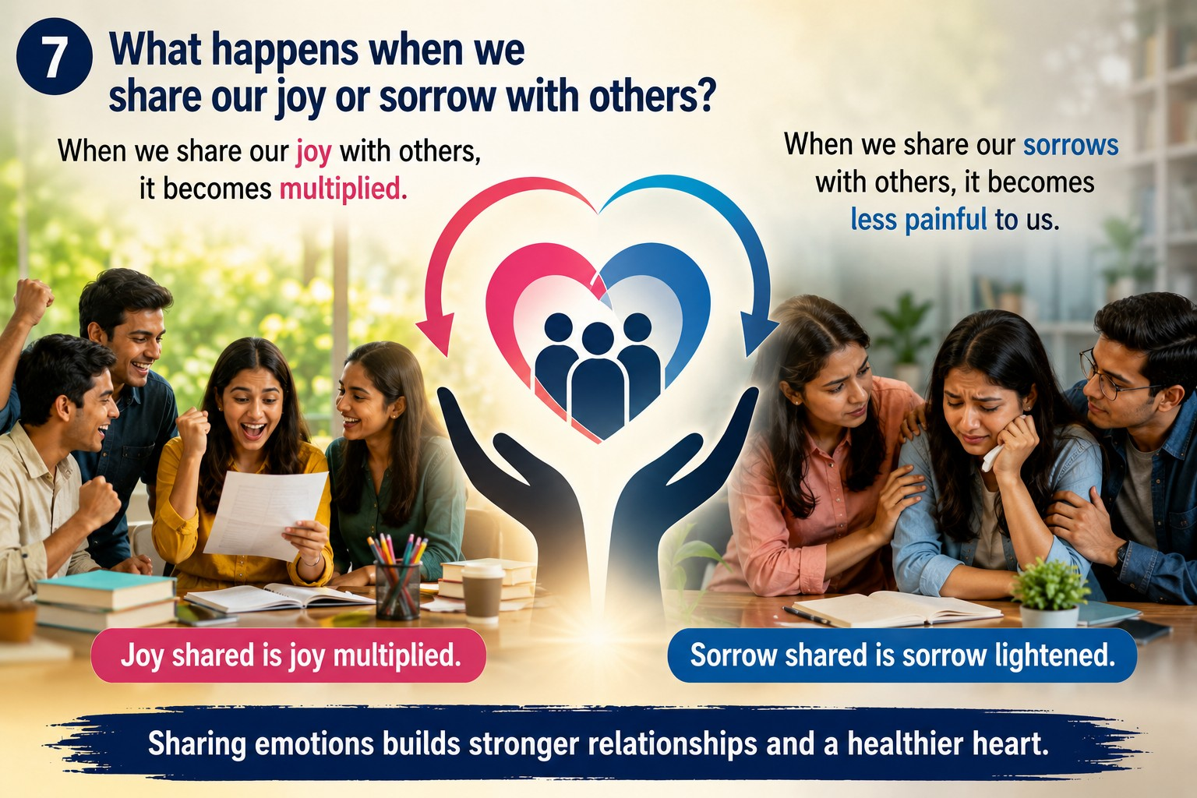

Slide 8
Relationships are of different kinds. Some are familial (পারিবারিক) and intimate (অন্তরঙ্গ), formed by blood and by marriage; some are social like the ones we have with friends and some are made in school where we form close bonds with classmates and teachers. Relationships can also be fostered (প্রতিপালিত) in workplace, which may quickly change from professional to social. There are relationships also between human beings and animals, between children and their toys that they cannot part with.

Slide 9
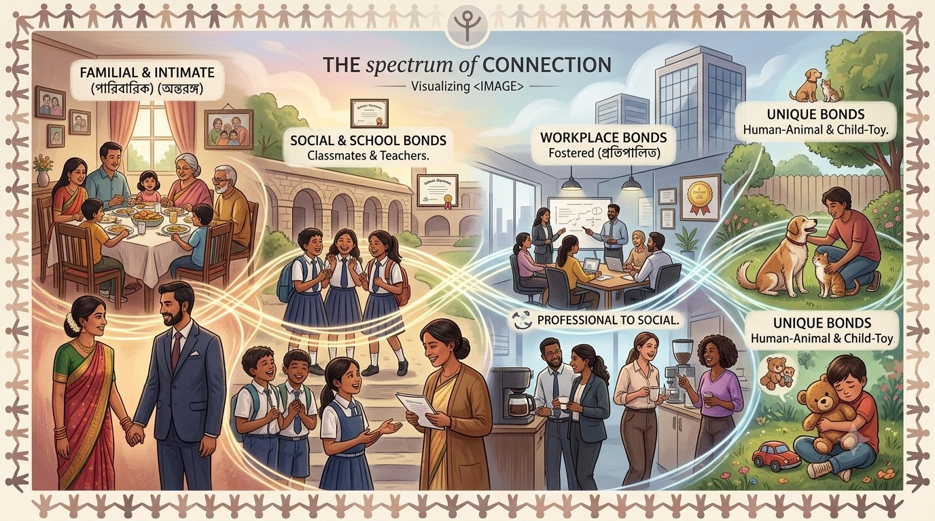

Slide 10
All these relationships keep us close to each other and provide (প্রদান) us all kinds of support, love and affection (স্নেহ). A person who has no family feels the pain of loneliness (একাকীত্ব) and isolation (আলাদা). There is no one to laugh or cry with him/her. When we share our joy with someone, it simply redoubles (দ্বিগুণ), and we when we suffer a loss and someone shares our sorrow, it lessens. Relationships are thus needed for our emotional health.

Slide 11
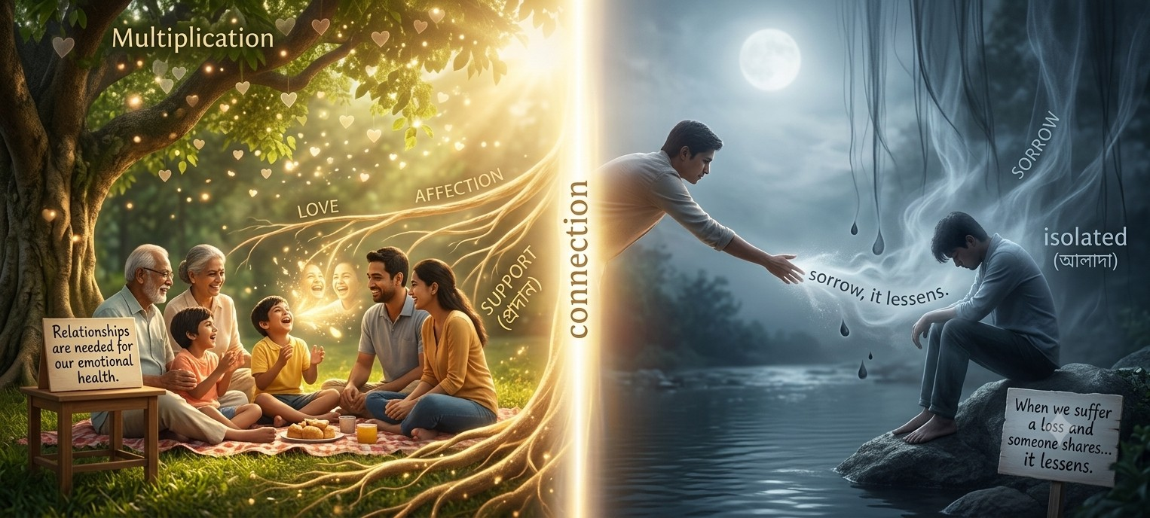

Slide 12
To build relationships, we need to have trust and respect for each other, and love where this is needed. We cannot be selfish and possessive (অধিকারী) if we want to establish an effective (কার্যকর) relationship. But quite often we see people quarrelling (ঝগড়া) and fighting with each other which only brings misery (দুর্দশা) and loss to all.

Slide 13
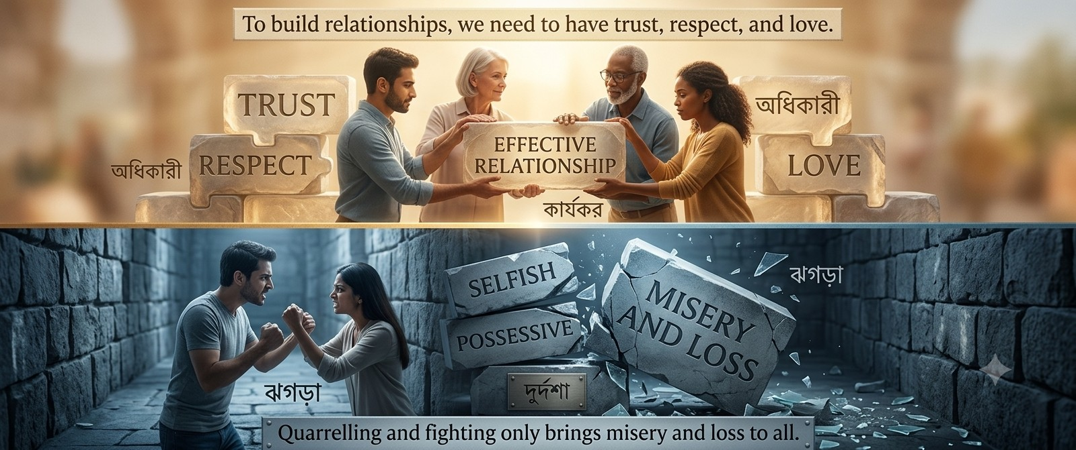

Slide 14
GROUP DISCUSSION
Create “flowchart” from the text

Slide 15


Slide 16
1. Man is by nature a social animal." Who says this? What does he mean by it?
Ans. The famous Greek philosopher Aristotle says, Man is by nature a social animal.“
By it he means that like most of the animals, man with his intuition seeks the Company of others and forms relationships in order to have physical and emotional support.

Slide 17
2. Differentiate (পার্থক্য করা) between the relationships of man and those of the animals.
Ans. The difference between the relationships of man and those of the animals is that unlike the animals, nan's relationships give meaning to his existence (অস্তিত্ব). Thus, they inspire him to do well in education, in workplace or in his profession.

Slide 18
3. How is familial relationship? How is it formed? Explain in your own words.
Ans. Familial relationships are very intimate. It is formed by blood and by marriage.

Slide 19
4. What happens to a person who has no family of his own? Explain with reference to the text.
Ans. A person who has no family of his own feels the pain of loneliness and isolation. There is no one to laugh or cry with him/her.

Slide 20
5. Relationships are needed for our emotional health. Do you agree? Give reasons for your answer.
Ans. Yes, I agree. It is because when we share our joy with someone, it simply multiplies and when we suffer a loss and someone shares our sorrow, it becomes less burdensome for us.

Slide 21
6. Describe your ideas regarding social relationships in the context of second paragraph. Give an example of your own.
Ans. We find social relationships in the context of the society or social structure. For example, relationships we have with friends, classmates and teachers can be termed as social. Our relationship with our neighbors is a social relationship.

Slide 22
7. What happens when we share our joy or sorrow with others? Explain in your own words.
Ans. When we share our joy with others, it becomes multiplied. On the other hand, When we share our sorrows with others, it becomes less painful to us.

Slide 23
8. Write down two benefits of all kinds of relationship.
Ans. Two benefits of all kinds of relationships are (i) they keep us close to each other and (ii) provide us with all kinds of support, love and affection.

Slide 24
9. What are the prerequisites (পূর্বশর্ত) of building relationships. Why shouldn't we be selfish and possessive?
Ans. The prerequisites of building relationships are trust and respect for each other, and love where it is required. We should not be selfish and possessive in order to enjoy an effective relationship.

Slide 25
10. We see people quarreling and fighting with each other which only brings misery and loss to all. Do you agree? Give reasons for your answer.
Ans. Yes, I agree with the statement that we see people quarreling and fighting with each other which only brings misery and loss to all. It is because quarreling and fighting can destroy our relationship with others, and without our relationships we are to pass a lonely and painful life.

Slide 26


Slide 27

The word famous means…..
  Ancient (b) legendary
  (c) Mythological (d) Elder
  Ans. (b) legendary

Slide 28
(2) The word “foster” indicates ____.
  (a) Nurture (b) Discourage
  (c) Ensure (d) Stop
  Ans: (a) Nurture

Slide 29
(3) “Existence” in the text is closed to ____.
  (a) Surroundings (b) Condition
  (c) Life (d) Situation
  Ans. (c) Life

Slide 30
(4) Man seeks company of others ____.
  (a) By habit (b) By force
  (c) By virtue (d) By nature
  Ans: (d) By nature

Slide 31
(5) The word “isolation” means ____ .
  (a) Friendlessness (b) Friendliness
  (c) Separation (d) Comfort
  Ans: (c) Separation

Slide 32

Man is by nature a social animal.
People build different kinds of relationships in life.
Relationships provide love, care, and emotional support.
Sharing joy increases happiness, and sharing sorrow reduces pain.
Trust, respect, and love help build strong relationships.
Healthy relationships lead to a happy and peaceful life.

Slide 33
SUMMARY
Man is by nature a social animal. Man seeks company of others for physical and emotional support. All kinds of relationships keep us close to each other and provide us with love and affection (স্নেহ). If we can share our joy with someone, it simply increases, and if we can share our sorrow, it becomes less painful. A person without a family cannot share his joy or sorrow. So, his joy is limited and his sorrow is more painful. Relationships are built on trust and respect for each other. We must avoid selfishness and possessiveness (অধিকার) to form an effective relationship.

Slide 34

Write a paragraph on “Relationship”

Slide 35


