Slide 1

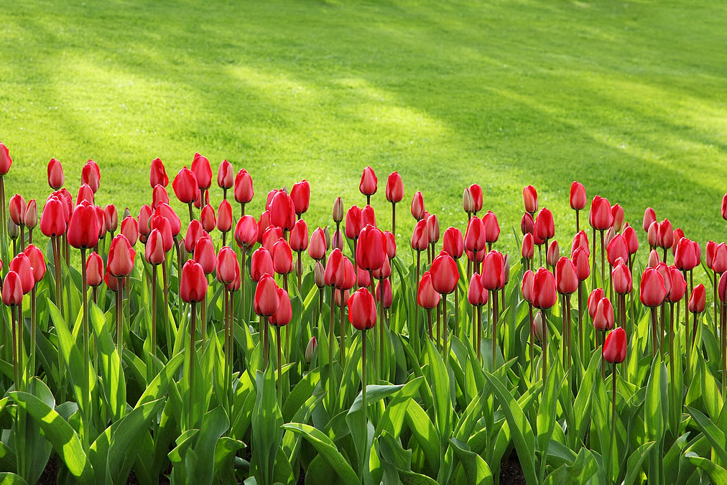


Slide 2

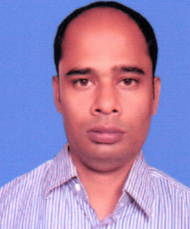
TEACHER’S INFORMATION:
Nittananda Shaha
ASSISTANT TEACHER
SABOIL GOVT. PRIMARY
SCHOOL
MOHADEBPUR, NAOGAON

Slide 3

Lessons Identity:
CLASS : FIVE
SUBJECT : ENGLISH
UNIT : 11
LESSON : All
TIME : 60 MINUTES.

Slide 4
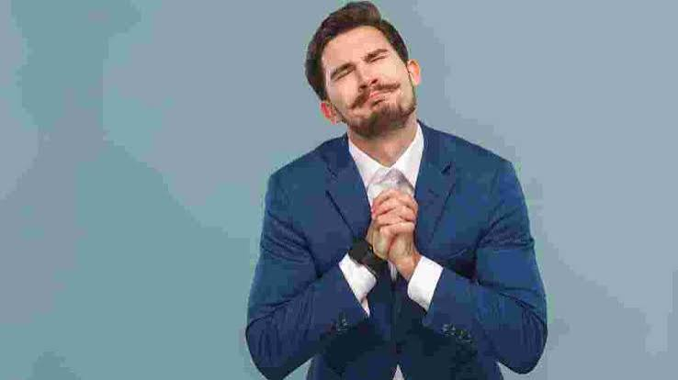
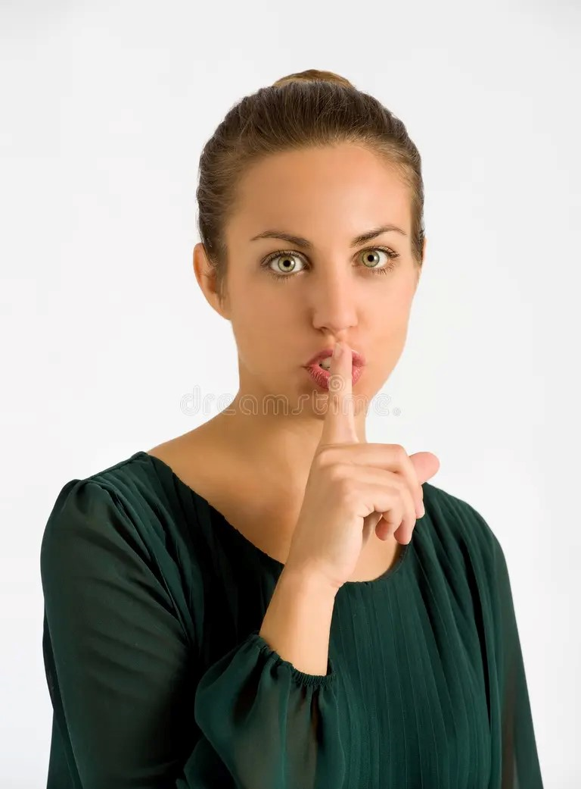

Slide 5
Can you guess
What’s our Todays class
‘Making Request’

Slide 6
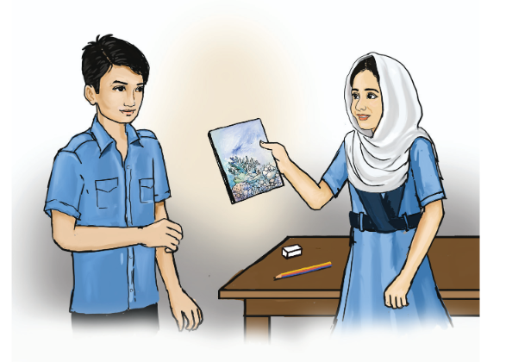
Look at the picture .Answer the question.
a) What do you see in the picture?
Ans: In the picture, a girl is giving a note book to a boy.
b) What do you think they are talking about?
Ans: They are talking about the note book.
c)How do you request some one to get something?
Ans: I request someone politely.

Slide 7
Request-an act of asking politely for something.
Conversation-a talk between two or more people.
Excuse- seek to lessen the blame attaching to fault
Necessary-need to be done
Sharpener- a device that’s make sharp.
List- Write a number of item.

Slide 8
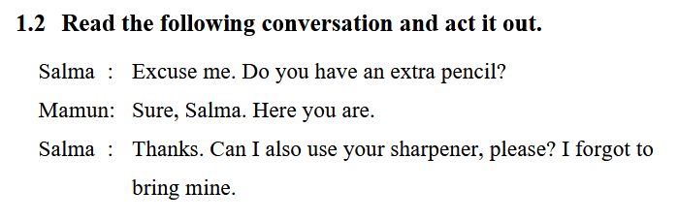

Slide 9
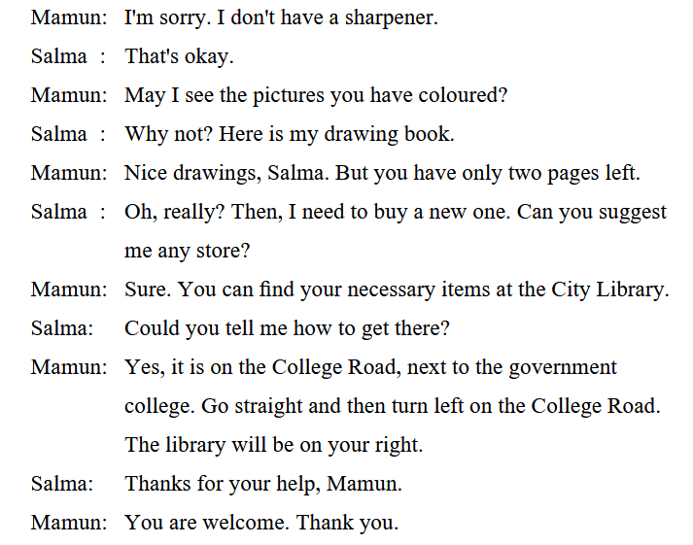

Slide 10
Open Your Text Book Page No 55 and 56

Slide 11
2.1 Salma politely asked Mamun for something. Read the conversation and list the sentences. One is done for you.
. Can I use your sharpener?
2.2 Discuss in groups. List more sentences about how you ask someone for something.
2.3 Mamun gave direction to Salma to get to the library.Read the conversation again and list the phrases / sentences. One is done for you.
. Go straight

Slide 12
2.4 Discuss in groups. List phrases / sentences about how you give directions to someone .
3.1 Language Focus: Making and Responding to Request.
In the conversation, we find the phrase-
Excuse me.
We use the phrase”Excuse me” to deaw someone’s attention.
In the conversation, we find the sentences-
• Can I use your sharpener?
• May I see the pictures you have coloured?
• Could you tell me how to get there?

Slide 13
We make requests politely to someone using the word
Can I
Could I
May I
Con you
Could you
In the conversation, we also find the sentences in which Mamun responded to requests politely–
Sure, Salma .Here you go.
I am sorry. I don’t have a sharpener.
We respond to any request using
Sure/Of course……or,
Sorry,
I don’t/Ican’t
If we say ‘no’ to a request, it is polite to give a reason.
Examples:
A
B
Can I use your pen?
Sure
Can you open the door?
Of course.
Could you lend me your Maths book?
Sorry, I can’t. It's at home
Could I have your exercise book?
Sorry, I don’t have it now

Slide 14
3.1.1 Work in pairs. Make requests and then respond to them with appropriate gestures using the following cues.
Example:
A
A: Could you lend me your bicycle, please?]
Request
B
B: Sure. Or, Sorry, I can't. It's broken.]
Response

Slide 15
a) You want a glass of water from someone.
b) You want someone to open the door.
c) You want someone to close the window.
d) You want a toy from your friend to play.
e) You want someone to give you her/his phone number.

Slide 16
3.2 Language Focus:
Giving Direction
In the conversation, Mamun used the following phrases to give directions–
• Go straight
• Turn left
We use some particular expression while giving directions to someone.
For example
• Turn left.
• Turn right.
• Go to the left.
• Go to the right.
• Go straight.
In the conversation, Mamun also used the preposition ‘next to’ to give direction to the library’s location. We use prepositions to give dirction to any locations. For example:
opposite to,
next to,
near,
behind,
in front of,
outside etc.

Slide 17
Making request Practice with pare.

Slide 18
3.3 Look at the pictures. Complete the sentences with the correct preposition from the box below.
Behind, in front of, next to, opposite to, outside
a) The jeep is -------------- the house.
The school is ----------------- the park.
The cow is ------------- the cow shed.
d) The girl is ------------ the tree.
e) The butterflies are --------- the window.
In front of
Opposite to
Next to
behind
outside

Slide 19
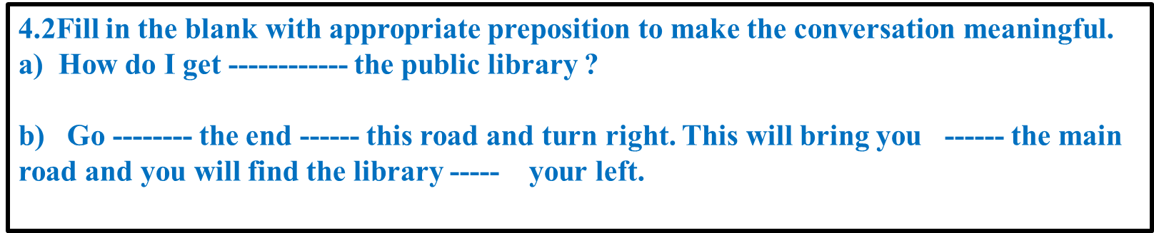






Slide 20
4.1 In pairs, read the following situations and make requests with gestures. Use the expressions you have learnt in activity 3.1.
a) Your watch has stopped working. You ask a stranger on the street for time.
You: Excuse me. Could you ________________________?
tell me.What time is it
b) You've come to the pharmacy with a prescription to buy some
medicines. Ask for these politely.
c) You're having lunch. You want your brother to pass the jug toyou.
d) You’ve missed your train to Sylhet. You want to know from the station master when the next train is.
e) It is raining outside. You want your friend to lend you an umbrella.

Slide 21
4.3 Jenny wants to go to the English Language Club. Tell her how to get there. Jenny is now at the spot shown with ‘Start journey’.

Slide 22


Good Bye Students

