Slide 1
WELCOME

Slide 2

Teacher’s Identity
MD. GAUSUL HAQUE
Assistant Teacher
KALIKAPUR CHOWKUNI HIGH SCHOOL, KOYRA,KHULNA

Slide 3
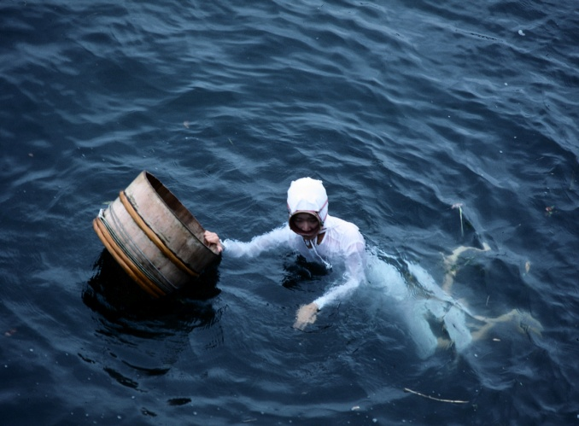
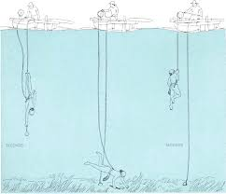
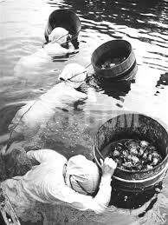
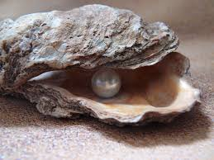
Look at the pictures and talk about it.
What do you see in these pictures?
What are they doing?
Can you guess what there collecting?

Slide 4

Today’s Lesson
English 1st Paper
Class- Eight
Unit:7, Lesson-1
“Pearls! Pearls! Pearls!”

Slide 5
Learning outcomes
After completing the lesson, the students will be able to…
Read and understand the text.
Know about the pearls.
Answer the questions.
Write the main ideas.
Write a paragraph.

Slide 6

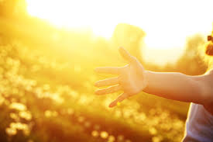
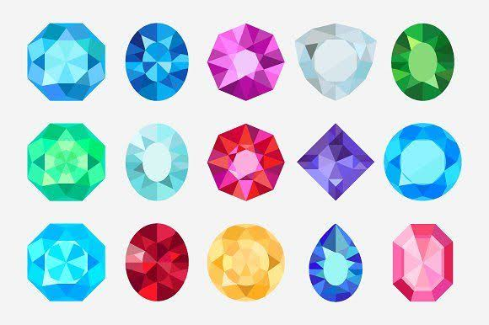
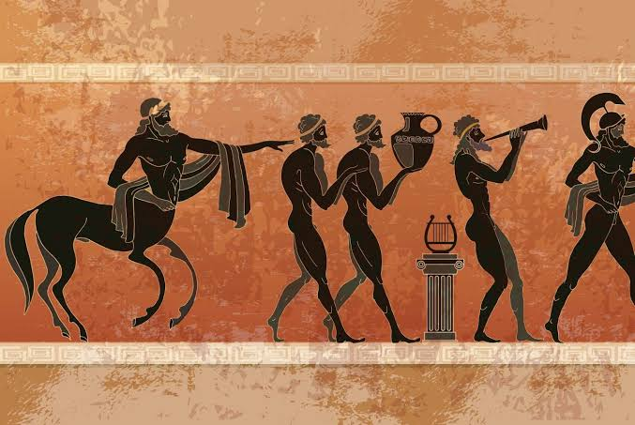
Key Words
1. Discover (V)
2. Shine (N)
3. Gem (N)
4. Mythology (N)
To find something for the first time.
A quality of brightness.
A valuable stone.
A set of stories or beliefs belonging to a particular religious or cultural tradition.

Slide 7
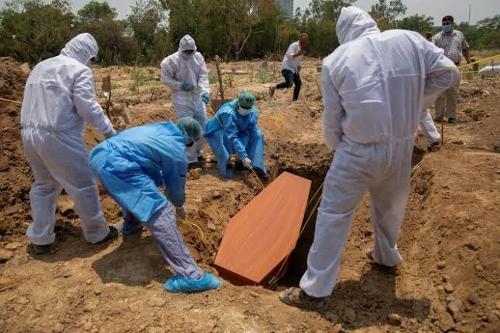
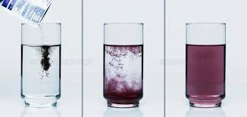
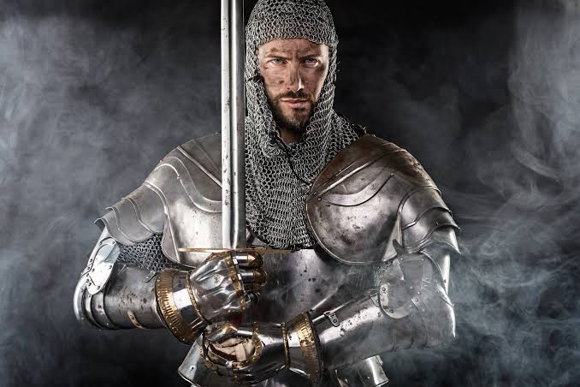
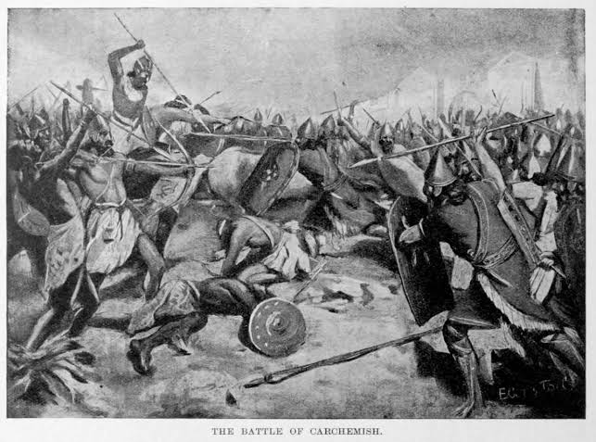
Key Words
5. Bury (V)
6. Dissolve (V)
7. Knight (N)
8. Battle (N)
To place a dead body in the ground or tomb.
To make a solid become part of a liquid.
A high rank warrior.
A sustained fight between armed forces.

Slide 8
Now take your text book and read it silently.
Page no-79

Slide 9
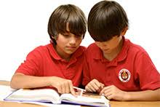
Pair work
Answer the following questions:
What is said about Cleopatra in mythology?
What have pearls been mentioned?
How did the Romans treat pearls?
Why did the brave knights wear pearls in battle field?

Slide 10
Group work
Fill in the gaps with appropriate words from the text in a group.
The history of pearls is very long. When human beings were looking for (a)………….., they first saw pearl at the sea shore. Pearl is actually a highly (b)……… gem. We also (c) ………the name of pearls in different religious books and in (d) ……… mythologies. It was greatly (e) ……...……. with love, marriage, wealth and social status.
food
valued
find
ancient
associated

Slide 11
Group work
Read the text in B again and write the information in the table.
Who | When / where
The ancient Egyptians | wore | pearls
The Greeks
The ancient Rumans
The brave knights

Slide 12
Answer sheet
The ancient Egyptians were worn pearls when they were buried.
The Greeks wore pearls in the time of love and marriage.
The ancient Romans wore pearls in social gathering.
The brave knights wore pearls in the battle fields.

Slide 13
Evaluation
Tell the correct answer from the alternatives.
The word ‘mythology’ in the text means……..
(a) love of God. (b) superstition. (c) science of logic.
(d) a collection of traditional stories which contains a belief.
The word ‘dissolve’ stands for?
(a) mould (b) fasten (c) prepare (d) melt
Egypt has an …… history.
(a) entire (b) unparalleled (c) ancient (d) associated
Pearls have been …… many times in religious texts.
(a) adorned (b) cited (c) excited (d) remarked

Slide 14
Evaluation
Do you think ‘pearls’ were discovered by ancient ? Why?
Why do you think pearls were valued so much in the past?
What good luck the knights thought would pearls bring them?

Slide 15
Home work
Write a paragraph on “Shine of pearls”

Slide 16
Thank you

