Slide 1


Slide 2



Krishna Rani Shill
Assistant Teacher
Kapilmuni Govt. Primary School
Paikgacha, Khulna
Subject: English
Class: 4
Environment Pollution

Slide 3


Greeting
Good morning, students.
Good morning, teacher.
How are you today?
Fine. and you?
Fine, thank you.

Slide 4
Let’s Watch a video

Slide 5
Learning Outcomes
By the end of the lesson students will be able to ..
Listening:
1.3.1 Recognize which words in a sentence are stressed.
3.4.1 Understand statements made by the teacher and students.
4.2.1 Understand and enjoy simple stories.
Speaking:
1.1.1 Say words, phrases and sentence with proper sound and stress.
6.2.1 Talk about people, objects, events etc.
Reading:
1.5.1 Read words phrases and sentence in the text with proper pronunciation, stress and intonation.
1.7.1 Read paragraphs, dialogues, stories, letters and other texts.

Slide 6
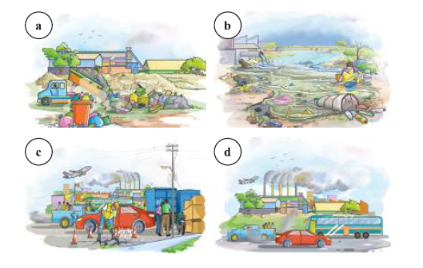
What are the pictures about?
Environment Pollution

Slide 7
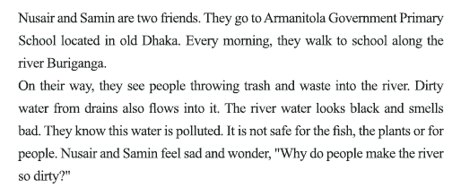
Teachers Reading

Slide 8
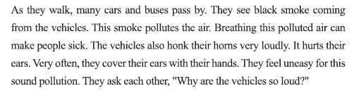
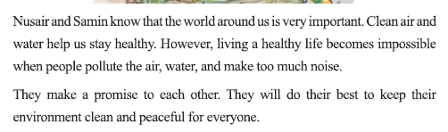

Slide 9
Some keywords of the lesson
Environment
পরিবেশ
Pollution
দূষণ
Throw
নিক্ষেপ করা
Trash
আবর্জনা
Vehicle
যানবাহন
Responsible
দায়ী

Slide 10
Breathing
শ্বাস নেওয়া
Wonder
আশ্চর্য
Honk
হর্ন বাজানো
Locate
অবস্থান
Peaceful
শান্তিপূর্ণ
Noise
কোলাহল

Slide 11

Individual work
Dear Students, Open your book at page no. 67 and read the text loudly…

Slide 12
Write True or False for each statement
Loud horn causes sound pollution.
True
People should throw waste in the water.
False
Breathing polluted air can make us sick.
True
Car and bus horns cause air pollution.
False
People are responsible for environment pollution.
True

Slide 13
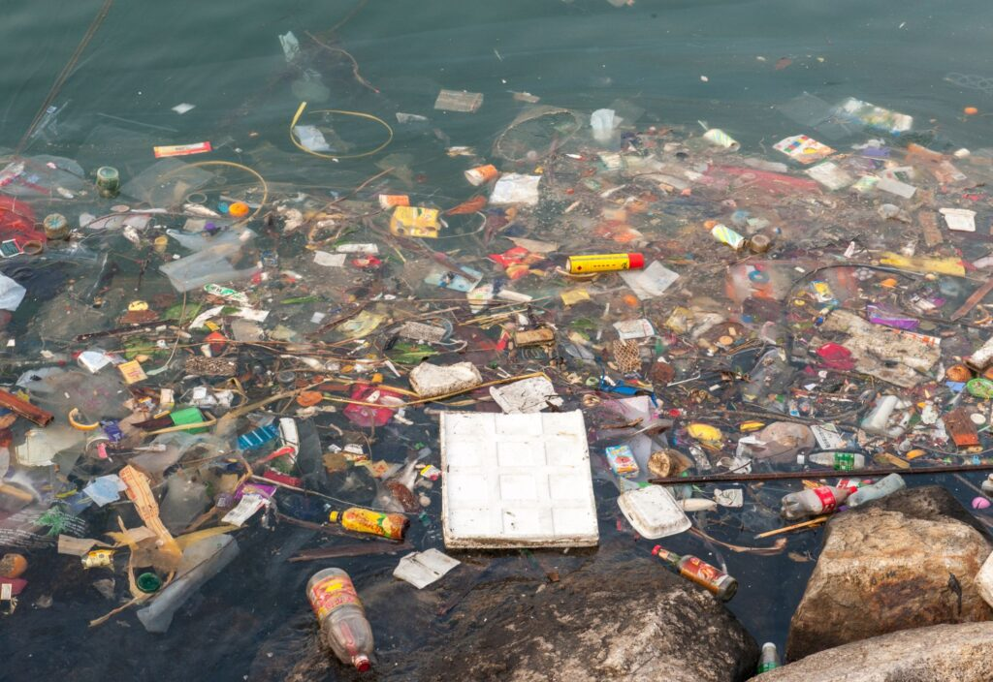
Pair work
Answer the following questions
a) How does water pollution happen?
Water pollution happens when people throw garbage and dirty water into rivers and ponds.

Slide 14
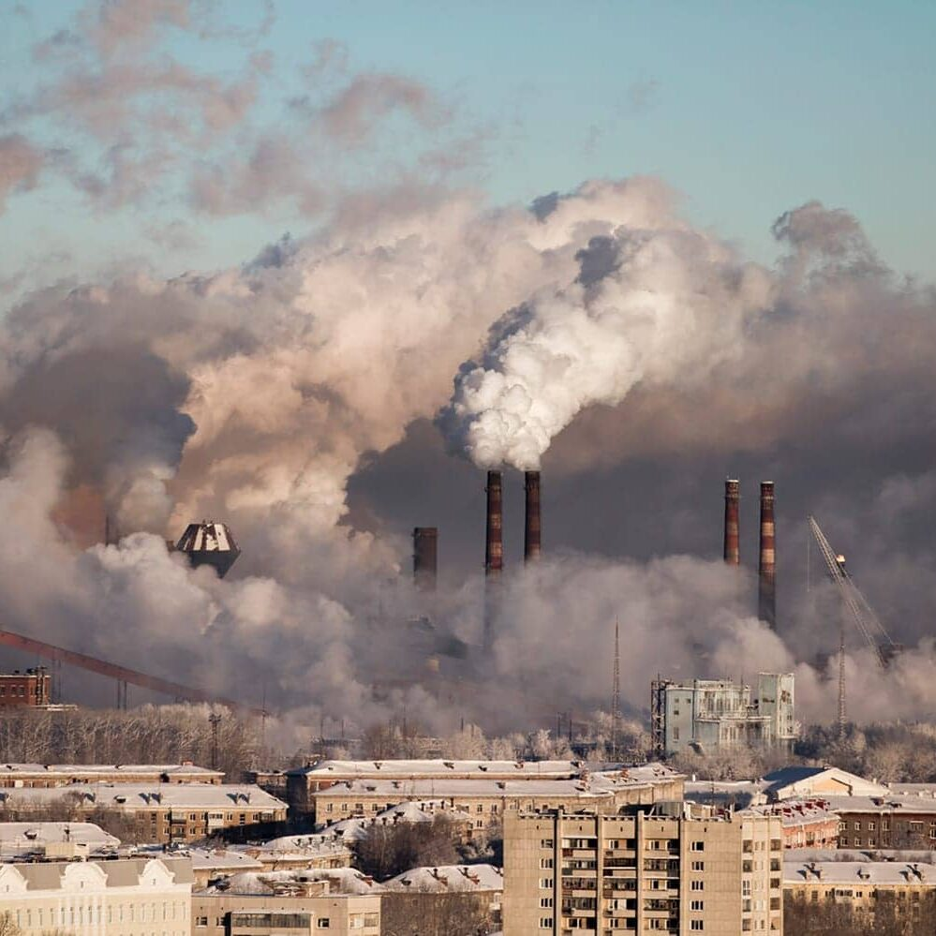
b) How does air pollution happen?
Air pollution happens when cars, buses and factories produce smoke and dust in the air.

Slide 15
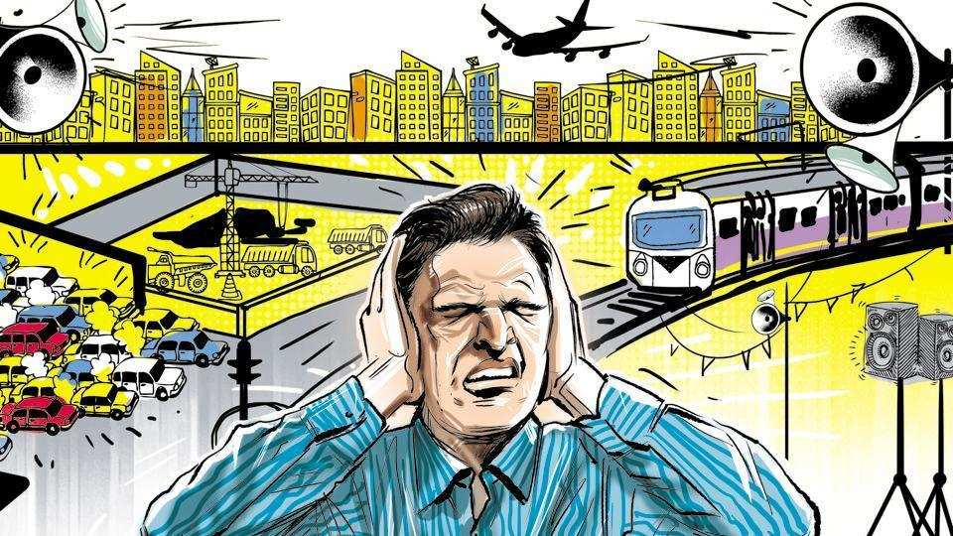
c) How does sound pollution happen?
Sound pollution happens when people use loud horns, loudspeakers and make unnecessary loud noises.

Slide 16
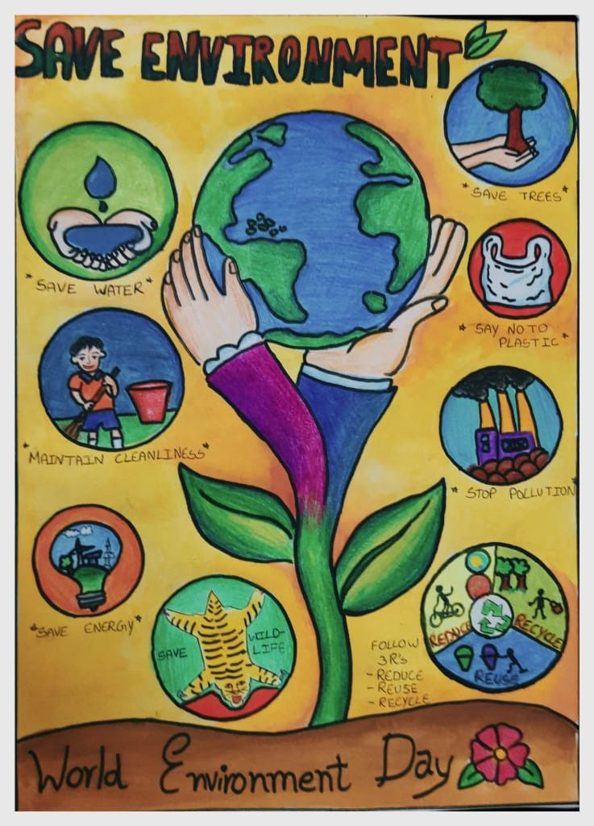
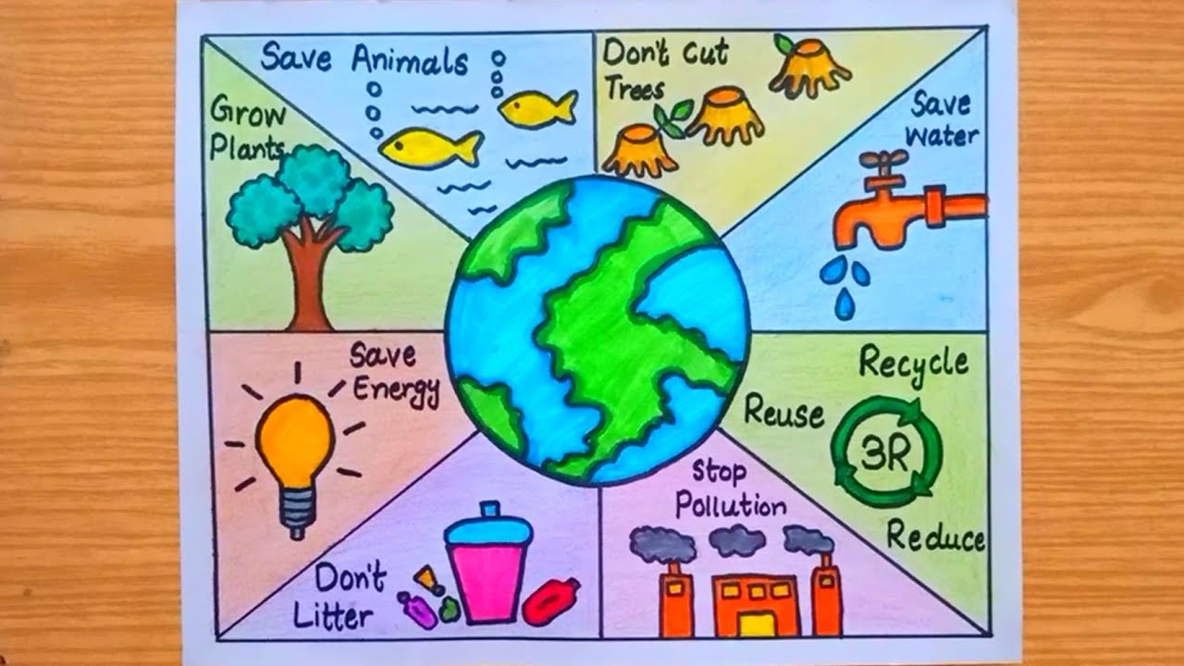
Group work
Dear students, Make a poster on how you keep our environment safe

Slide 17
Home Tasks
Write a short composition on ‘Environment Pollution’

Slide 18
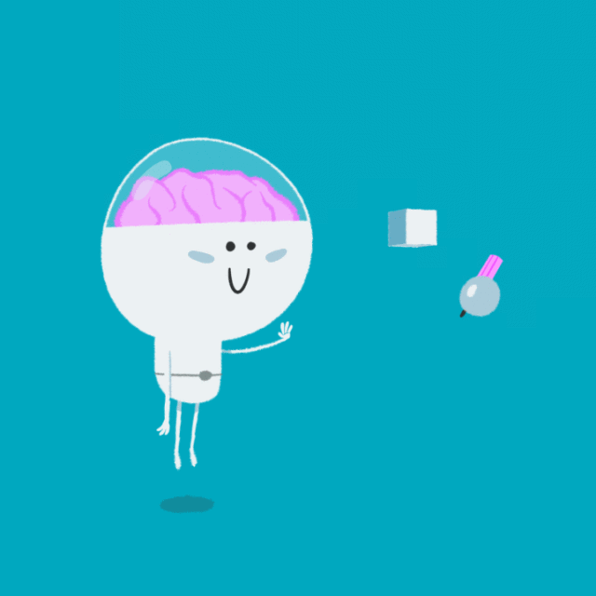
OK! STUDENTS, NO MORE TODAY……..
BYE ……….

