Slide 1



Slide 2


Slide 3



Introduction to the Lesson
Unit-12
Activity-1.1,1.2,2.1
Lesson Title-Eating Healthy
Class-Five
Sub-English

Slide 4
Learning Outcomes
Students will be able to-
3.4.1Ask simple questions on familiar topics.
3.4.2Answer simple questions appropriately and confidently.
4.2.1Read aloud texts with proper stress,intonation.

Slide 5
Review of the prior knowledge
*Have you ever bought anything from a store?
*What did you buy from a store?

Slide 6
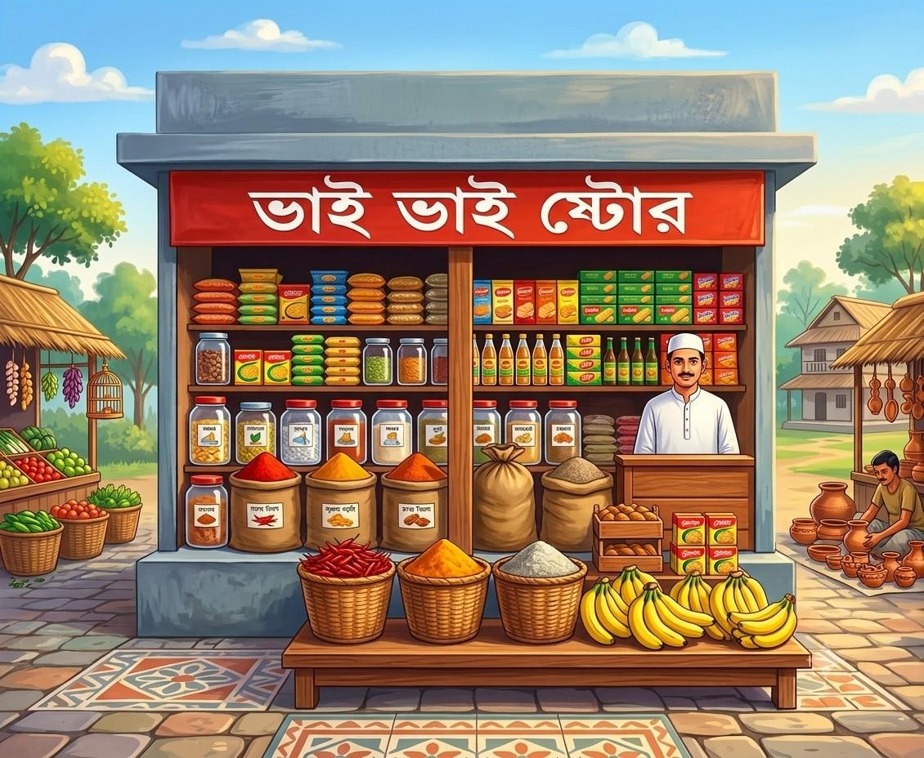
Look at the picture
a.What do you see in the picture?
b.Write the names of the food seen in the grocery shop and share your list with your friends.

Slide 7
Can you guess what may be our today’s Lesson?

Slide 8
Our Today’s Lesson
Eating
Healthy

Slide 9
New words
Grocery
Related to food and household items sold in a shop

Slide 10

Conversation
Dialogue

Slide 11

Enjoy
To get pleasure from something

Slide 12
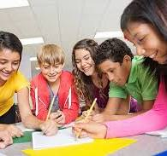
Together
With each other

Slide 13
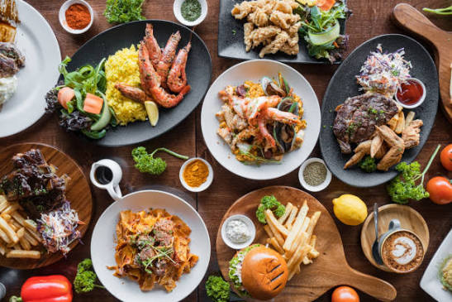
Delicious
Tasty

Slide 14
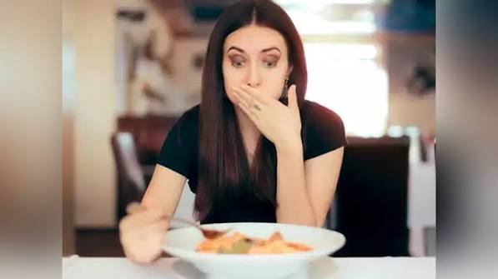
Hastily
Quickly

Slide 15
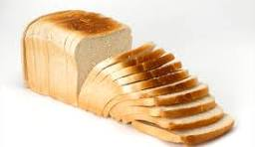
Sliced
Cut

Slide 16
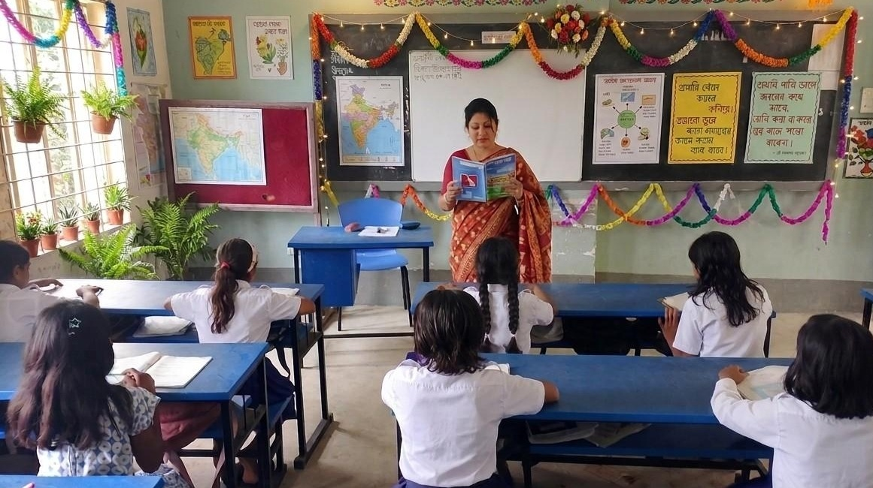
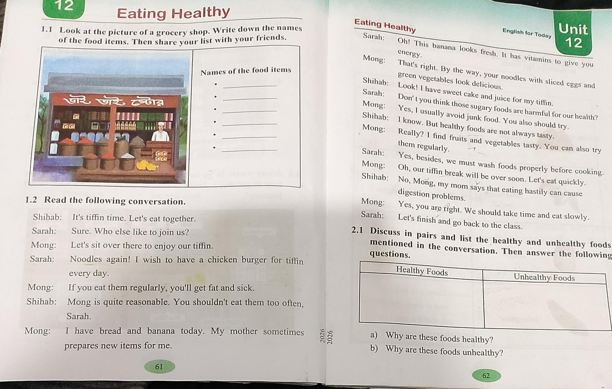
Teacher’s Model Reading

Slide 17
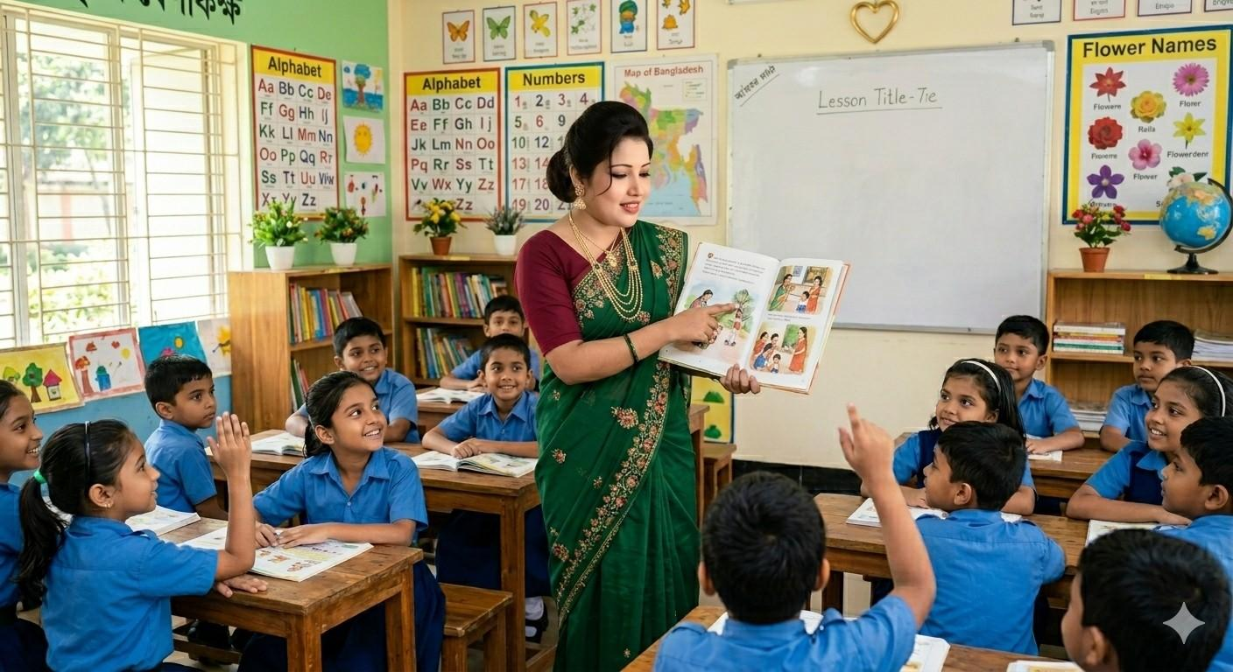
Choral Reading

Slide 18
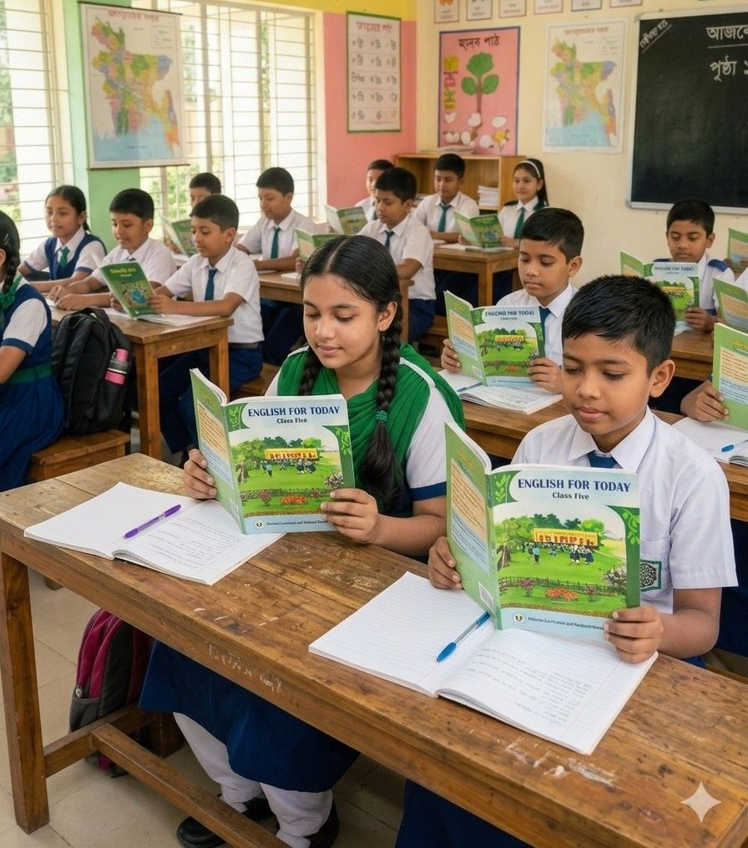
Student’s Reading

Slide 19
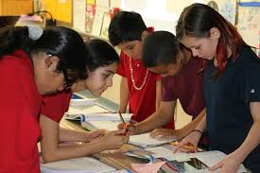

Group Work
Read the text in groups and role-play the
Characters-Shihab,Sarah and Mong.
Answer the following questions.
a)Is sweet cake a healthy food?
b)Mention 2 healthy foods name.

Slide 20

Pair Work
Read the text in pairs and list the healthy and unhealthy foods mentioned in the conversation.Then answer the following questions.

Slide 21
Healthy Foods | Unhealthy Foods
*Noodles prepared with Sliced eggs and green Vegetables *Banana *Fruits *Vegetables | *Sweet Cake *Juice(Sugary drink) *Junk Food
a)Why are these foods healthy?
b)Why are these foods unhealthy?

Slide 22
One day one word
Reasonable
যুক্তিসংগত
Sara’s idea is reasonable.

Slide 23

Assessment
Read the conversation individually from activity 1.2 at textbook page 61-62.

Slide 24
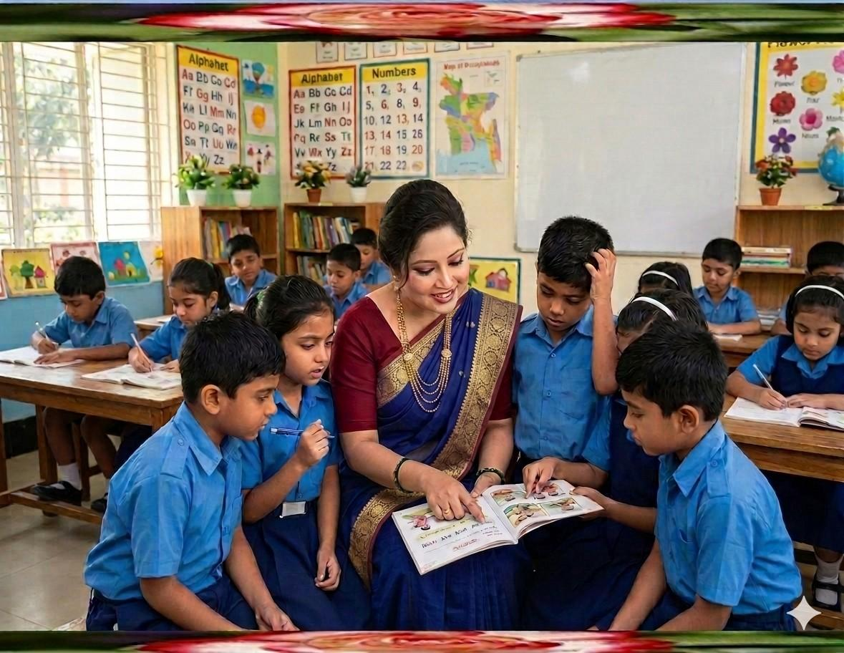
Feedback
Support the students during the class
who cannot read aloud the conversation properly.

Slide 25
Summary of the session
“What have you learnt today?”
We have learnt about the unhealthy foods.We have also learnt that we should always eat healthy food.

Slide 26

Home Work
Write the names of 5 healthy foods and 5 unhealthy foods in your exercise book.Then write two sentences about why healthy foods are important for our body.

Slide 27


