Slide 1


Slide 2
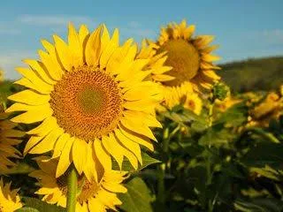
WELCOME

Slide 3

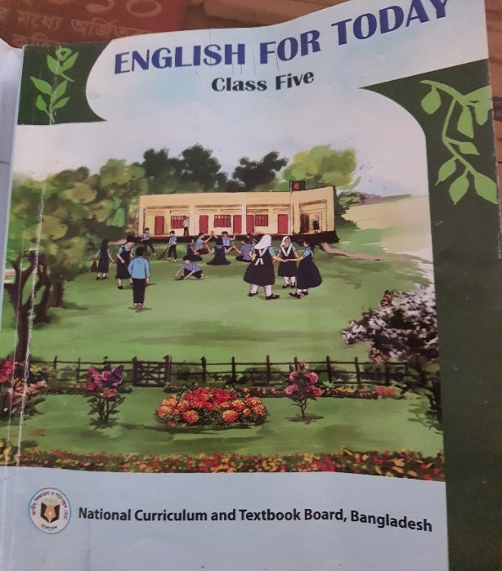

IDENTITY
Muktamony
Head teacher
Atashia Government Primary School
Shibpur,Narsingdi.
Title –Poem: The Swing
Class- Five
Subject- English
Unit-10 ,Page- 52-53
Lesson- 1-2, (How……down!)
Time-40 minutes
Date---/07/2026

Slide 4
Learning outcomes
Learning outcomes:
Student will be able to-
6.1.1 Read rhymes and poems and recite with joy.
6.1.2 Comprehend and express the main ideas of rhymes and poems through reading.

Slide 5

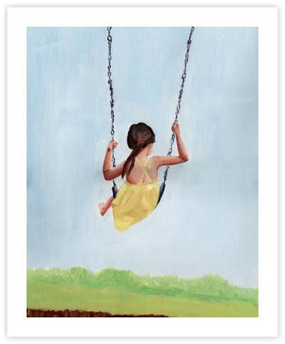

What do you see in the picture ? Can you guess what may be our today’s lesson.

Slide 6
Our today’s lesson-
The Swing
-- Robert Louis Stevenson

Slide 7


What do you see in the picture ?

Slide 8


How do you like to go up in a swing,
Up in the air so blue ?
Oh, I do think it the pleasantest thing
Ever a child can do .

Slide 9

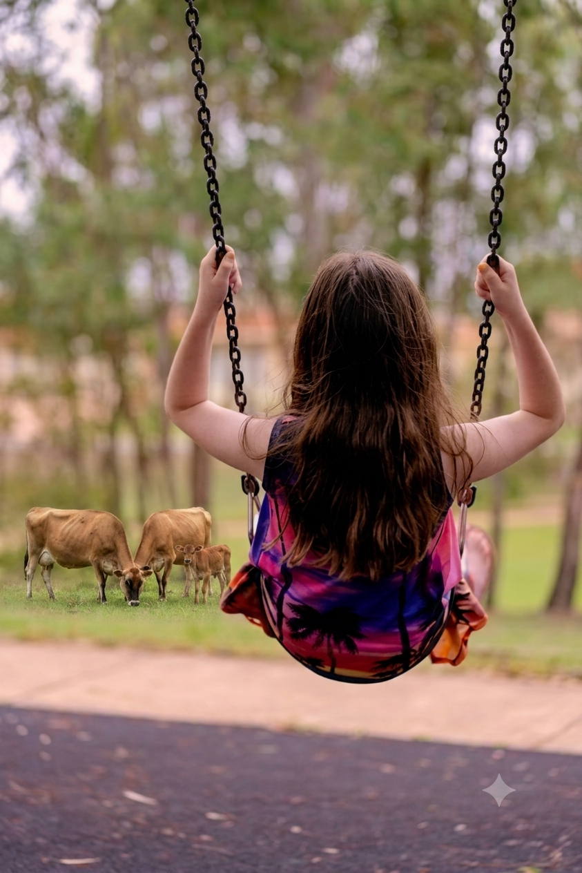
Up in the air and over the wall,
till I can see wide,
Rivers and trees and cattle and all
Over the countryside-

Slide 10

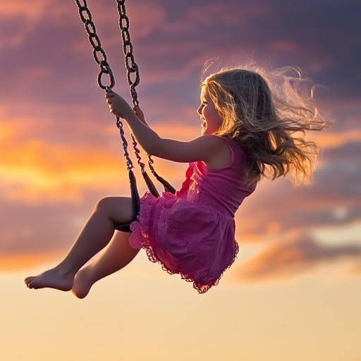
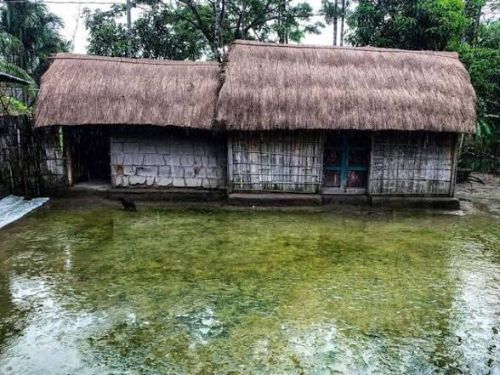

Till I look down on the garden green,
Down on the roof so brown-
Up in the air I go flying again,
Up in the air and down !

Slide 11
New words
Swing- দোলনা-a seat made with rope or chains to swing up and down
Wide-প্রশস্ত- more than average width
Cattle-গবাদিপশু- large domestic animals with horns and hoofs
Countryside- the land and scenery of a rural area
Pleasantest-
Roof-ছাদ-celling
Air-বাতাস-wind
Think- চিন্তা করা- imagine
Rivers-নদী-a large natural stream of water

Slide 12
Open your book at page no 52 .
Model reading/recite poem
Proper stress and intonation
Ss repeat the lines after me.repeat the activity 2/3 times.
Individual reading

Slide 13
Ask and answer the question.
What is the poem about ?
Answer: The poem is about the swing.
What does the speaker see when the swing goes up ?
Answer: The speaker sees the trees, cattle,and the countryside when the swing goes up .
c. How does the speaker feel while swinging ?
Answer: While swinging the speaker feels that it is the most beautiful and pleasant thing in the world.
d. Do you have a swing at school or home ? What do you see from ?
Answer: Yes, there is a swing in our school. From it I see the beautiful cornfield ,the cattle and the boys playing in the school field.

Slide 14
2.2 Write down the rhyming words from the poem .
Swing and thing
Blue and do
Wall and all
Wide and countryside
green and again
brown and down

Slide 15
Make sentences:
Swing- Children loves the swing.
River- Narasunda is a small river.
Air-We do not live without air.
Cattle- The Cattle are eating grass in the field.
Garden- I have a garden.
Trees- Trees give us Oxyzen.

Slide 16

Choose the correct answer :
What is the name of the poem ?
River b. the swing c. Trees d. cattle
ii. Who writes the poem- the swing ?
Robert louis Stevenson b, Mykel
c. Sufia Kamal d. Words Worth
iii. Roof is - a. red b. Green c. blue d. Brown
What is the last sentence of the poem ?
Up in the air and down ! b. up in the air so blue
c. ever a child can do c. Over the countryside-

Slide 17


Group work
Recite the poem-1
Recite the poem-2

Slide 18
Assessment
Who is the writer of the poem ?
2. What is the poem about ?

Slide 19

Home Work
Draw a picture of your swinging experience.
Show the picture and share your experience in your class.

Slide 20
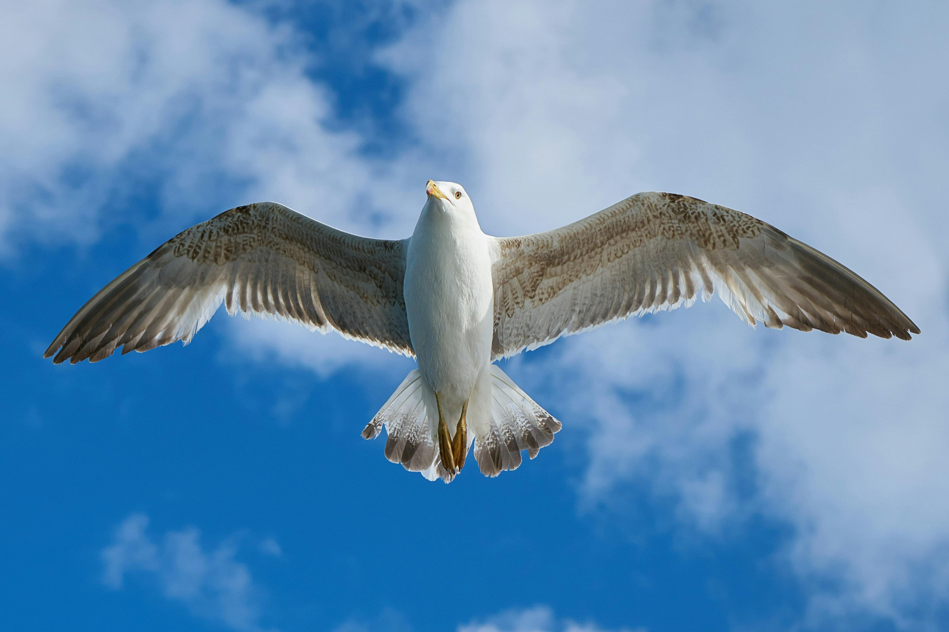
GOODBYE

