Slide 1


Slide 2
Introduction
Mst. Manira Ferdousi
Assistant Teacher (English)
Rotia High School
E-mail: mfboby89@gmail.com
Class-Nine
English 1st Paper
Unit – 8, Lesson – 4
Lake Baikal

Slide 3
Learning Outcomes
SS will be able to learn new word and english meaning.
SS will be able to read and understand texts through silent reading.
SS will be able to ask answer questions.
SS will be able to describe a place.

Slide 4
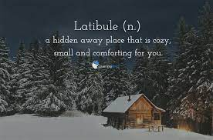
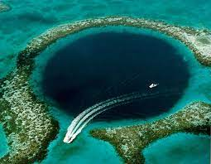
New vocabulary
New Word
Deepest
Meaning
Highest amount of depth. The Mariana Trench, in the Pacific Ocean, is the deepest location on Earth.
.Synonym
Innermost

Slide 5
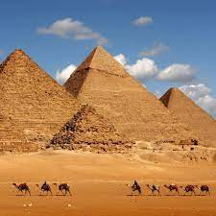
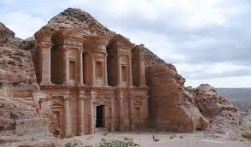
New vocabulary
New Word
Ancient
Meaning
Belonging to the very distant past and no longer in existence.
.Synonym
Primitive
Antonym
Modern

Slide 6
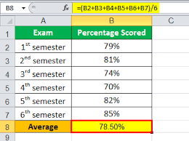
New vocabulary
New Word
Average
Meaning
Usual
.Synonym
Regular
Antonym
extreme

Slide 7


New vocabulary
New Word
Excellent
Meaning
very good of its kind : eminently good : first-class. archaic : superior.
.Synonym
Brilliant
Antonym
Imperfect

Slide 8
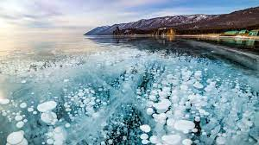
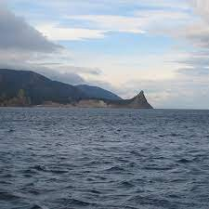
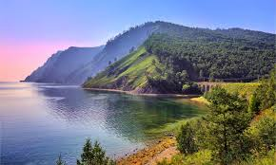
Look at the pictur . Work in pairs and ask and answer the following questions.

Slide 9

I think, it is Lake Baukal.
What do you think it is?
Where is this situated?
It is situated in Russia.

Slide 10
Are you familiar with something like this?
Yes , I know a beautiful lake named Kaptai Lake. It is situated in Rangamati in Bangladesg.

Slide 11
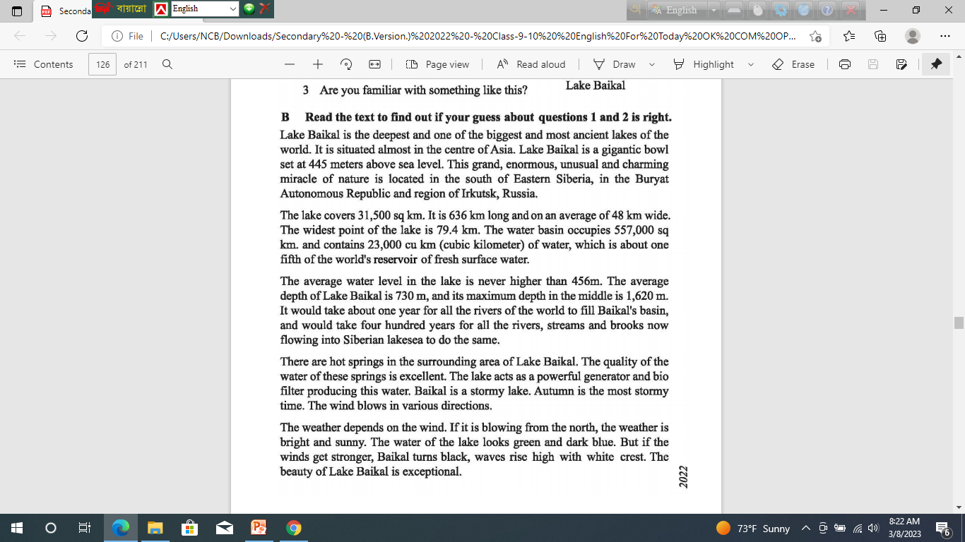

Slide 12

Group work

Slide 13
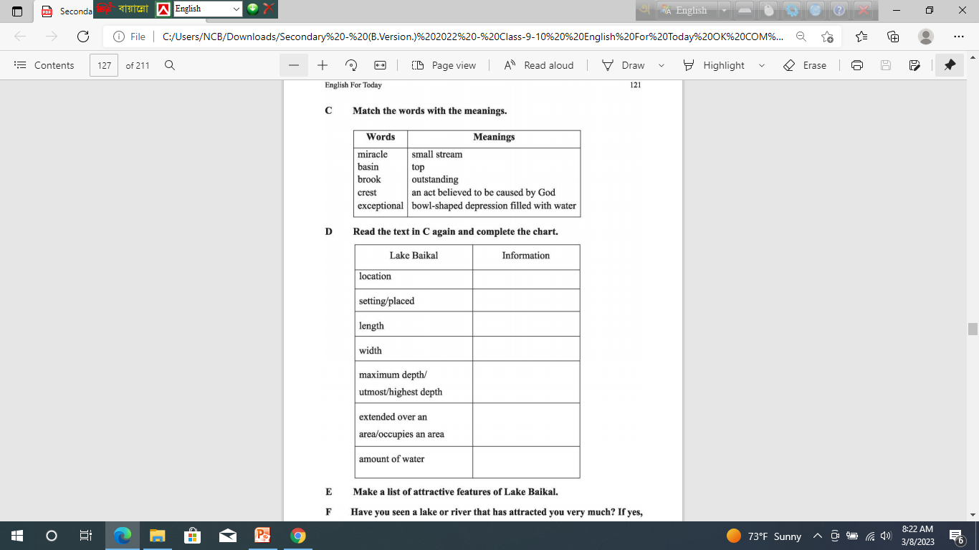

Slide 14
Answer
(C ) Match the word with the meanings.
Words | Meanings
Miracle | An act believed to be caused by God.
Basin | Bowl-shaped low surface filled with water.
Brook | Small stream.
Crest | top
Exceptional | Outstanding .

Slide 15
Answer
(d ) Read the text in B again and complete the chart.
Lake Baikal | Information
Location | In the south of Eastern Siberia , in the Buryat Autonomous Republic and region of Irkutsk, Russia.
Setting /placed | 445 meter above sea level.
Length | 636 km long
Maximum depth/ utmost/highest depth | 1,620 m.
Extended over an area/ occupies an area | 557.000 sq k.m.
Amount of water | 23,000 cubic kilometer.

Slide 16

Pair work

Slide 17
E Make a list of attractive features of Lake Baikal.
It is the deepest and one of the biggest and most ancient lakes of the world.
Situated at 445 meters above sea level.
It reserves about one fifth of the world’s fresh surface water.
To fill Baikal’s basin, it will take one year for all the rivers of the world .
The beauty of Lake Baikal is exceptional.

Slide 18

Have you seen a lake or river that has attracted you very much? If yes, write what aspects of the lake or river appealed to you. If not , go and see a lake or a river . Then write about it.

Slide 19


