Slide 1
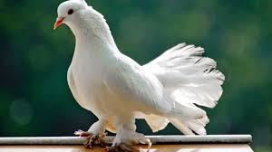
WELCOME EVERYONE

Slide 2
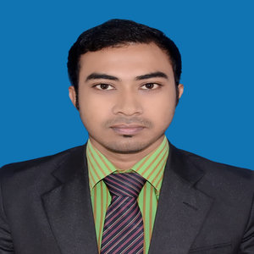
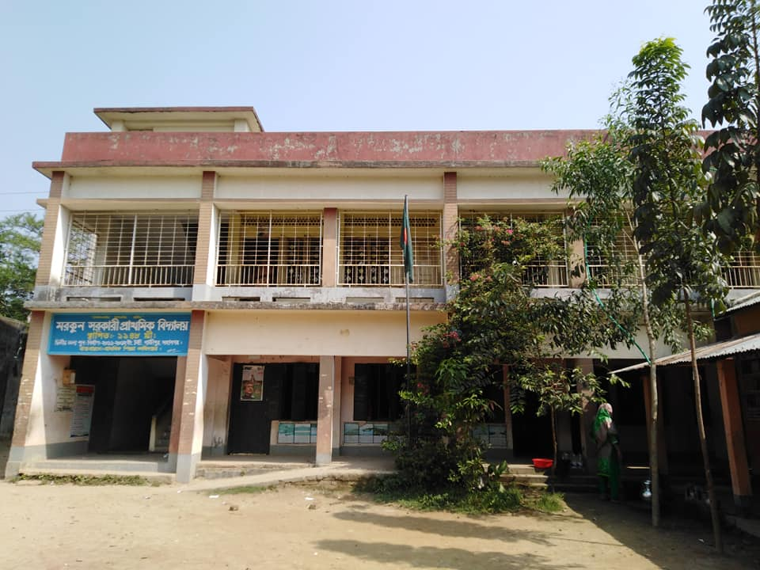
TEACHER’S IDENTITY
NAME :
MD. RADHWAN HASAN
(ASSISTANT TEACHER)
SCHOOL NAME :
MORKUN GOVT. PRIMARY SCHOOL ,
MORKUN , TONGI,
GAZIPUR-1710

Slide 3
LESSON IDENTITY
1. CLASS : 4
2. SUBJECT: ENGLISH
3. UNITE: 11 ,
4. LESSON NAME:
A HOLIDAY TRIP

Slide 4
LEARNING OUTCCOME
Student will be able to:
7.4.3 Write short, legible and organised compositions using mind maps
9.5.3 Use present perfect to talk about immediate past activities

Slide 5
Lets see a video………….

Slide 6
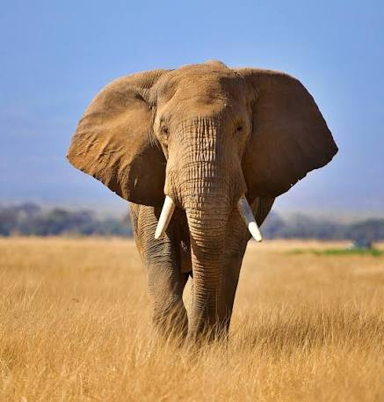
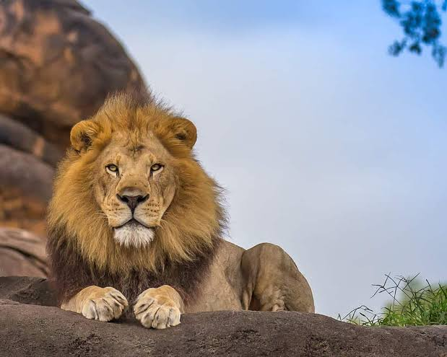
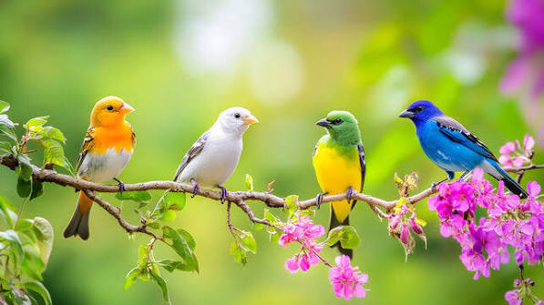
Animal

Slide 7
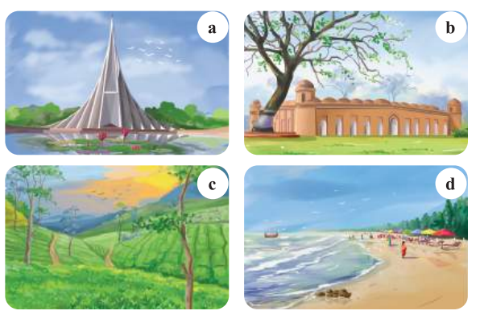

Slide 8
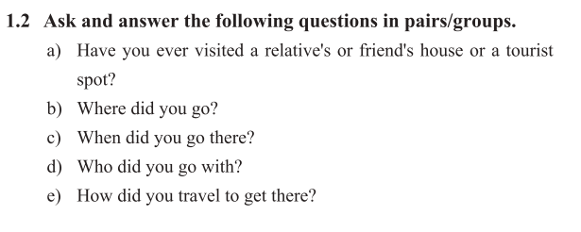

Slide 9
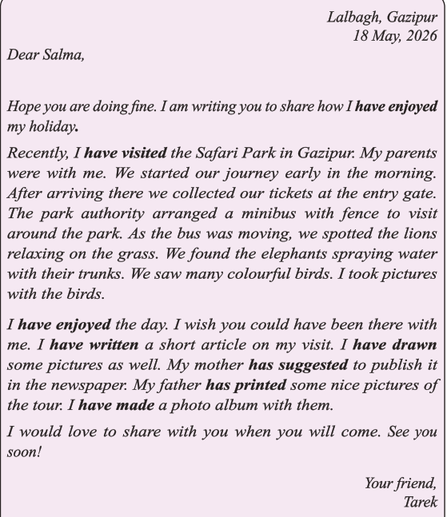

Slide 10
I HAVE
WRITTEN
MADE
PRINTED
ENJOYED

Slide 11
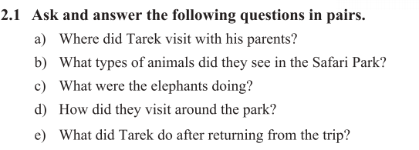
GROUP WORK

Slide 12
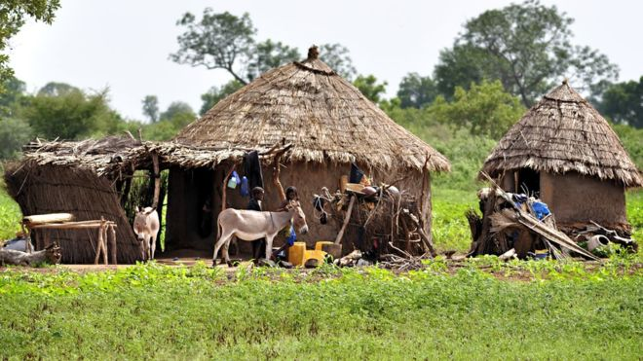
HOME WORK
Write a letter about your holday trip.

Slide 13

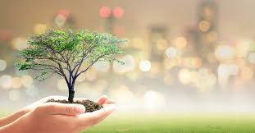
THANK YOU

Slide 14
CREATED BY:
MD. RADHWAN HASAN
ASSISTANT TEACHER
MORKUN GOVT. PRIMARY SCHOOL ,
MORKUN , TONGI, GAZIPUR-1710
MOB: 01916299687
EMAIL: radhwanhasan@gmail.com

