Slide 1
GOOD MORNING

Slide 2
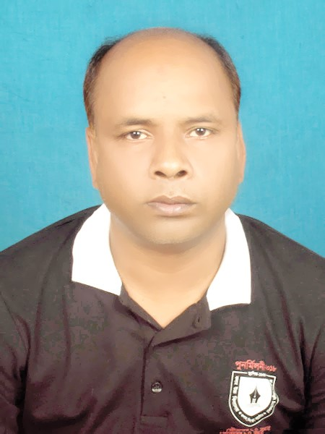
IDENTIFICATION
Md. Abul Bashar
Assistant Teacher
Digholgram Govt. Primary School

Slide 3
Class: Two
Subject: English

Slide 4
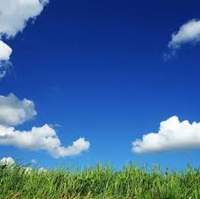

Slide 5
Lesson Title: Colours, Shapes and Signs.
Lesson Part: Colours (Activity A,B,)

Slide 6
Learning Outcomes:
8.1– Recognizing and using words Frequently used in the text for participating in everyday conversations.

Slide 7

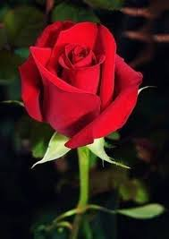
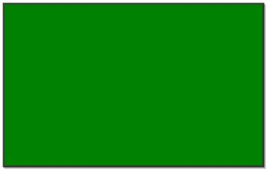
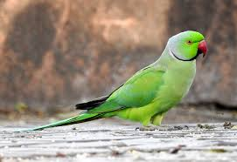
Red
Green

Slide 8
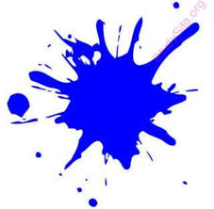

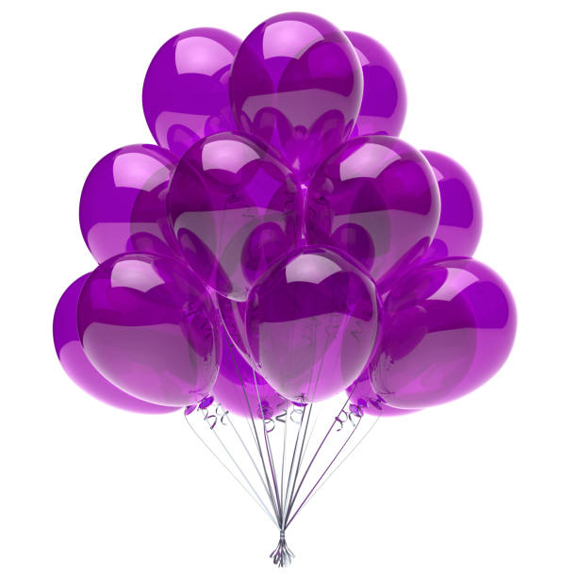
Blue
Violet

Slide 9

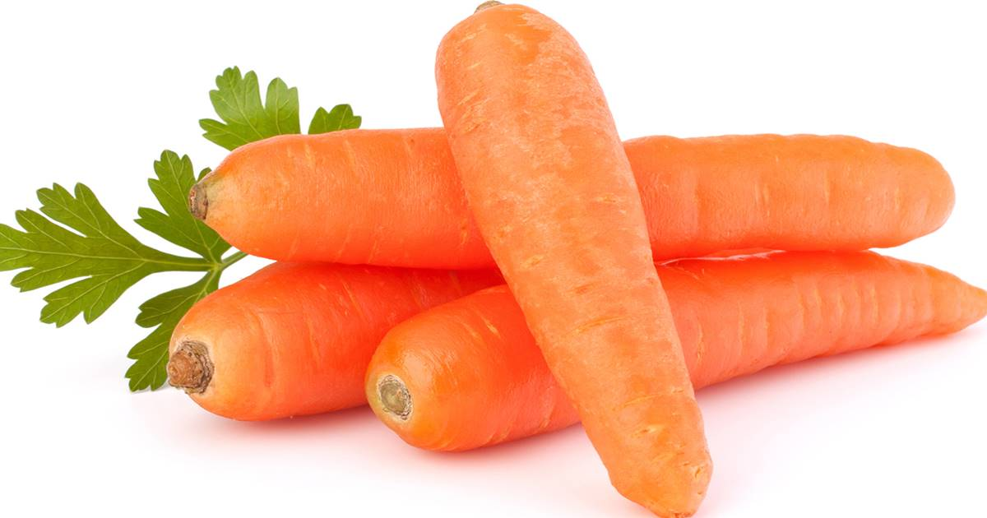
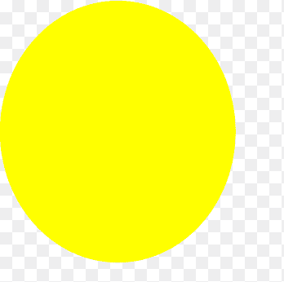
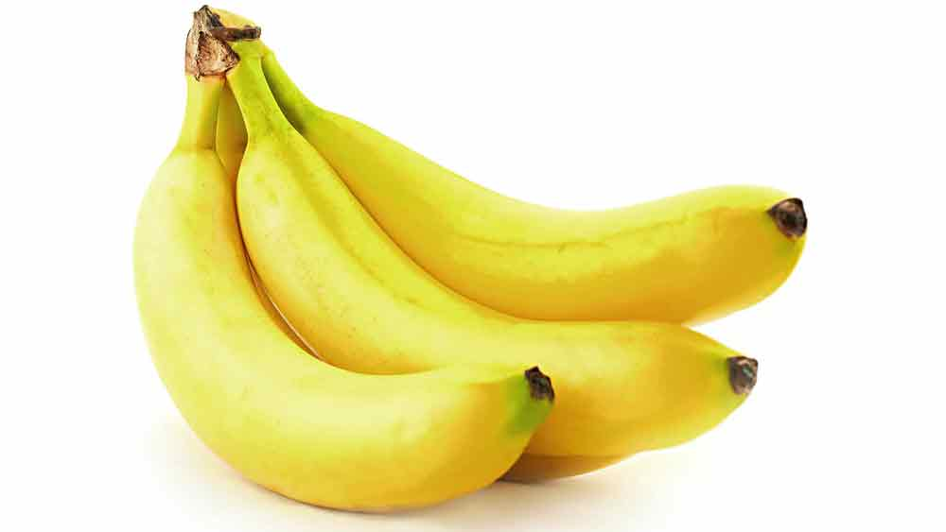
Orange
Yellow

Slide 10
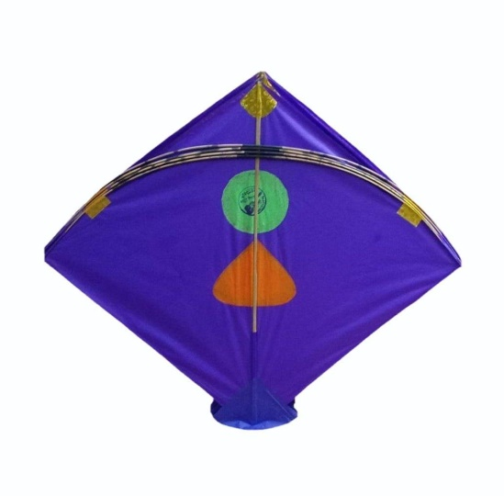
Indigo

Slide 11
Red
Green
Blue

Slide 12

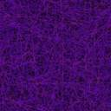
Violet
Orange
Yellow
Indigo

Slide 13
Red, red, red
The rose is red.
Green, green, green
The parrot is green.
Blue, blue, blue
The sky is blue.
Violet, violet, violet
The balloon is violet.

Slide 14
Orange, orange, orange
The carrot is orange.
Yellow, yellow,yellow
The banana is yellow.
Indigo. indigo, indigo
The kite is indigo.

Slide 15
Group work
Pair work
Individual reading

Slide 16
Evaluation
What is this ?
What colour is it ?
yellow
green
What colour is it ?
What colour is it ?
What colour is it?
Who can say the name of 4 colours ?
red
blue

Slide 17
What is this colour?
This colour is red.

Slide 18
What is this colour?
This colour is green.

Slide 19
What is this color?
This color is yellow.

Slide 20
What is this colour?
This colour is violet.

Slide 21
What is this colour?
This colour is blue.

Slide 22
What is this colour?
This colour is orange.

Slide 23
What is this colour?
This colour is indigo.

Slide 24
Write the name of 4 colours.
Write in English:
লাল=
সবুজ=
নীল=
হলুদ=
কমলা=
red
green
blue
yellow
orange

Slide 25
GOOD BY STUDENTS

