Slide 1


Slide 2

WELCOME

Slide 3
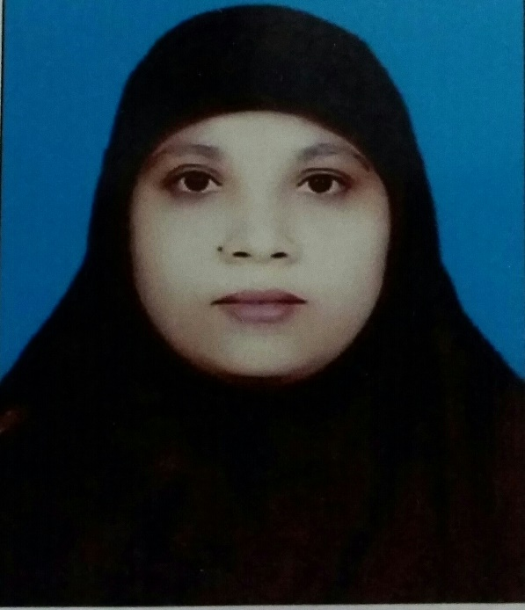
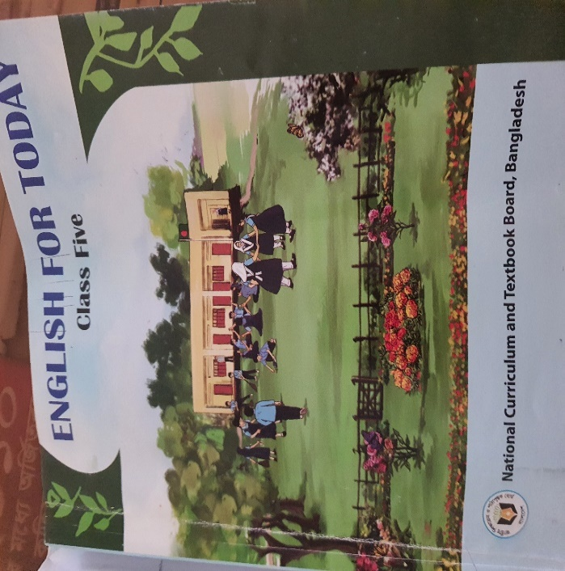

IDENTITY
Muktamony
Head teacher
Atashia Government Primary School
Shibpur , Narsingdi.
Title –Eating Healthy
Class- Five
Subject- English
Unit-12 ,Page-61-62
Lesson- 1, (Look…..class)
Time-40 minutes
Date---/07/2026

Slide 4
Learning Outcomes
Learning Outcomes:
3.4.1 Ask simple questions on familiar topics.
3.4.2 Answer simple questions appropriately and confidently.
4.2.1 Read aloud texts with proper stress , intonation.

Slide 5
Review of prior knowledge
Review of prior knowledge :
Have you ever bought anything from a store ?
What did you buy from a store ?
Is it a healthy food ?

Slide 6
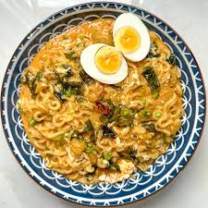
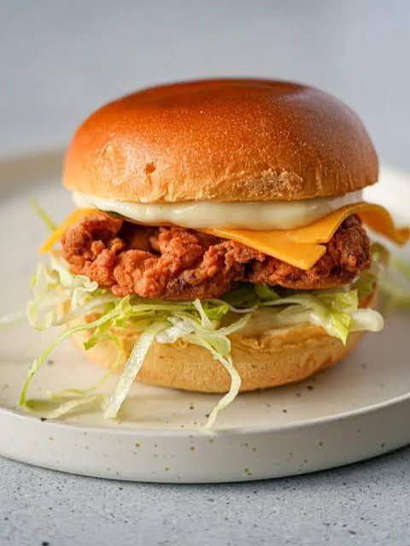
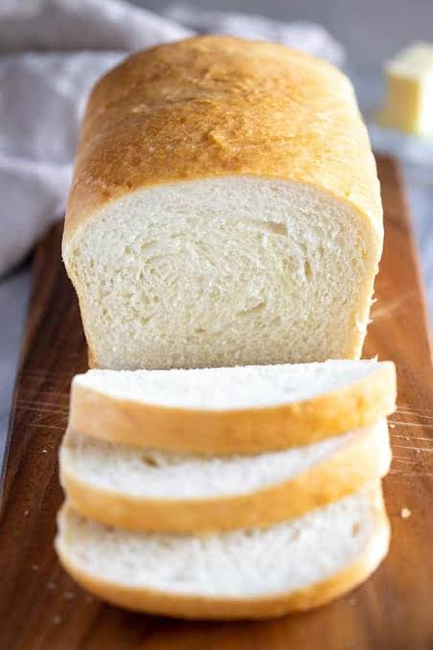
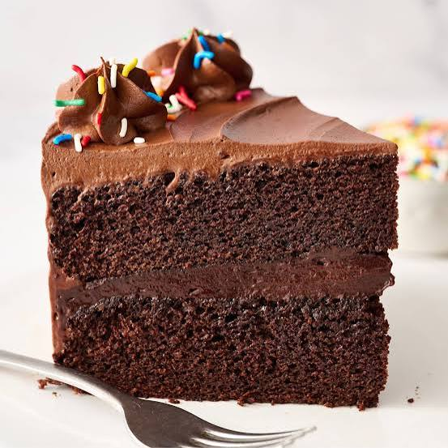
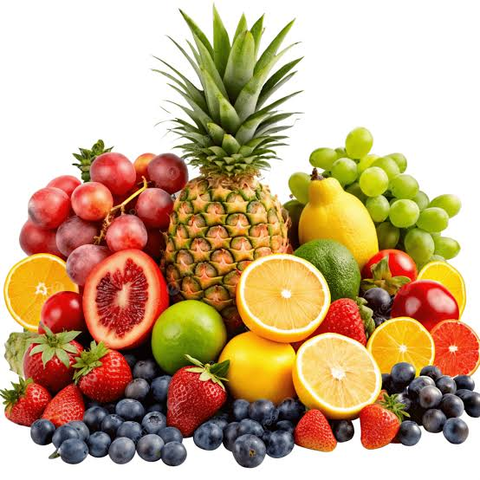
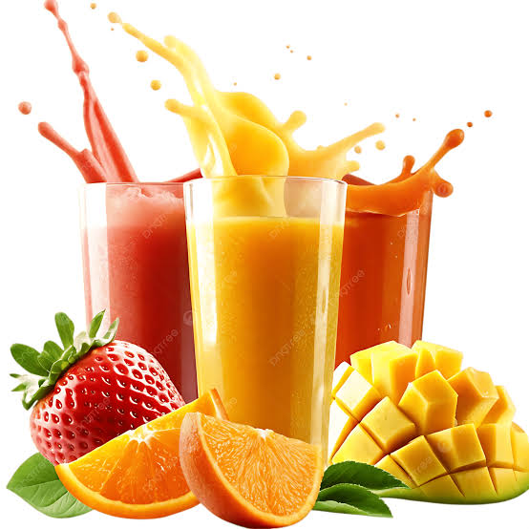
Look at the picture ? What do you see in the picture ? Is it healthy food ?

Slide 7
Our today’s topic is-
Eating Healthy

Slide 8
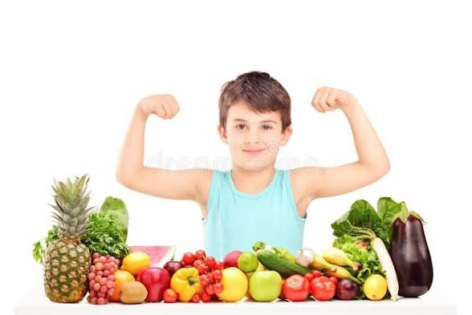
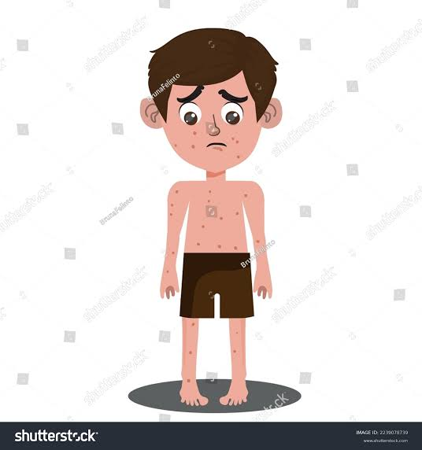
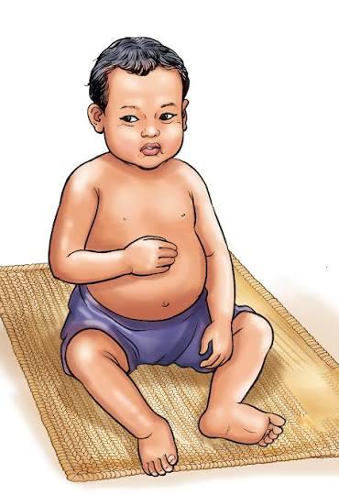
What do you see in the picture ? Who is a healthy boy ? Why ?

Slide 9
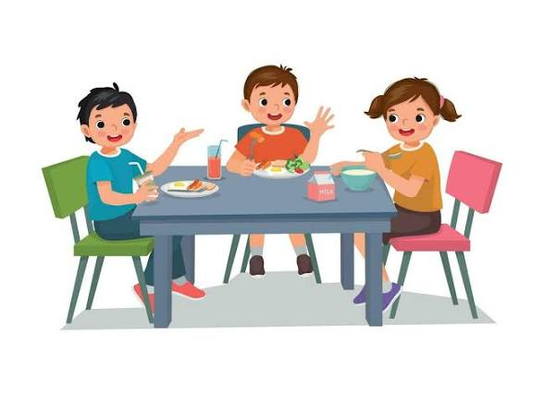
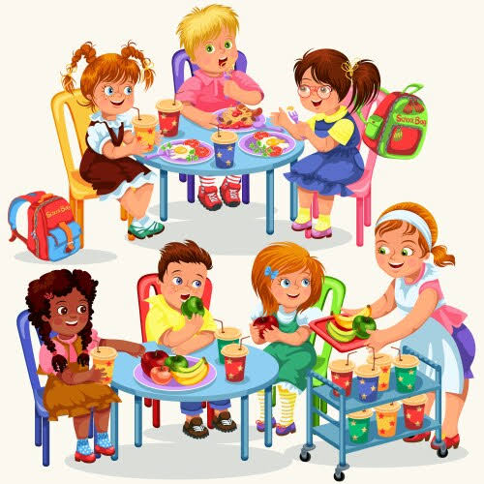

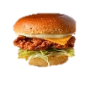
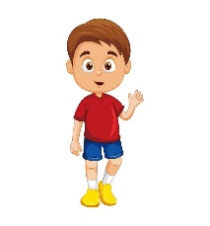
Shihab
Mong
Sarah
Shihab: It’s tiffin time . Let’s eat together.
Sarah: Sure. Who else like to join us ?
Mong : Let’s sit over there to enjoy our tiffin.

Slide 10

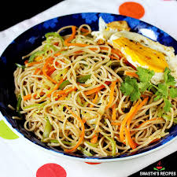
Sarah: Noodles again ! I wish to have a chicken burger for tiffin every day.

Slide 11

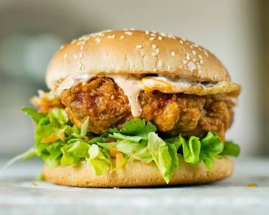
Mong: If you eat them regularly, you ‘ll get fat and sick.
Shihab: Mong is quite reasonable. You shouldn’t eat them too often, Sarah.

Slide 12
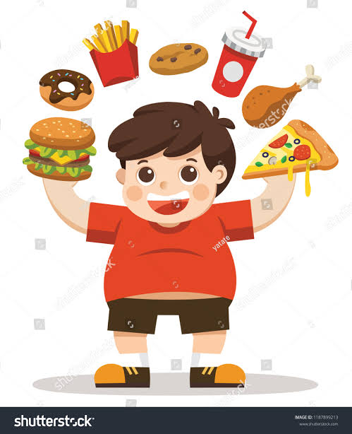
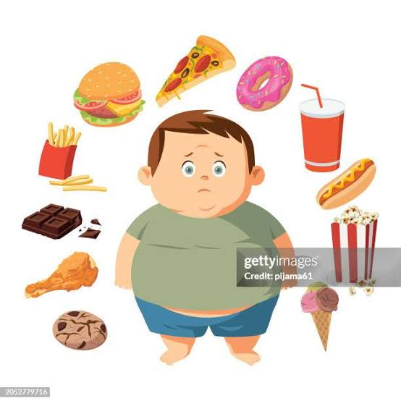
Mong: If you eat them regularly, you ‘ll get fat and sick.

Slide 13
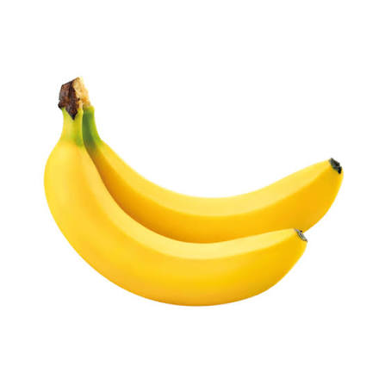
Mong: I have bread and banana today. My mother sometimes prepares new items for me. Sarah: Oh! This banana looks fresh . It has vitamins to give you energy.

Slide 14

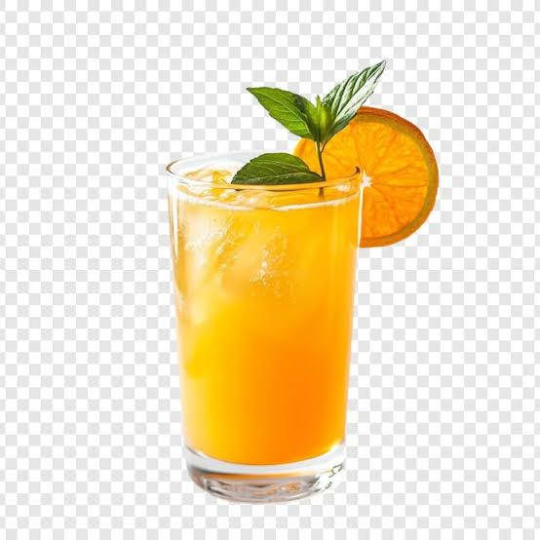
Shihab: Look! I have sweet cake and juice for my tiffin.
Sarah: Don’t you think those sugary foods are harmful for our health ?
Mong : Yes, I usually avoid junk food .You also should try .

Slide 15
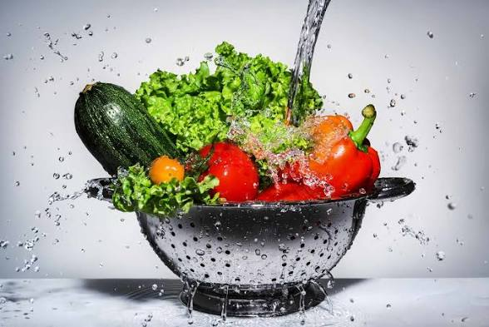
Mong : I find fruits and vegetables tasty . You can also try them regularly.

Slide 16
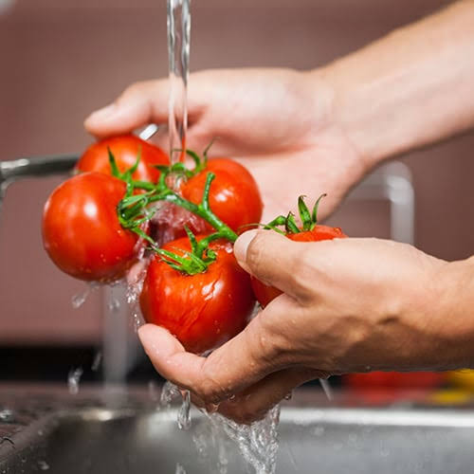
Sarah : We must wash foods properly before cooking.

Slide 17
Reasonable-যুক্তিসম্মত- equitable/ pointful
Together-একত্রে-With or in proximity to another
Regularly-নিয়মিত-do something constantly
Sliced –টুকরো করা/ফালি-cut into pieces
Delicious- সুস্বাদু-highly pleasant to the taste
Sugary- চিনিযুক্ত-connected with sugar
Harmful- ক্ষতিকর- something is dangerous that can harm/ injurious
Hastily-দ্রুততা- with excessive speed
Digestion-হজম-assimilation

Slide 18
Open your book at page 61 .
Model reading
Individual reading
Role-play

Slide 19
Conversation
Then ,invite two students to the front of class.
Role-play the dialogue with the students .
Ask other students to observe and listen.

Slide 20
Rewrite the following text using capital letters and punctua marks where necessary .
Who else like to join us
Answer: Who else like to join us ?
2. Lets eat to together
Answer: Let’s eat together.
3. Oh this banana looks fresh
Answer: Oh! This banana looks fresh.
4. Its tiffin time
Answer: It’s tiffin time .
5. Lets eat quickly
Answer: Let’s eat quickly.

Slide 21
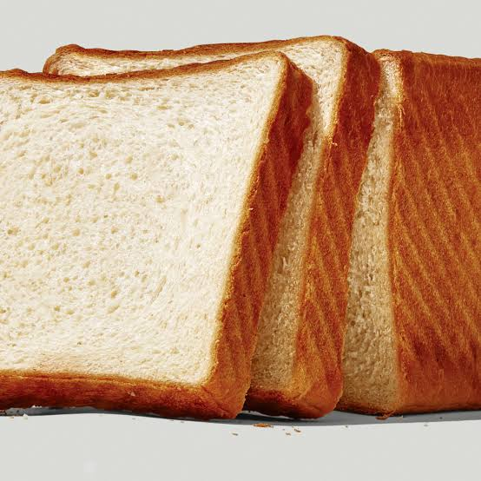
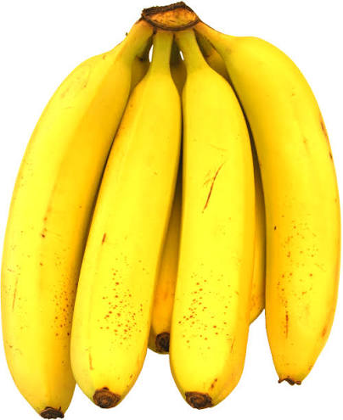
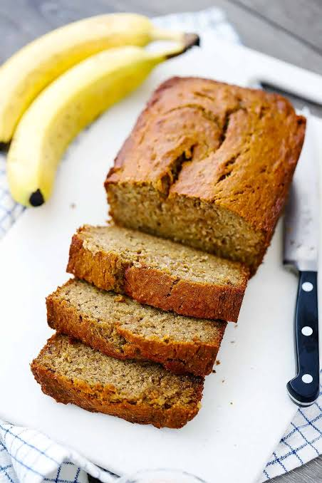
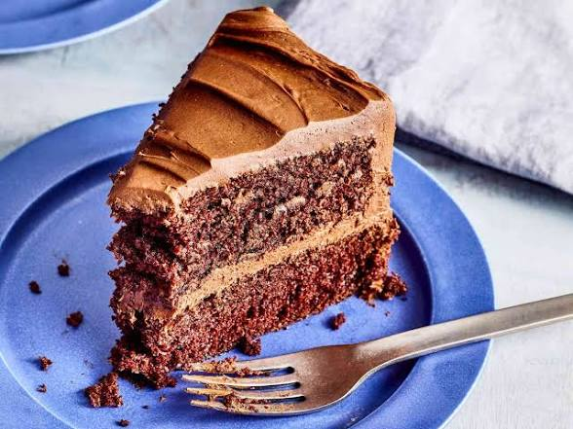
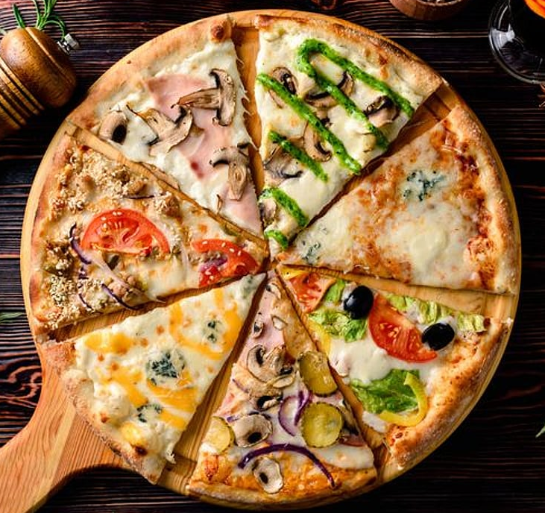
Tell the name any healthy food , any junk food .

Slide 22
Ask and answer the questions-
i. Who wants to have a chicken burger everyday for tiffin ?
Answer: Sarah wants to have a chicken burger everyday for tiffin .
ii. How should we eat our foods ?
Answer: We should take time and eat our foods slowly.
iii. Why is the banana good for health ?
Answer : Banana is good for health because it gives us energy.
iv. Why does shihab call Mong quite reasonable ?
Answer: shihab calls Mong quite reasonable because Mong never wants to eat junk food. What eating hastily can cause ?
v. What eating hastily can cause ?
Answer: Eating hastily can cause digestion problems.
vi. Which foods does Mong find tasty ?
Answer: Mong finds fruits and vegetables tasty .
vii. What does Sarah advice ?
Answer: Sarah advices to wash foods properly before cooking.

Slide 23
Make sentence
Join- He will join the meeting at 9 am.
Reasonable- Mong is quite reasonable.
Often- He often comes here.
Hastily- We should not eat hastily.
Slowly- Sima is walking slowly.
Healthy- Healthy foods are not always tasty.

Slide 24
Pair Work
2.1 Discuss in pairs and list the healthy food and unhealthy foods mentioned in the conversation.
Healthy foods | Unhealthy foods
Banana, vegetables | Burger, cips,chocolate
Why are these foods healthy ?
Why are these foods unhealthy ?

Slide 25
Feedback: I will support the students during the class who cannot read aloud the conversation properly.
Summary of the session : Recap the main points of the lesson.
What have we learnt today ?
We have learnt about the unhealthy foods.
We have also learnt that we should always eat healthy food.

Slide 26

Home Work
1.Write at least 5 sentences about ‘Healthy Food’ .

Slide 27

GOODBYE

