Slide 1
GOOD
MORNING

Slide 2
Presented by:
Priangka Das
Assistant Teacher
Noingaon Government Primary School
Dowara Bazar, Sunamganj

Slide 3

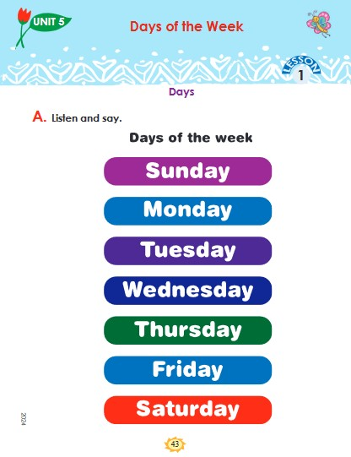
INTRODUCTION
Unit 5
Days of the week
Lesson 1: Days
Page : 43

Slide 4
Learning outcomes:
8.1 Recognising and using words frequently used in the texts for participating in everyday conversations

Slide 5
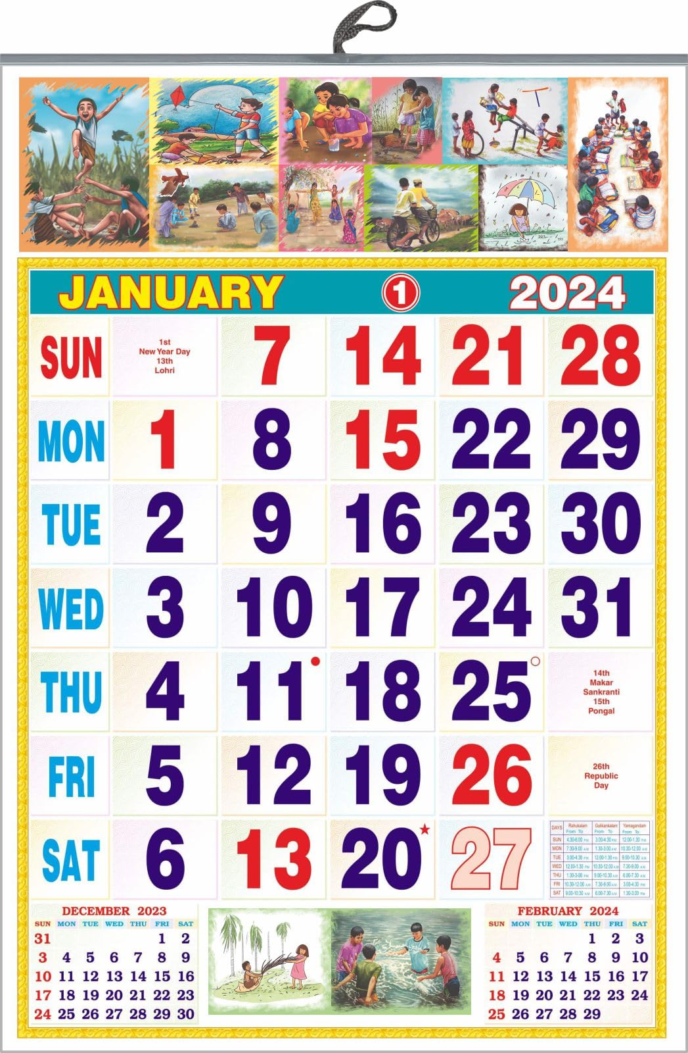
What is in this picture?

Slide 6

আজকের পাঠ
DAYS

Slide 7







Rearrange

Slide 8
Rearrange the DAYS(GW)
A
A
A
A
A
A
A
A
SUNDAY
D
D
D
D
D
D
D
D
MONDAY
E
E
E
F
H
I
M
TUESDAY
N
N
N
O
WEDNESDAY
THURSDAY
R
R
R
FRIDAY
S
S
S
S
S
SATURDAY
T
T
T
U
U
U
U
W
Y
Y
Y
Y
Y
Y
Y

Slide 9
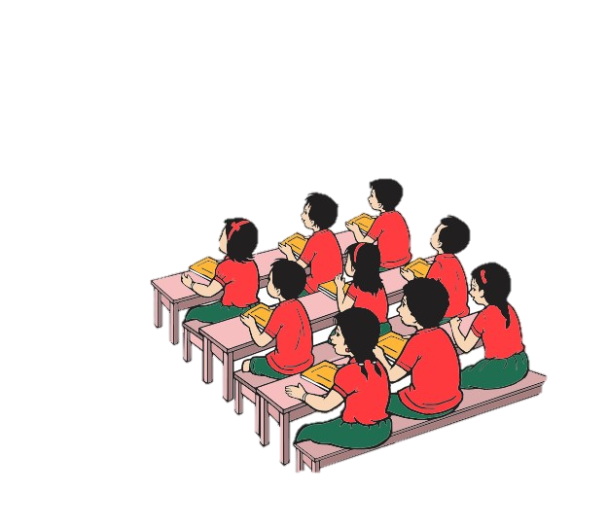
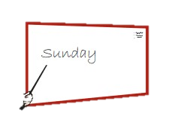
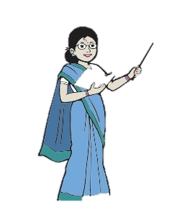
POINT AND SAY(WW)
Sunday
Tuesday
Monday
Thursday
Friday
Saturday
Wednesday
S4
S7
S5
S3
S1
S6
S2
Continue…….
S8…….

Slide 10
GOOD BYE

