Slide 1
English With Anisur Rahman
Cover
Add your lesson content here...
Lesson Information
Class: 3
Subject: English
Unit: 4 – Let's Play with Sounds and Numbers
Lesson: 1 (Continuation)
Pages: 49–51
Duration: 40–45 minutes
📚 English With Anisur Rahman | Learn English with Bangla Explanation

Slide 2
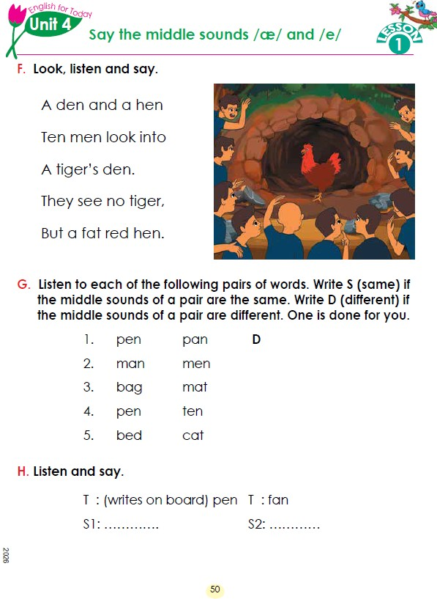
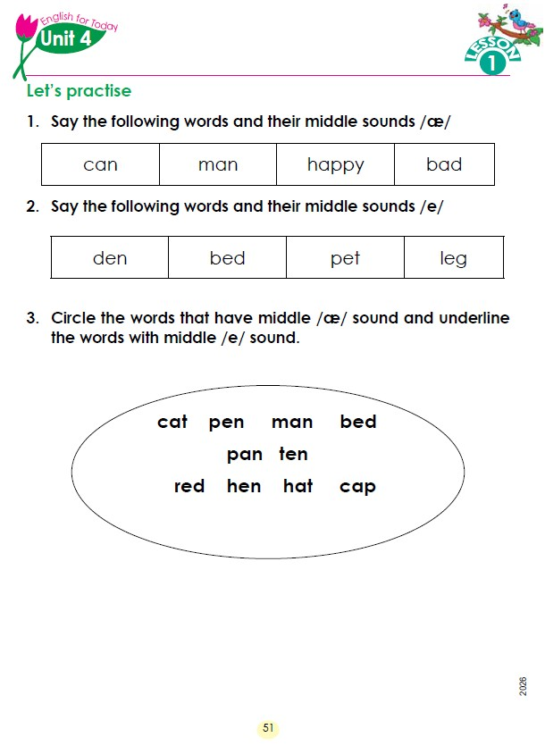
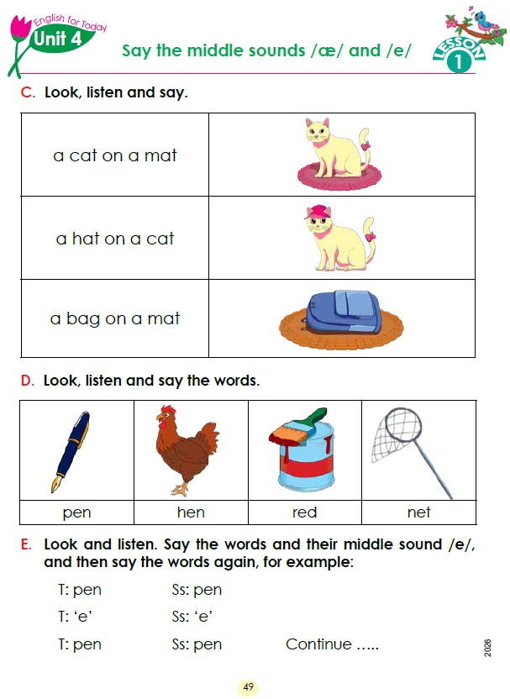
English With Anisur Rahman
Cover
Add your lesson content here...
📚 English With Anisur Rahman | Learn English with Bangla Explanation

Slide 3
English With Anisur Rahman
Learning Outcomes
Add your lesson content here...
🎯 Learning Outcomes
By the end of the lesson, students will be able to:
Recognise the middle sounds /æ/ and /e/.
Read simple words and sentences with correct pronunciation.
Compare words with the same and different middle sounds.
Identify and classify words based on vowel sounds.
📚 English With Anisur Rahman | Learn English with Bangla Explanation

Slide 4
English With Anisur Rahman
Warm-up
Add your lesson content here...
🌸 Greeting (2 minutes)
Assalamu Alaikum.
Good morning, everyone.
How are you today?
📚 English With Anisur Rahman | Learn English with Bangla Explanation

Slide 5
English With Anisur Rahman
Revision
Add your lesson content here...
Review Page 48.
Teacher asks:
What words did we learn?
Which sound did we learn yesterday?
Students answer:
bag
mat
hat
cat
Teacher:
Excellent!
Today we shall learn another sound.
/e/
📚 English With Anisur Rahman | Learn English with Bangla Explanation

Slide 6
English With Anisur Rahman
Vocabulary
Add your lesson content here...
Word | Bangla | Middle Sound
pen | কলম | /e/
hen | মুরগি | /e/
red | লাল | /e/
net | জাল | /e/
📚 English With Anisur Rahman | Learn English with Bangla Explanation

Slide 7
English With Anisur Rahman
Vocabulary
Add your lesson content here...
Word | Bangla
pen | কলম
hen | মুরগি
net | জাল
red | লাল
den | গর্ত / গুহা
tiger | বাঘ
fat | মোটা
leg | পা
pet | পোষা প্রাণী
happy | সুখী
📚 English With Anisur Rahman | Learn English with Bangla Explanation

Slide 8
English With Anisur Rahman
Activity C
Add your lesson content here...
📚 English With Anisur Rahman | Learn English with Bangla Explanation

Slide 9
English With Anisur Rahman
Activity D,E
Add your lesson content here...
📚 English With Anisur Rahman | Learn English with Bangla Explanation

Slide 10
English With Anisur Rahman
Activity F
Add your lesson content here...
📚 English With Anisur Rahman | Learn English with Bangla Explanation

Slide 11
English With Anisur Rahman
Activity G
Add your lesson content here...
📚 English With Anisur Rahman | Learn English with Bangla Explanation

Slide 12
English With Anisur Rahman
Activity H
Add your lesson content here...
📚 English With Anisur Rahman | Learn English with Bangla Explanation

Slide 13
English With Anisur Rahman
Activity H
Add your lesson content here...
📚 English With Anisur Rahman | Learn English with Bangla Explanation

Slide 14
English With Anisur Rahman
Pair Work
Add your lesson content here...
📚 English With Anisur Rahman | Learn English with Bangla Explanation

Slide 15
English With Anisur Rahman
Practice
Add your lesson content here...
📚 English With Anisur Rahman | Learn English with Bangla Explanation

Slide 16
English With Anisur Rahman
Quiz
Add your lesson content here...
📚 English With Anisur Rahman | Learn English with Bangla Explanation

Slide 17
English With Anisur Rahman
Assessment
Add your lesson content here...
📚 English With Anisur Rahman | Learn English with Bangla Explanation

Slide 18
English With Anisur Rahman
Homework
Add your lesson content here...
📚 English With Anisur Rahman | Learn English with Bangla Explanation

Slide 19
English With Anisur Rahman
Thank You
Add your lesson content here...
Thank You
Wish you all the best.
📚 English With Anisur Rahman | Learn English with Bangla Explanation

