Slide 1

Nasrin Jahan

Slide 2
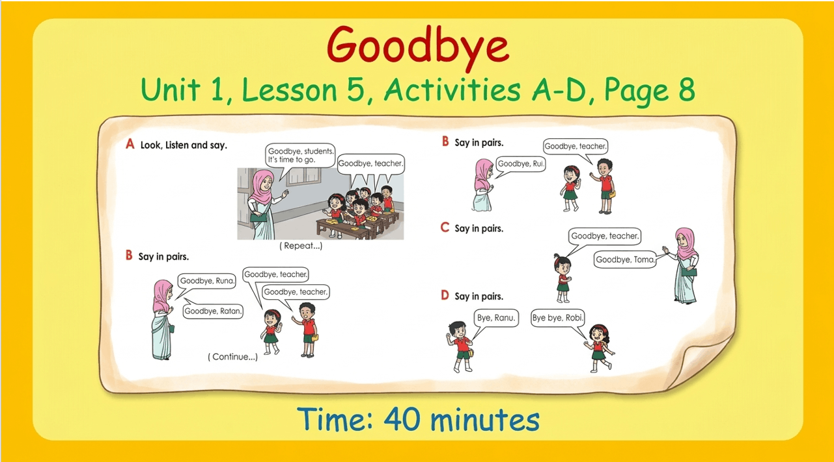
Nasrin Jahan

Slide 3
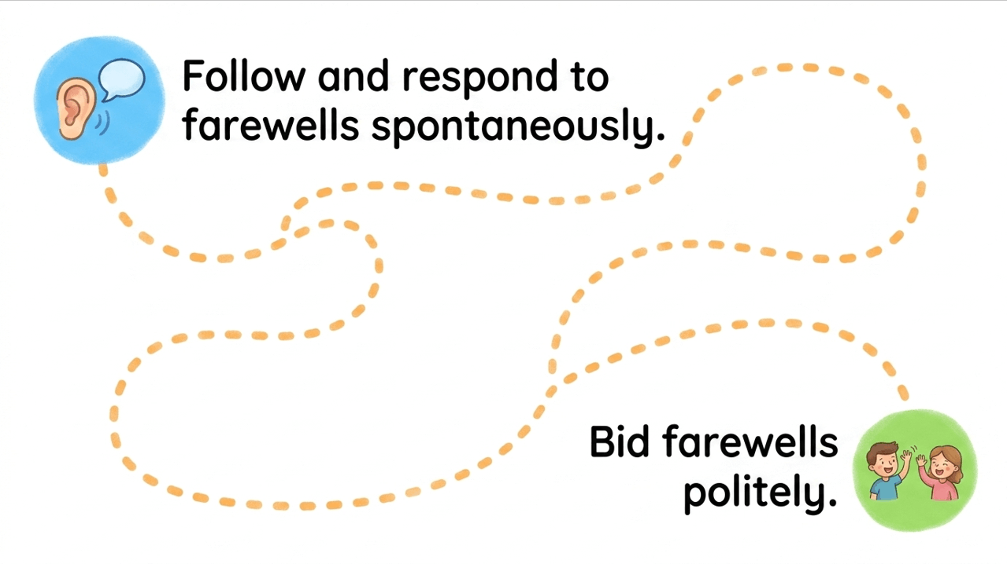
Nasrin Jahan

Slide 4
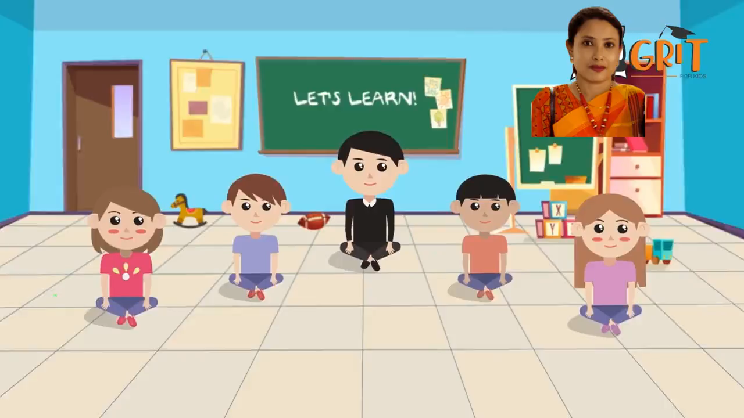
Nasrin Jahan

Slide 5

Nasrin Jahan

Slide 6

Nasrin Jahan

Slide 7

Nasrin Jahan

Slide 8
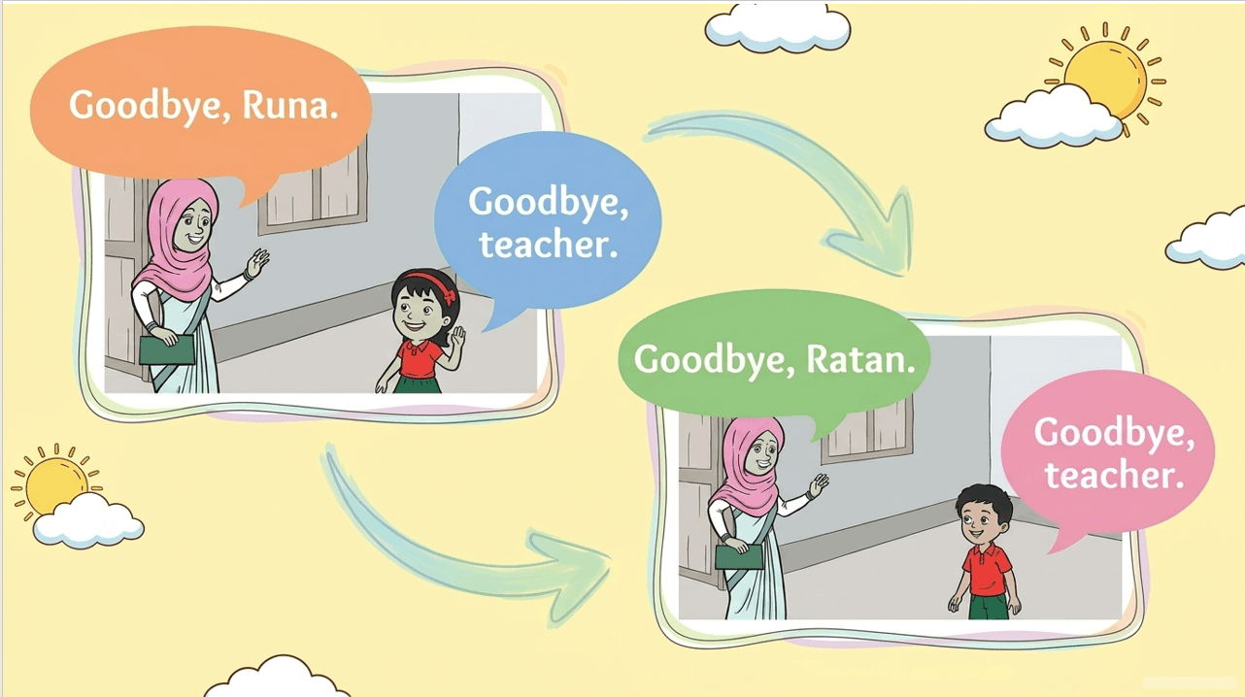
Nasrin Jahan

Slide 9
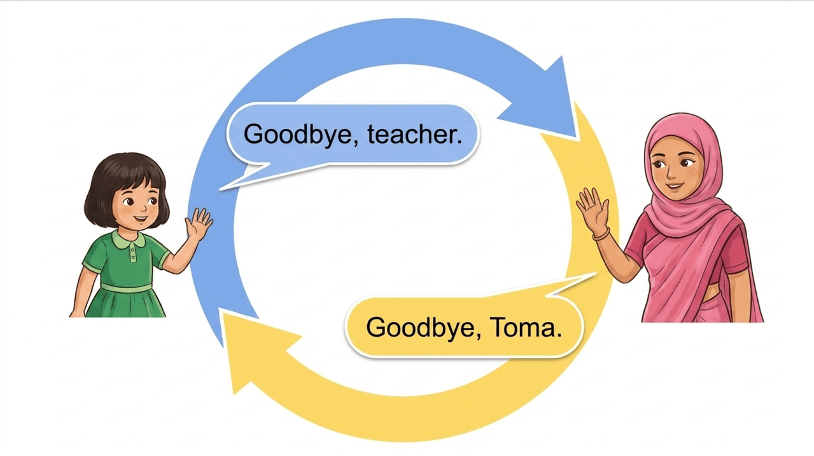
Nasrin Jahan

Slide 10
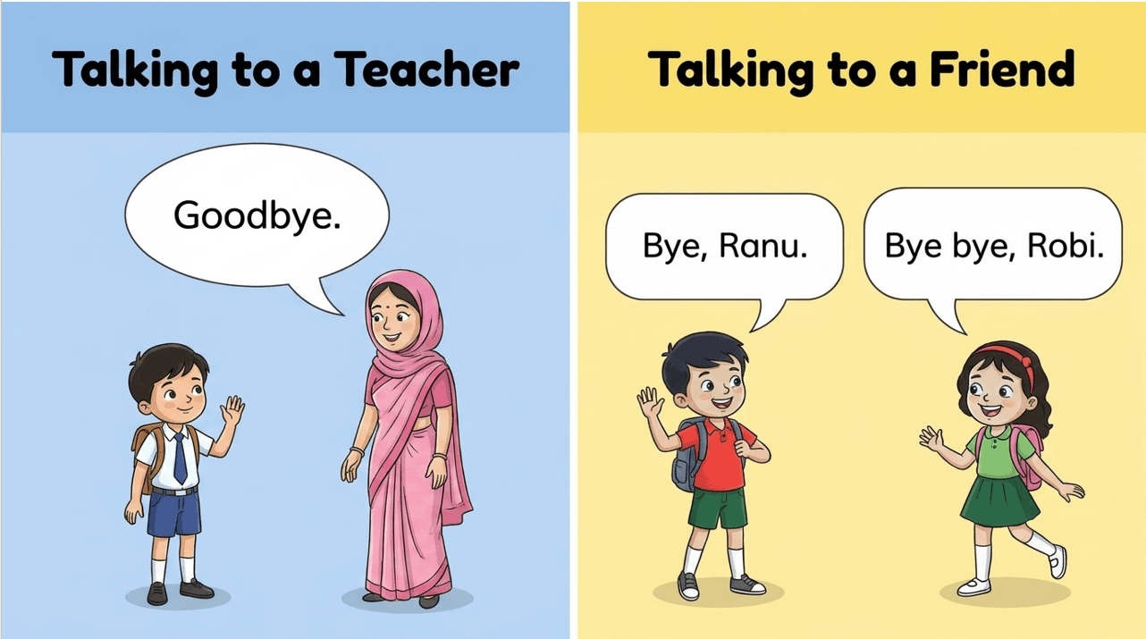
Nasrin Jahan

Slide 11


Slide 12

Nasrin Jahan

Slide 13

Nasrin Jahan

