Slide 1
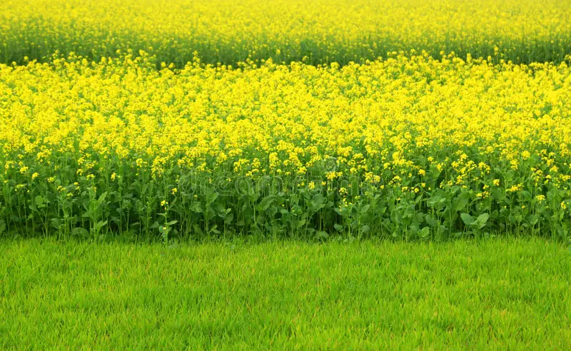
Good Morning

Slide 2
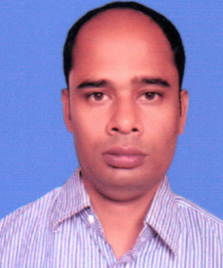
TEACHER’S INFORMATION:
Nittananda Shaha
ASSISTANT TEACHER
SABOIL GOVT. PRIMARY
SCHOOL
MOHADEBPUR, NAOGAON

Slide 3
Lesson Introduction
Class :5
Unit :16
Title : The Giving Tree
Page : 82-90 ( Activity : 1.1, 1.2, 2.1, 2.2, 3.1, 3.1.1, 3.1.2, 3.1.3, 4.1 )

Slide 4
1.1Look at the picture attentively. Ask and answer the following questions in pairs.
a) What is your favourite tree? Why do you like?
b) How do the trees help us?

Slide 5
Announcement of the Lesson
The Giving Tree
Write out in your khata

Slide 6
Vocabulery
Meening
Word
gather
to bring or come together
crowns
an ornamental headdress worn by a monarch as a symbol of sovereignty
king
a male monarch or sovereign ruler of a nation
forest
a large, complex ecosystem characterized by a dense growth of trees, shrubs, and other vegetation
Climb up
to move upward toward the top of something
brances
a secondary part
trunk
The thick, main woody stem of a tree that supports the branches.

Slide 7
1.2 Read the story .
Once there was a tree and she loved a little boy. Every day the boy would gather leaves and make them into crowns. He would play king of the forest wearing the crown. He would climb up her trunk and swing from her branches . When he was tired , he would sleep in her shade. The boy loved the tree very much. And the tree was happy.
But time went by. The boy grew older. He stopped playing with the tree . And the tree was often alone.

Slide 8
Then one day the boy came to the tree. The tree said, ‘Come, Boy , come and climb up my trunk. Swing from my branches and eat apples. Play in my shade and be happy.’ ‘I am too big to climb and play,’ said the boy. ‘I want to buy things. I want some money. Can you give me some money?’
‘I'm sorry,’ said the tree. ‘I have no money. I have only leaves and
apples. Take my apples, Boy, and sell them in the city’. And so, the boy climbed up the tree and gathered her apples. And the tree was happy.

Slide 9
But the boy stayed away for a long time. And then one day the boy came back . The tree shook with joy. She said , ‘Come, Boy, climb up my trunk. Swing from my branches and be happy.’ ‘I am too busy to climb trees,’ said the boy. ‘I want a house to keep me warm,’ he said .‘ Can you give me a house?’ ‘I have no house,’ said the tree. ‘The forest is my house. But you may cut off my branches and build a house. Then you will be happy .’ So, the boy cut off her branches and carried them away to build his house. And the tree was happy.

Slide 10
But the boy stayed away for a long time. And when he came back, the tree was very happy. ‘Come, Boy,’ she whispered, ‘come and play.’ ‘I am too old and sad to play’ said the boy.
‘I want a boat that will take me far away from here. Can
you give me a boat?’

Slide 11
‘Cut down my trunk and make a boat,’ said the tree. And be happy . ’And so, the boy cut down her trunk and made a boat to sail away. And the tree was happy, but not really
And after a long time, the boy came back again. ‘I am sorry, Boy’ said the tree, ‘but I have nothing left to give you.’ My apples are gone, my branches are gone, my trunk is gone. I am just an old stump,’ said the tree. ‘I don’t need very much now. Just a quiet place to sit and rest. I am very tired,’ said the boy. ‘Well ,” said the tree , ’come, Boy, sit down and rest.’ And the boy did. And the tree was happy.

Slide 12
2.1 Discuss in pairs whether the sentences are True or False. If ‘False’ , give the correct information.
a) The tree didn't love the little boy.
False
The tree loved the little boy.
b) In a small village
b) The boy would sleep in the tree's shade when he was tired.
True
c) The tree was often alone because the boy grew older.
True
d) Her school
d) The tree gave the boy money.
False
The tree gave the boy apples to sell for money.
e) The boy cut off the tree’s branches to build a house.
True
f) The boy cut down the tree's trunk and made furniture.
False
The boy cut down the tree's trunk to made boat.
g) The tree was not really happy when the boy made a boat.
False
b) By making sure she can see the board
The tree was happy, even though she was sad to love her trunk.
h) The boy came back to the tree after a long time.
True
i) The tree had more apples, branches, or trunk to give to the boy.
False
The tree had nothing left, only a stump.
True
j) The boy wanted a quiet place to rest when he was old and tired.

Slide 13
2.2 Read the story again. Answers to the following questions .
a)What things did the boy take from the tree?
Ans: The boy took apples, branches and the trunk from the tree.
b) Was the tree really happy when the boy took her things?
Ans : The tree was happy when she gave the boy her apple and branches. However, after giving her trunk, she was not happy in the true sense. Actually, at the end, the tree had nothing left with her to offer the boy.
c) Did the boy give anything to the tree?
Ans: No , the boy didn’t give anything to the tree.

Slide 14
d) Could the tree help the boy when it was just a stump?
Ans: Yes, the tree could help the boy when it was just a stump . When the boy , now old and tired, came to the tree,it let him sit and rest on it’s stump.
e) What can we learn from the story?
Ans : From the story , we can learn about love , kindness , and selflessness – true happiness comes from giving , not taking.

Slide 15
d) Could the tree help the boy when it was just a stump?
Ans: Yes, the tree could help the boy when it was just a stump . When the boy , now old and tired, came to the tree,it let him sit and rest on it’s stump.
e) What can we learn from the story?
Ans : From the story , we can learn about love , kindness , and selflessness – true happiness comes from giving , not taking.

Slide 16
3.1 Language Focus: Wh-questions
Wh-pronoun
Rules
Examples
Who
to ask about people.
Who is your friend?
What
to ask about things or activities.
What is your favourite book?
We use
When
to ask about time.
When is your birthday?
Where
to ask about places.
Where do you live?
Why
to ask for reasons.
Why do you like ice-cream?
Which
To ask for a specific choice from a set of options.
Which colour do you prefer?
How
to ask about manner, quantity, or quality.
How many pencils do you have?
Whom
to ask about person.
Whom did you give the book?
Whose
to ask question about ownership or possession.
Whose book is this?

Slide 17
3.1.1Notice the underlined word(s) of the following statements . And make questions on them. The first one is done for you.
a) Statement: The boy loved the tree very much.
Question: Who loved the tree very much?
b) Statement: He would sleep in her shade.
Question : Where would he sleep?
c) Statement: The boy sold the apples in the city.
Question: What did the boy sell in the city?
d) Statement: The tree felt happy helping the boy.
Question: How did the tree feel helping the boy?
e) Statement: The boy made a boat.
Question: What did the boy make?
f) Statement: The boy could not climb the tree because he grew up.
Question: Why could the boy not climb up the tree?
g) Statement: The boy came back to the tree after a long time.
Question : When did the boy come back to the tree?

Slide 18
3.1.2 Make question taking word(s) from all the three columns.
the boy sleep in her shade?
Who
the tree?
What
loved
the boy build his house?
Where
When
did
the tree give the boy anything?
Why
didn't
the boy make?
How
the boy sell the apples?
Who
loved
the tree?
the boy make?
What
did
the boy sell the apples?
Where
did
When
did
the boy sleep in her shade?
Why
didn't
the tree give the boy anything?
the boy build his house?
How
did

Slide 19
3.1.3 Look at the questions in the following speech bubbles and
write their answers in the speech bubble boxes.
What is your favourite book?
My favourite book is Harry Potter.
When do you go to School?
I go to school at 8.30 am.
Where do you live?
I live in Dhaka.
Why do you like ice-cream?
I love ice-cream because it is sweet and cold.
How do you go to school?
I go to school by bus.
Who is your English teacher?
Mr.Rahman is my English teacher.
Now, practise the dialogues in pairs with proper stress and intonation.

Slide 20
4.1 Sit in a group of six and pass a small ball around. When you get the ball, select a topic from the box and ask Wh-questions on the topic.
School
hobby
family
pets
sports
favourite
book
holidays
festivals
Teacher
friends
One is done for you:
Student 1:
Favourite book
What is your favourite book?
Student 2:
My favourite book is …….

Slide 21
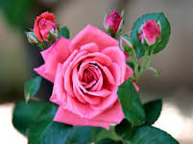
T
H
A
N
K
Y
O
u

