Slide 1


Slide 2


Slide 3
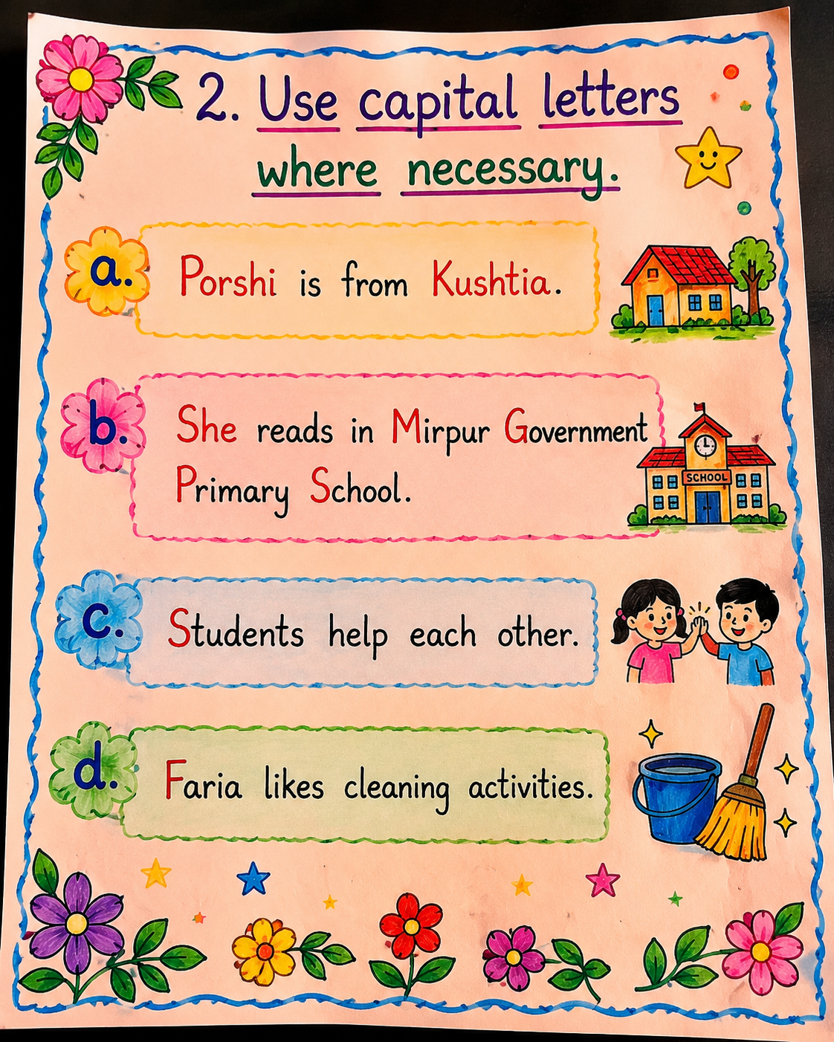

Slide 4
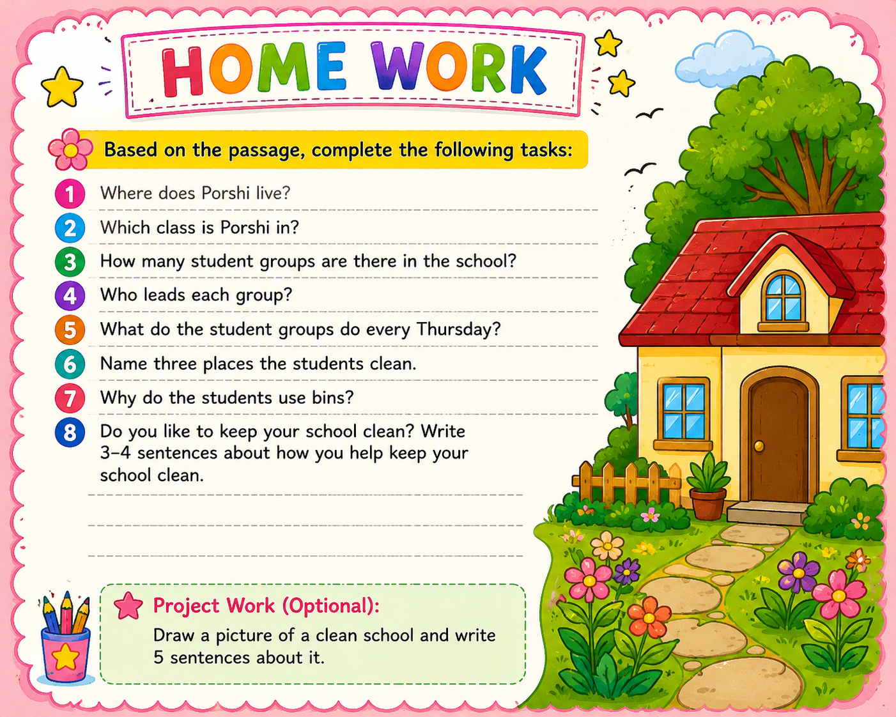

Slide 5
Thank you all

