Slide 2
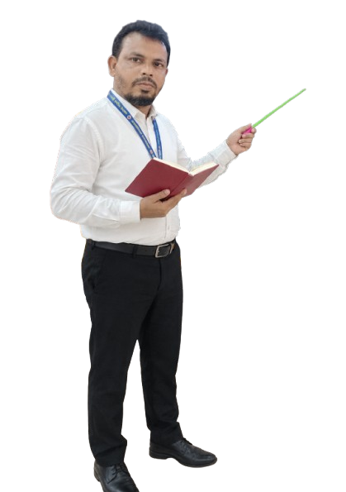


MD KOYES AHMED
Unit 5
Days of the week
Lesson 5:
How does a plant grow?
Session: 8
C, D
Page : 51
Assistant Teacher
Mohammadpur A. Gofur GPS
Dakshin Surma, Sylhet.
E-mail: koyesdsurma.syl@gmail.com
Mobile: 01710504502.

Slide 3
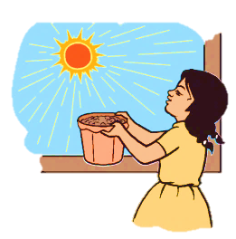
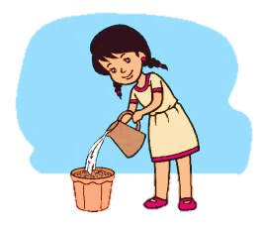
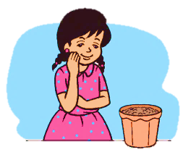
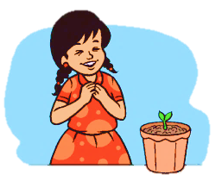

Slide 4
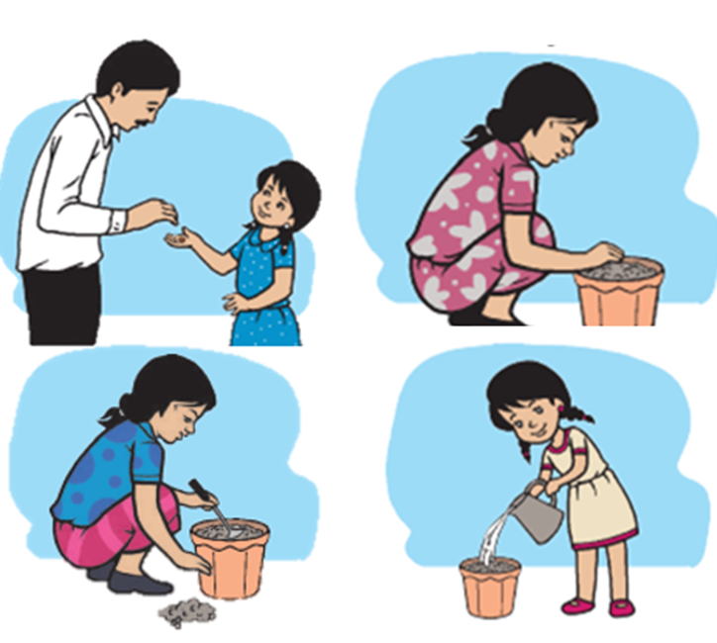

Slide 5
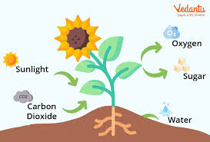
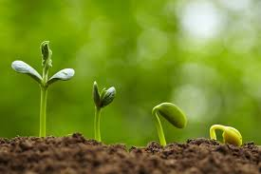
We are going to learn a story
How does a plant grow????
????

Slide 6
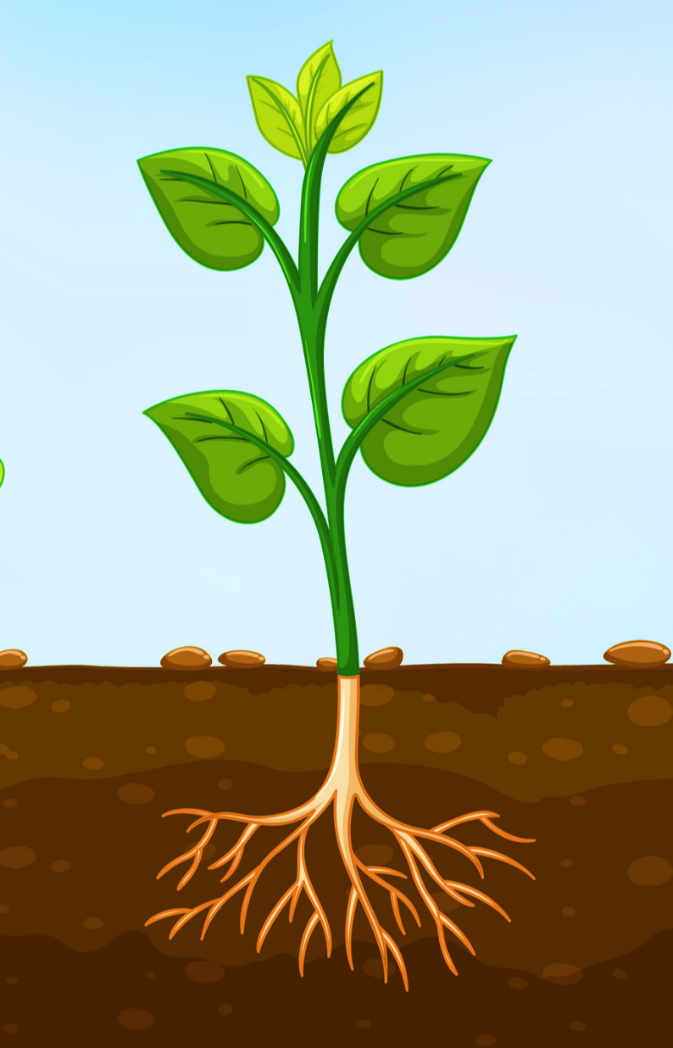
Plant
leaves

Slide 7

On Wednesday, Rima puts the pot in the sun.

Slide 8
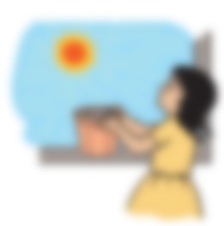
Rima waters the seed again on Thursday.

Slide 9
On Friday, Rima waits.

Slide 10
On Saturday, Rima sees something in the pot. It’s a small plant with two leaves!

Slide 11
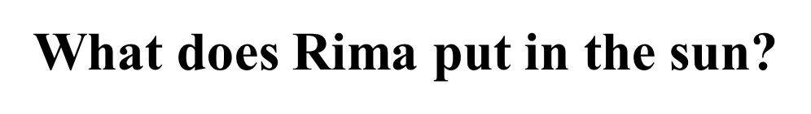

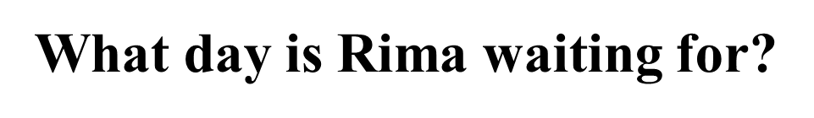

Click on sentence

Slide 12
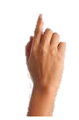
On Saturday , Rima sees something in the pot. It’s a small plant with two leaves !
On Friday, Rima waits.
Rima waters the seed again on Thursday.
On Wednesday, Rima puts the pot in the sun.

Slide 13
On Saturday , Rima sees something in the pot. It’s a small plant with two leaves !
On Friday, Rima waits.
Rima waters the seed again on Thursday.
On Wednesday, Rima puts the pot in the sun.

Slide 14

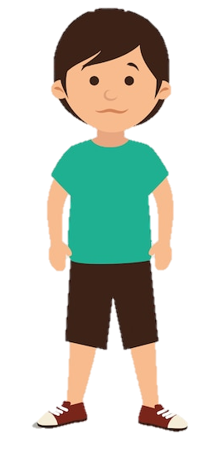
On Wednesday, Rima………………
On Thursday, Rima ……………….
On Friday, Rima……..
On Saturday, Rima ……………

Slide 15
Write down the name of seven days in a week
in the handwriting notebook

