Slide 1
WELCOME
TO THE
ENGLISH
CLASS

Slide 2

TEACHER
Aysha Siddika Auntara
Assistant Teacher
Kolapara Government Primary School
Sreenagar, Munshiganj

Slide 3




Lession
Title: Making Request
Class- Five
Subject- English
Unit-11 , Activity-2.1, 2.2
Time-40 minutes
Date: /06/2026

Slide 4
Learning Outcomes
Students will be able to –
3.3.3 make requests for everyday communication clearly and confidently
3.3.2 give simple directions with appropriate gesture
5.1.2 get the specific information from the simple text

Slide 5
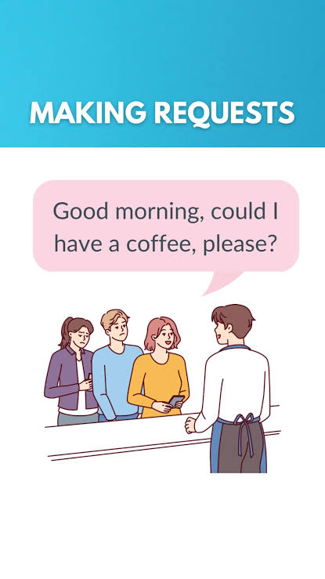

Slide 6
In the conversation Salma politely asked for something and Mamun gave direction to Salma on how to get to the library.
Today we will list what type of language they used for asking something and giving directions.

Slide 7
Turn to page 55

Slide 8
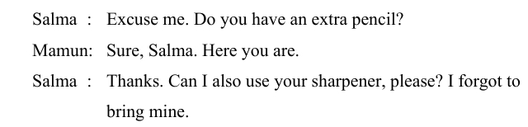

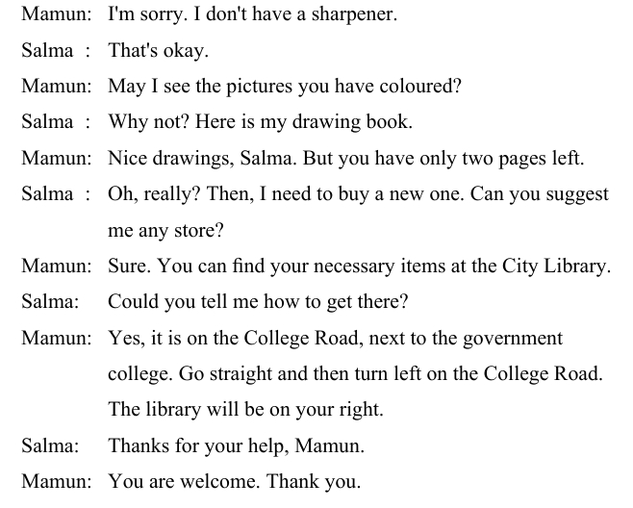
Let’s make a list of what type of language they used for asking something. One is done for you.

Slide 9
Group Work
Discuss in group and make a list of more sentences (at least 4) about asking for something.
Ruler
Book
Sharpener
Pencil
Crayon
Ball
Visual Support:
May I have your ________,please?
Can you give me your _______, please?

Slide 10
Let’s make a list of what type of language they used for giving directions,
Go straight
Turn Left
Turn right

Slide 11
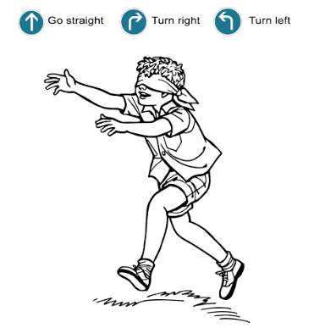
Game Time!
‘Blind Guide’
In this game there would be two teams. Each team will send two persons. One will be blindfolded and the other one will be his/her guide. The guide will instruct his/her classmate to reach the destination. The team that will reach the destination first, would be the winner. You can use English only. If someone uses Bangla while playing that team will be disqualified.

Slide 12
Thank you so much

