Slide 1
Welcome

Slide 2
MD. GAUSUL HAQUE
SENIOR TEACHER
KALIKAPUR CHOWKUNI ML. HIGH SCHOOL
KOYRA, KHULNA

Slide 3
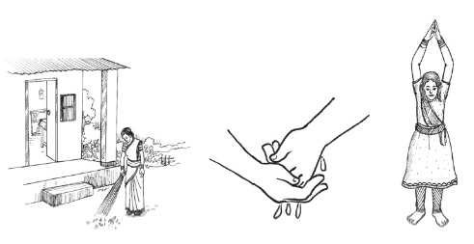

Slide 4
ENGLISH FOR TODAY
CLASS-8
UNIT: 3
LESSON:1
HEALTH & HYGIENE

Slide 6
Key Words
Disease : Illness, Sickness, Ill health
Essential : Necessary, Vital, Required
Concentrate : Focus, Centre

Slide 7
Thank You

