Slide 1

Welcome

Slide 2
Name: Md. Ismoddoha Suvho
Designation: Assistant Teacher
School: 69No. Dokkhin Nojumoddin Bepari Kandi Tufan Ullah Govt. Primary School
Teacher
Introduction

Slide 3
Lesson Introduction
Class: Three
Subject: English for Today
Unit: 5
Lesson: 2
Lesson Title: Joyful School Time 2
Lesson Part: (Review Sessions 64 & 65)
Page: 68-69
Time: 40 Minutes

Slide 4
Learning Outcomes
4.2 Reading aloud simple sentences with proper stress, intonation and punctuation.
9.1 Recognising and using capitalization and punctuation marks for meaningful communication. (full stop)

Slide 5
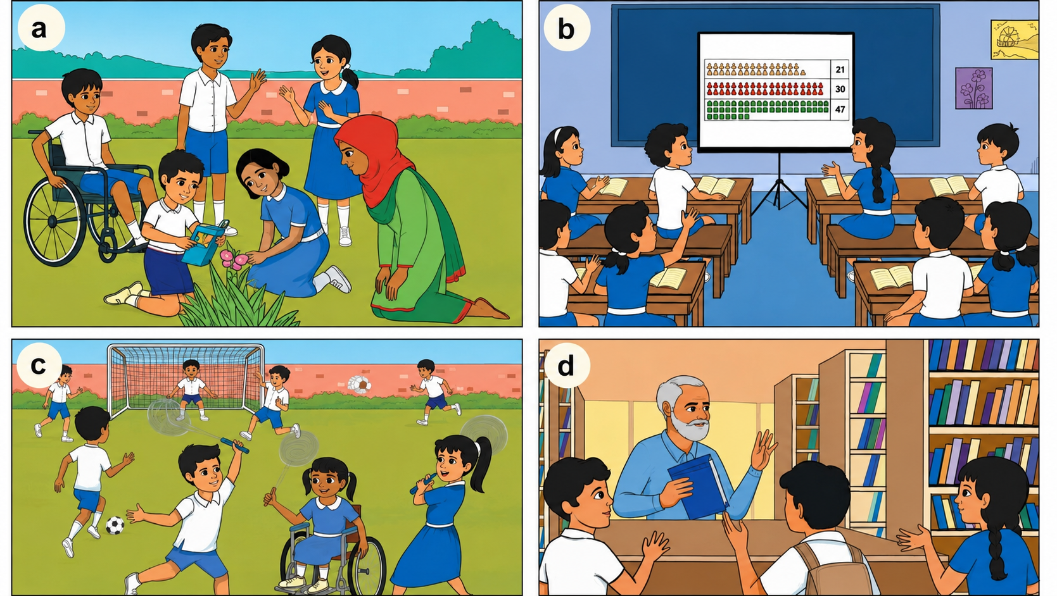
Who are in the pictures?

Slide 6
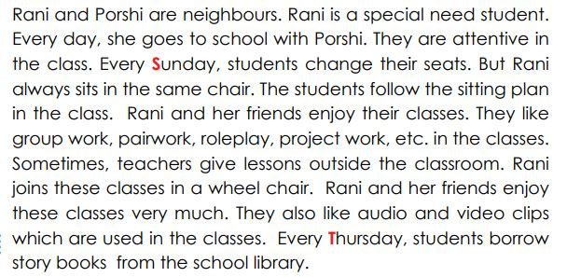
Find Noun, Pronoun and Verb

Slide 7

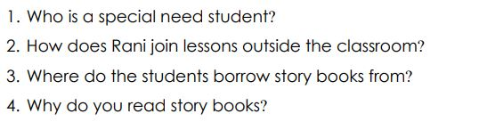
Write the correct answer in group

Slide 8
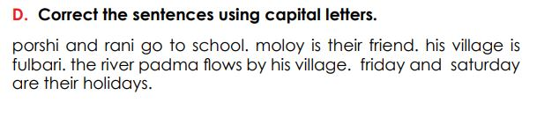
Write correct sentences using capital letters in your notebook

Slide 9
Compare with your answers
Porshi and Rani go to school. Moloy is their friend. His village is Fulbari. The river Padma flows by his village. Friday and Saturday are their holidays.

Slide 10
Home work
Find out all noun, pronoun and verb from Activity B from page no. 65 and 68 and write down in your notebook.

Slide 11

Good Bye

