Slide 1
WELCOME
TO THE
ENGLISH
CLASS

Slide 2
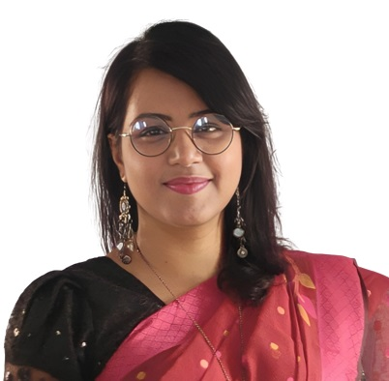
TEACHER
Aysha Siddika Auntara
Assistant Teacher
Kolapara Government Primary School
Sreenagar, Munshiganj

Slide 3




Lession
Title: Making Request
Class- Five
Subject- English
Unit-11 , Activity-1.1, 1.2
Time-40 minutes
Date: /06/2026

Slide 4
Learning Outcomes
Students will be able to –
4.2.1 read aloud texts with proper stress, intonation
8.1.2 recognize and use a range of words and phrases in written communication

Slide 5
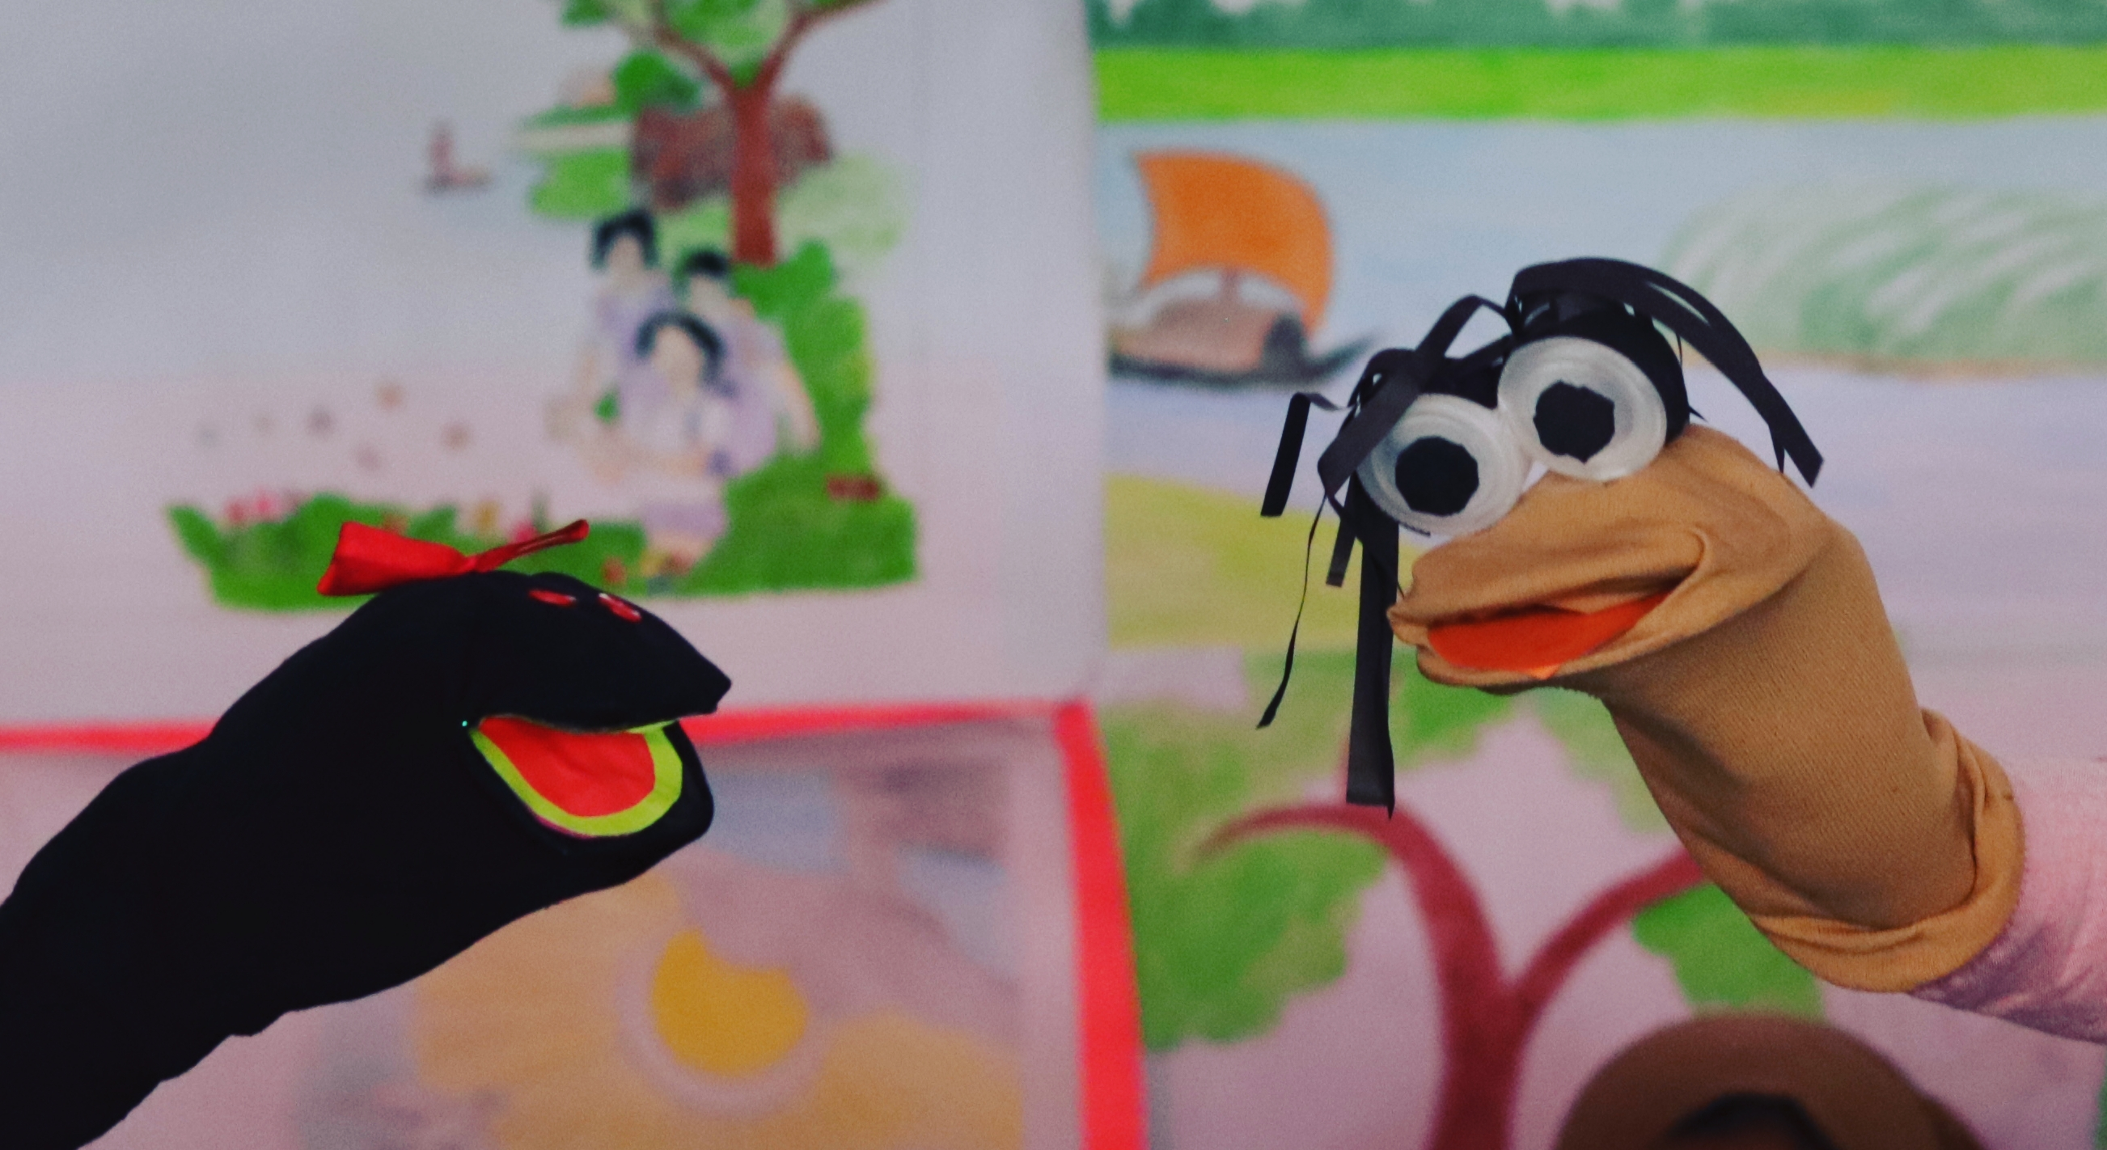
Let’s watch a puppet show!

Slide 6
Rinku: Excuse me. May I have your pencil, please?
Jhinku: Of course. Here you go.
Rinku: Thank you. Can you please give me a paper, please?
Jhinku: Sure!
Rinku: Thanks.
Jhinku: You’re welcome. May I have your sharpener, please?
Rinku: Yes. Here you go.
Jhinku: Thank you.

Slide 7
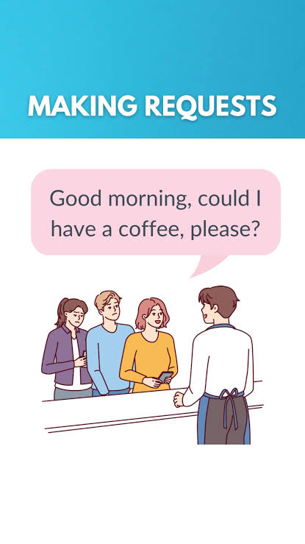

Slide 8
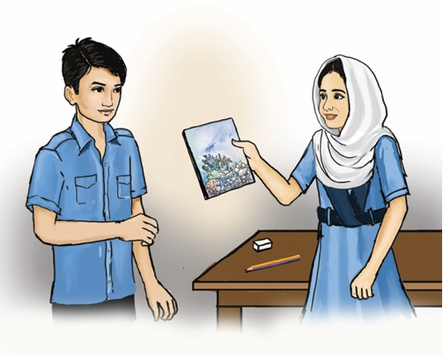
Making Request

Slide 9
What do you see in the picture?

Slide 10
What do you think they are talking about?

Slide 11
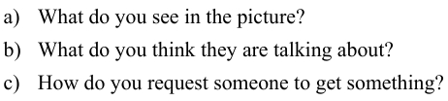
Discuss the following questions in pair.

Slide 12

New words
Sharpener
S-h-a-r-p-e-n-e-r
a thing we use to sharp pencil
May I have your sharpener, please?
Suggest
S-u-g-g-e-s-t
to propose or advise
Can you suggest me a good store?
Necessary
N-e-c-e-s-s-a-r-y
Need
Good food is necessary for good health.

Slide 13
Straight
S-t-r-a-i-g-h-t
direct
Go straight.
Left
L-e-f-t
Going left
Turn left
Right
R-i-g-h-t
Going right
Turn right
Write down these words and sentences in your exercise book.

Slide 14
Turn to page 55

Slide 15
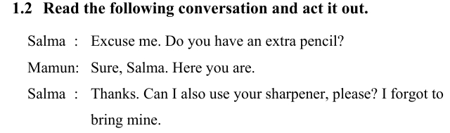
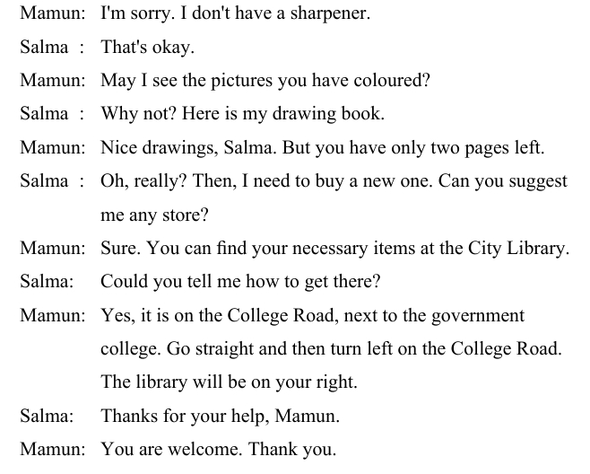
Listen to me and put your finger under the line

Slide 17
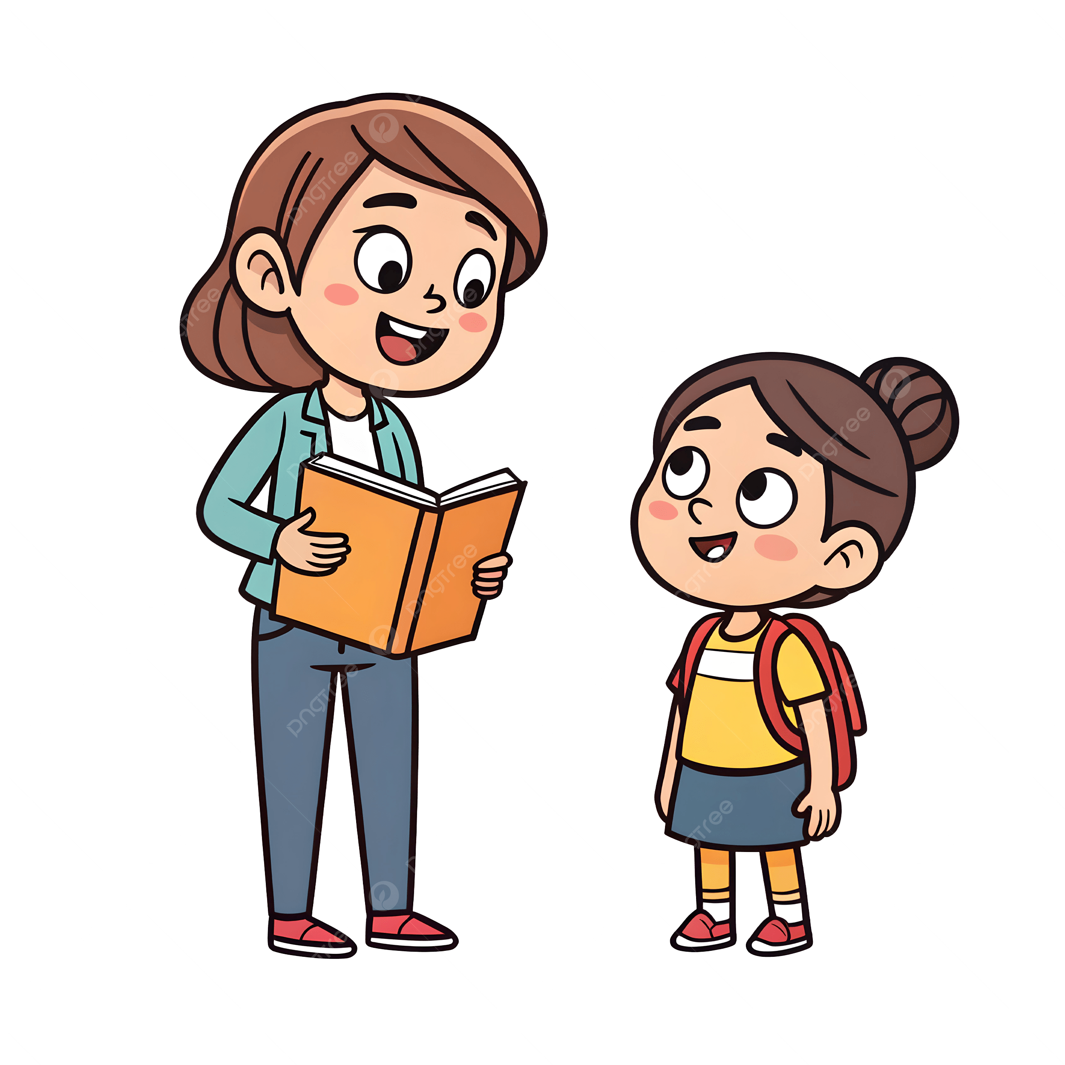
Listen to me and my partner
T and s pair

Slide 18
Listen to your class mates
S and s pair

Slide 19
Pair Work
Find a partner and make a pair.
Act the conversation out with your pair

Slide 20

One pair will come to the front and act this conversation out

Slide 21
Thank you so much

