Slide 2


MD KOYES AHMED
Class: Three
Sub: English
Unit: 3
Lesson: 1
Session: 1
Page: 34
Assistant Teacher
Mohammadpur A. Gofur GPS
Dakshin Surma, Sylhet.
E-mail: koyesdsurma.syl@gmail.com
Mobile: 01710504502.
Subject: English
Grade-3
Unit: 3
Lesson: 1
Session- 1
Session Duration: 45 minutes
Page-26

Slide 3
Become familiar with English sounds by listening to common English words.
Carrying out commands, instructions and requests in everyday life with appropriate gesture.
say simple words and phrases with proper sounds and stress.
recognize and read the name of objects having the same initial and final sounds.

Slide 4

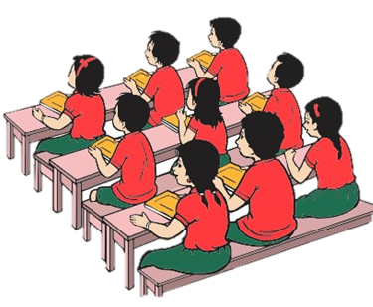
Lead in
Review of the previous session
Ask ss “What did we learn in our last class?”

Slide 5
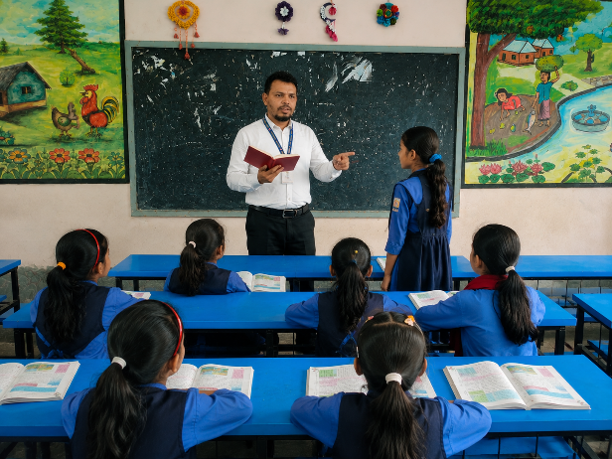
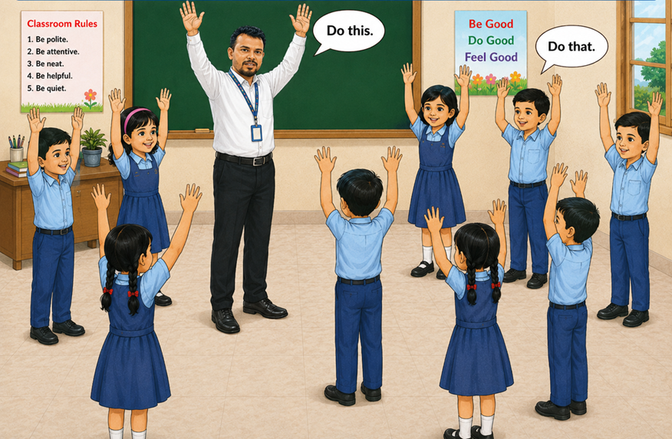
Look at the picture!
What can you see in the picture?
“Who can hands up?”
“Who can do like picture?”

Slide 6

Today’s lesson is
commands

Slide 7
Let's watch this video and you do with action
Raise your right hand up,
Put your right hand down.
Up down, up down
Then turn around.
Put your hands together
And clap like this
That’s what we do today
Hey!

Slide 8
Look ,Listen and repeat after me
Ask the ss, “What are they doing?” What am I doing?
Encourage them to answer, “Standing/ playing/ reading/raising hands/talking ………..etc.”

Slide 9
“Let’s play the game ‘Do this. Do that’ altogether”.
follow first.
Do do
This this
Do do
That that
Do this
Do that
This this
That that

Slide 10

Listen instructions and do this!

Slide 11
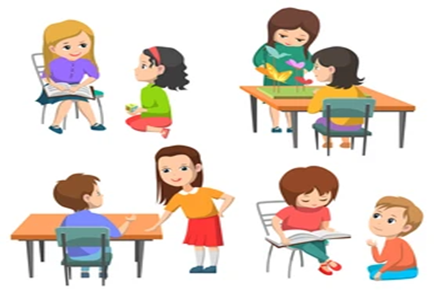
Now One command the instructions, other do this
Continue the practice by changing students role

Slide 12
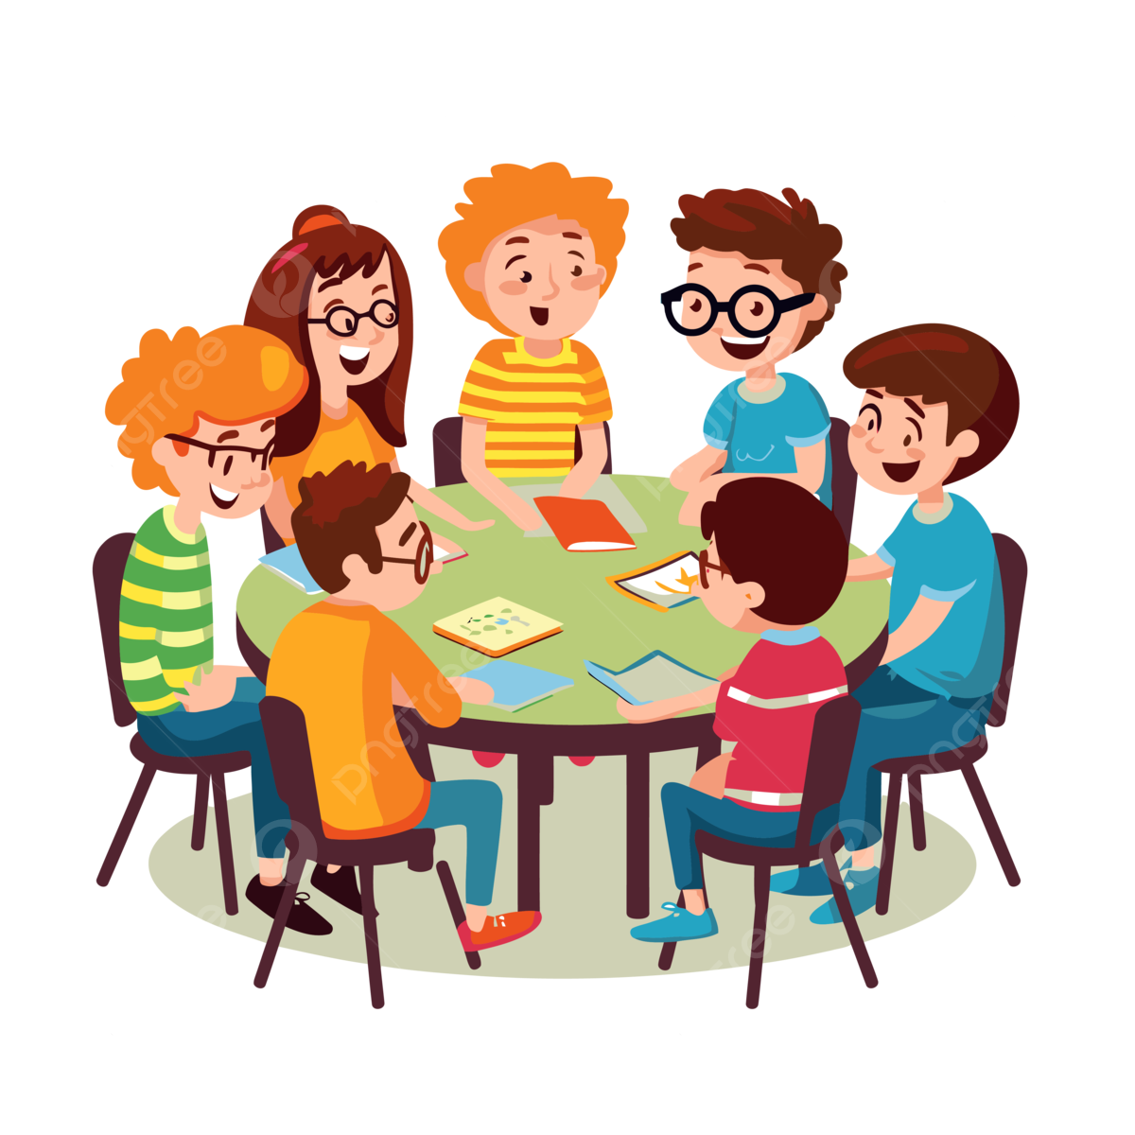
Ask each group to practice in groups

Slide 13
Call randomly two students name for showing action in front of the class.
Click on the word

Slide 14
Record the rhyme and send it me

