Slide 1

WELCOME

Slide 2
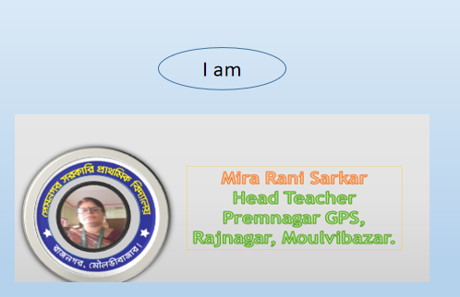

Slide 3
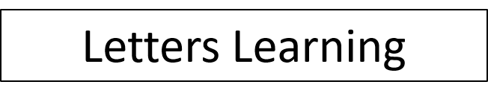



Slide 4



Slide 5

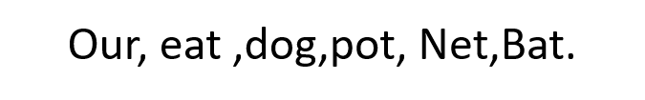

Slide 6


Market , Go, Eat .Good . Fiower.

Slide 7
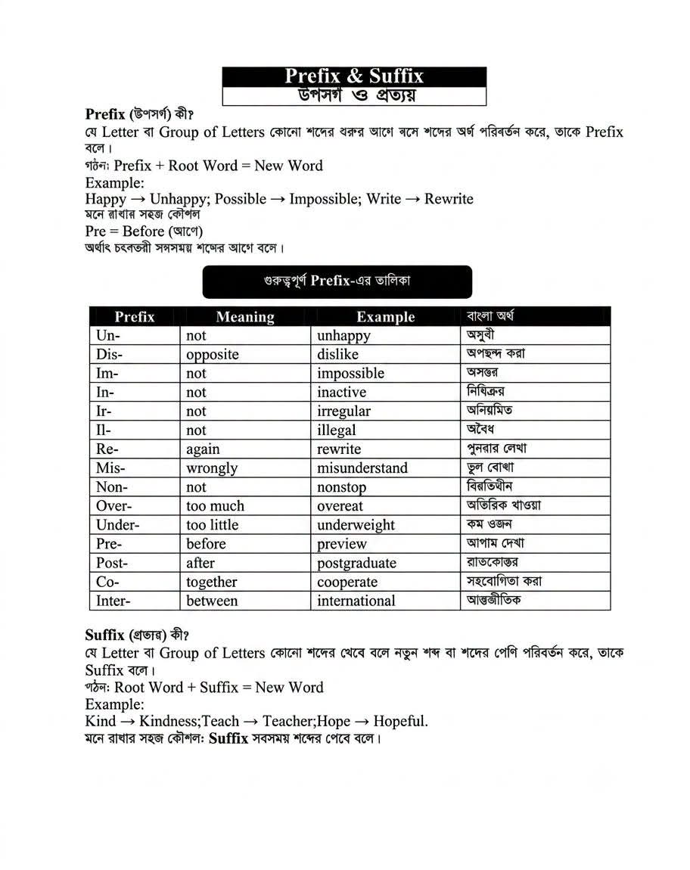

Slide 8
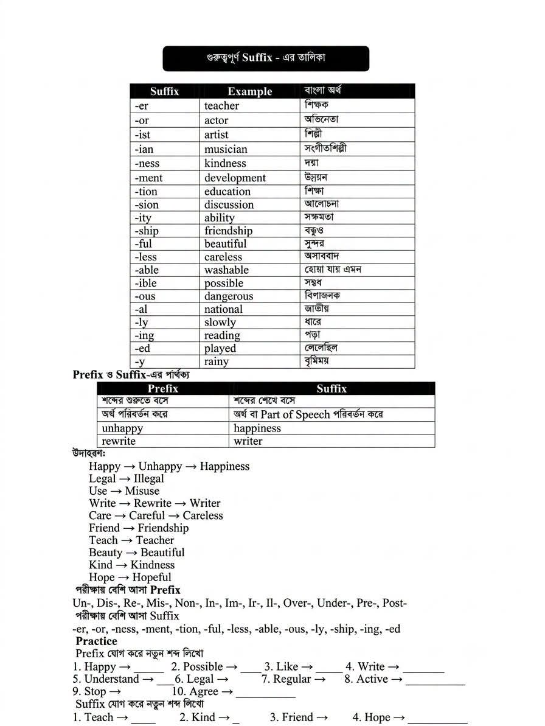

Slide 9
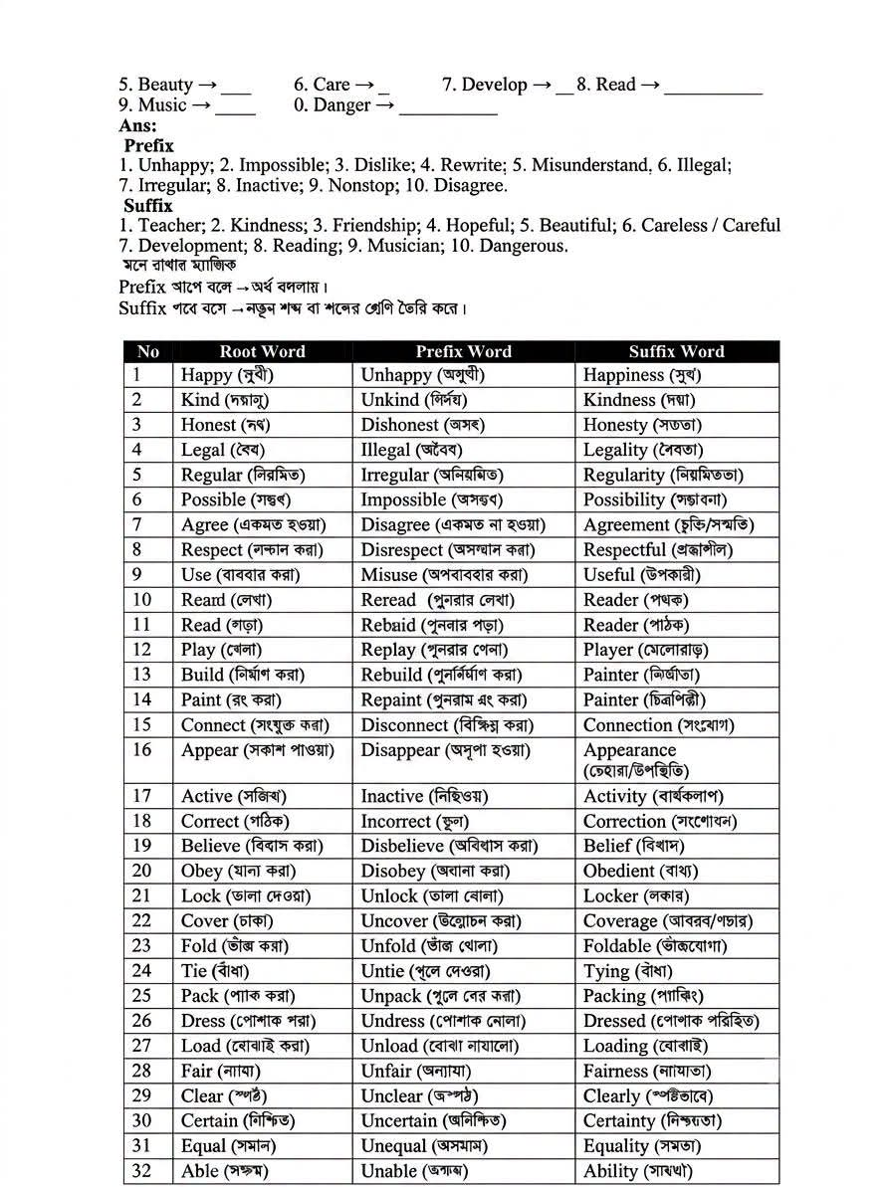

Slide 10
THANK YOU, GOOD BYE.

