Slide 1

Welcome

Slide 2



Teacher Information
Name: Md. Ismoddoha Suvho
Designation: Assistant Teacher
School: 69No. Dokkhin Nojumoddin Bepari Kandi Tufan Ullah Govt. Primary School
District: Shariatpur

Slide 3
Lesson Introduction
Class: Two
Subject: English for Today
Unit: 7
Lesson: 2
Lesson Title: Rainbow
Lesson Part: Seven Colours Make Rainbow
Activity: A
Session: 63
Page: 65
Time: 40 Minutes

Slide 4
Learning Outcomes
2.1.1 Listen to rhymes and respond with joy.

Slide 5

What did we learn
in the last class?

Slide 6







Red
Orange
Yellow
Green
Blue
Violet
Indigo

Slide 7
Let’s sing a song

Slide 8
Today we are going to recite the rhyme
Rainbow

Slide 9
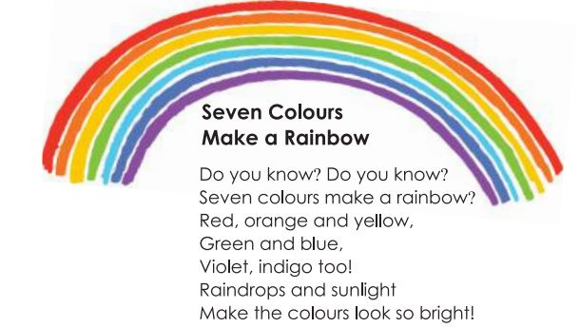
Repeat after me twice

Slide 10
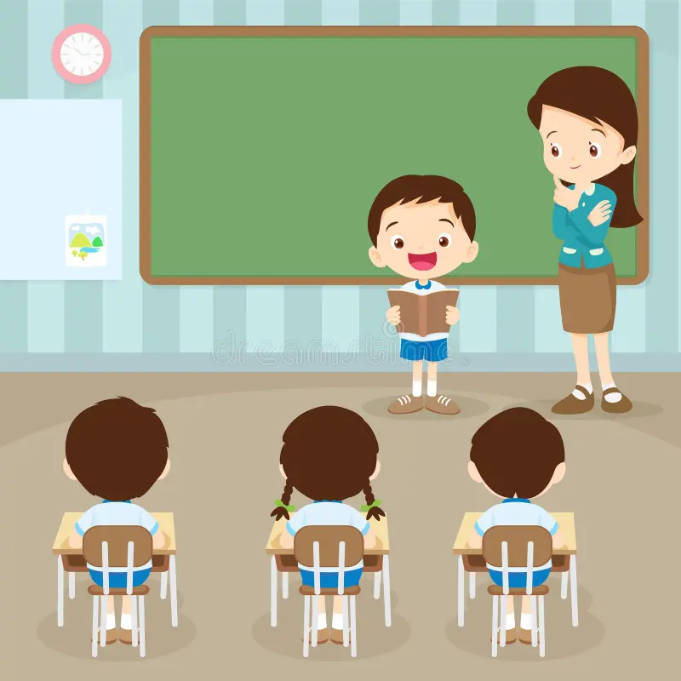
Rainbow
Solo Recite Rhyme
A student come to the front and recite the rhyme with rhythm. Everyone recite after him/her.

Slide 11

Group Work
One student will read the texts, and the other students follow and repeat after him/her.
Practice 2 or 3 times.
Do same work in pairs 2 times.

Slide 12
Home Work
Write the rhymes in your Excercise book

Slide 13

Good Bye

