Slide 1
WELCOME

Slide 2
Presented By
ABIDA SULTANA
Assistant Teacher
Reboti Roman Govt Primary School
Muglabazar, South Surma,
Sylhet.
Class : One
Subject : English
Unit – 2 ( Lesson-4, Page-20)
Tittle : Numbers

Slide 3

Today’s Lesson
Class: One
Sub: English
Unit: 2
Lesson:4 , page-20
Title: Numbers 1, 2
Time: 50 Min.

Slide 4
Learning Outcomes
Students will be able to know …..
Identify the numbers 1 and 2.
Say the numbers one and two correctly.
Count objects up to two.
Trace and write the numbers 1 and 2.
Match numbers with the correct number of objects.

Slide 5
Teaching learning materials
Books
Board
Marker
Ball/ picture of Animals
digital content
Pointic Stick
Number card

Slide 6
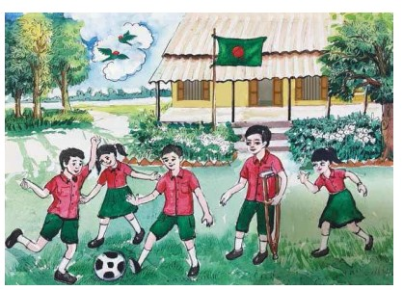
Today’s lesson
Numbers: 1-2

Slide 7
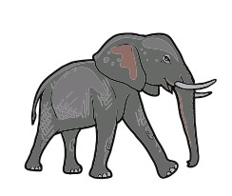

1
One
Elephant
2
Two
Tiger’s

Slide 8
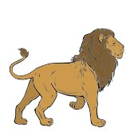

Look, listen and say
How many lion`s are here?

Slide 9


Look, listen and say
How many student’s are here?

Slide 10

Today we are going to learn how to count and read the numbers of 1 and 2”.
Now open your book at page 20-21.

Slide 11
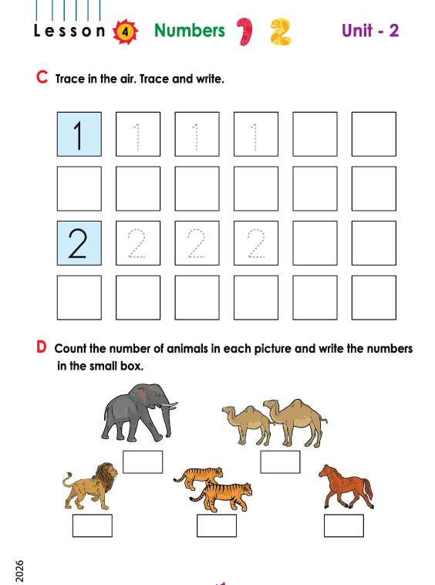

Slide 12
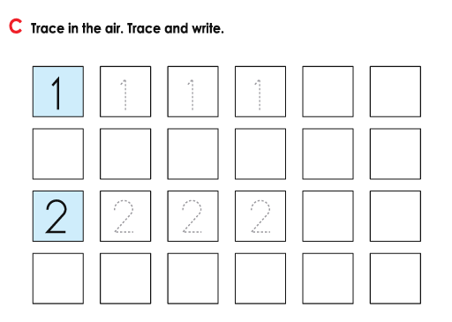
Trace and write the numbers 1 and 2.

Slide 13
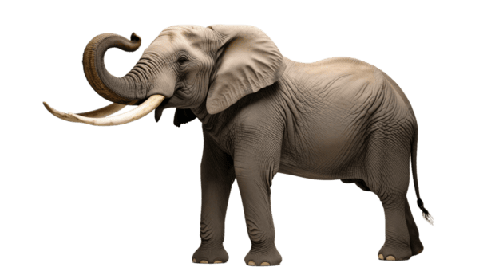
1
One
One Elephant

Slide 14
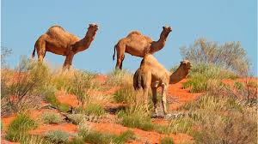
2
Two
Two camels

Slide 15


GROUP WORK
1
1
2

Slide 16
Matching the numbers
1
Two
2
One

Slide 17


What can you see in the picture?
1
2

Slide 18
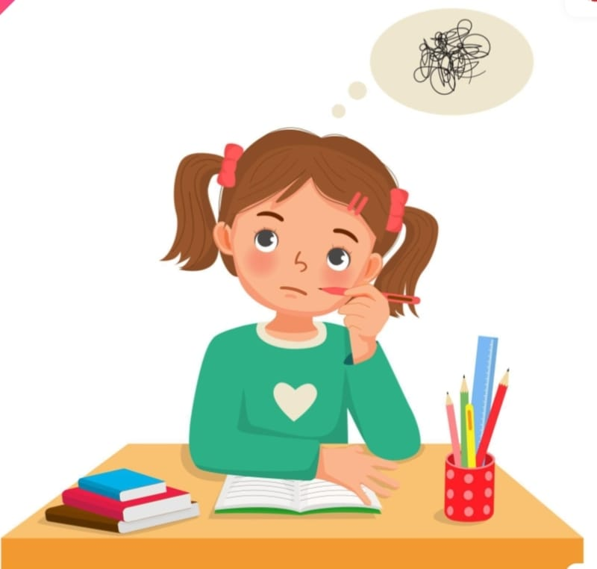
What have we learnt today?
We can learn about Number 1 and 2.

Slide 19

Home work
Write down from 1-2 numbers in your note book.

Slide 20
GOOD BYE

