Slide 1


Welcome!

Slide 2
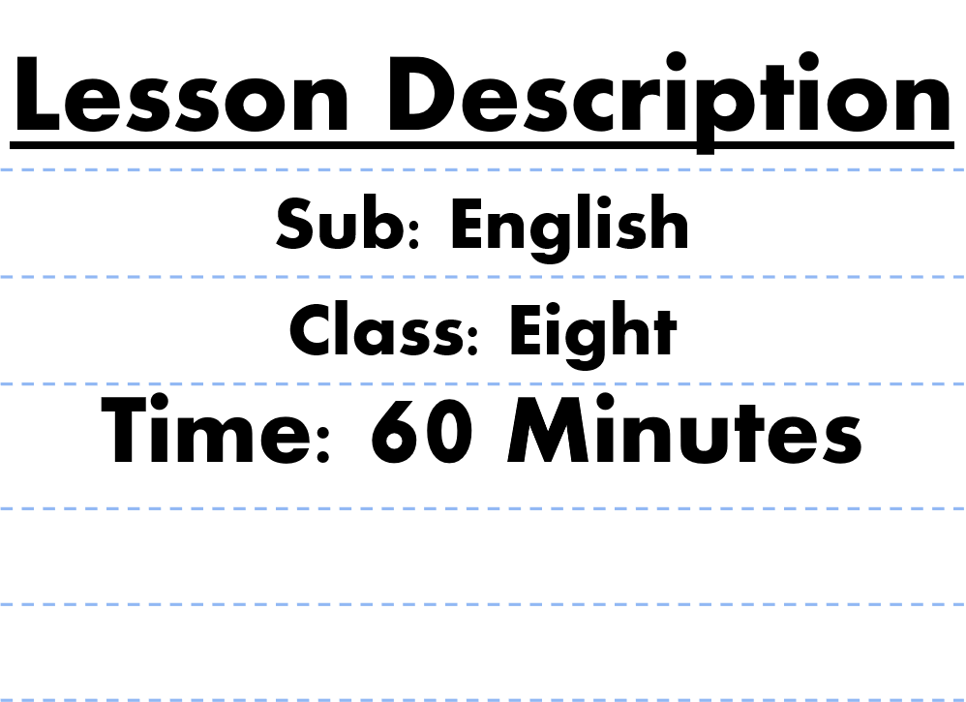
About the teacher& Lesson
Selina Akter
Assistant Teacher
Bahadder kata High School.
Chakaria,Cox’s Bazar
E-mail: selikamal8485@gmail.com

Slide 3



PARTS OF SPEECH
VERB

Slide 4


Lesson Objectives
Provide various examples of action and linking verbs.
Construct sentences with correct verb usage.
Define the meaning of a verb.

Slide 5

Verb
A verb is a word that expresses an action or a state of being.
Together with nouns, verbs are the primary elements of a sentence or phrase.
Examples
Aaron danced to his favorite music.
The verb "danced" in the sentence above expresses an action of the subject "Aaron."
Aaron is a member of the school's dance club.
The verb "is" in the sentence above expresses the state of being of the subject "Aaron."

Slide 6


Verb and Time
Using verbs, one can identify whether an action occurred in the past, is occurring in the present, or will occur in the future. Verbs express time through these tense forms.
Past
Present
Future
Aaron played basketball.
Aaron plays basketball.
Aaron will play basketball.

Slide 7

Action Verbs
An action verb describes what someone or something does. Remember that action verbs are not always physical actions; they can also be mental actions.
Example
Physical Action:
Aaron read a book.
The verb "read" expresses a physical action done by the subject "Aaron."
Mental Action:
Aaron thought of an idea.
The verb "thought" expresses a mental action done by the subject "Aaron."

Slide 8
Examples
Physical Verbs
Mental Verbs
run
know
skip
realize
play
hope
sing
decide
draw
believe
walk
imagine
eat
guess
sleep
feel
watch
understand
wave
recognize

Slide 9
Linking Verbs
A linking verb expresses a state of being and relates the subject to other parts of a sentence. Be verbs and sense verbs are considered linking verbs.
Be verbs are the most commonly used linking verbs.
Example
Aaron was a basketball team captain in high school.
The be verb "was" expresses a state of being of the subject "Aaron."
Other be verbs are am, is, are, was, were, be,been, and being

Slide 10
Sense Verb
A sense verb describes one of the five senses: sight, hearing, smell, and touch.
Other verbs that can be considered as linking verbs are the following:
appear
grow
seem
become
look
smell
feel
remain
sound
stay
taste
turn
Aaron became a professional basketball player.
The sense verb "became" expresses a state of being of the subject "Aaron."

Slide 11

Thank you for listening!

