Slide 1
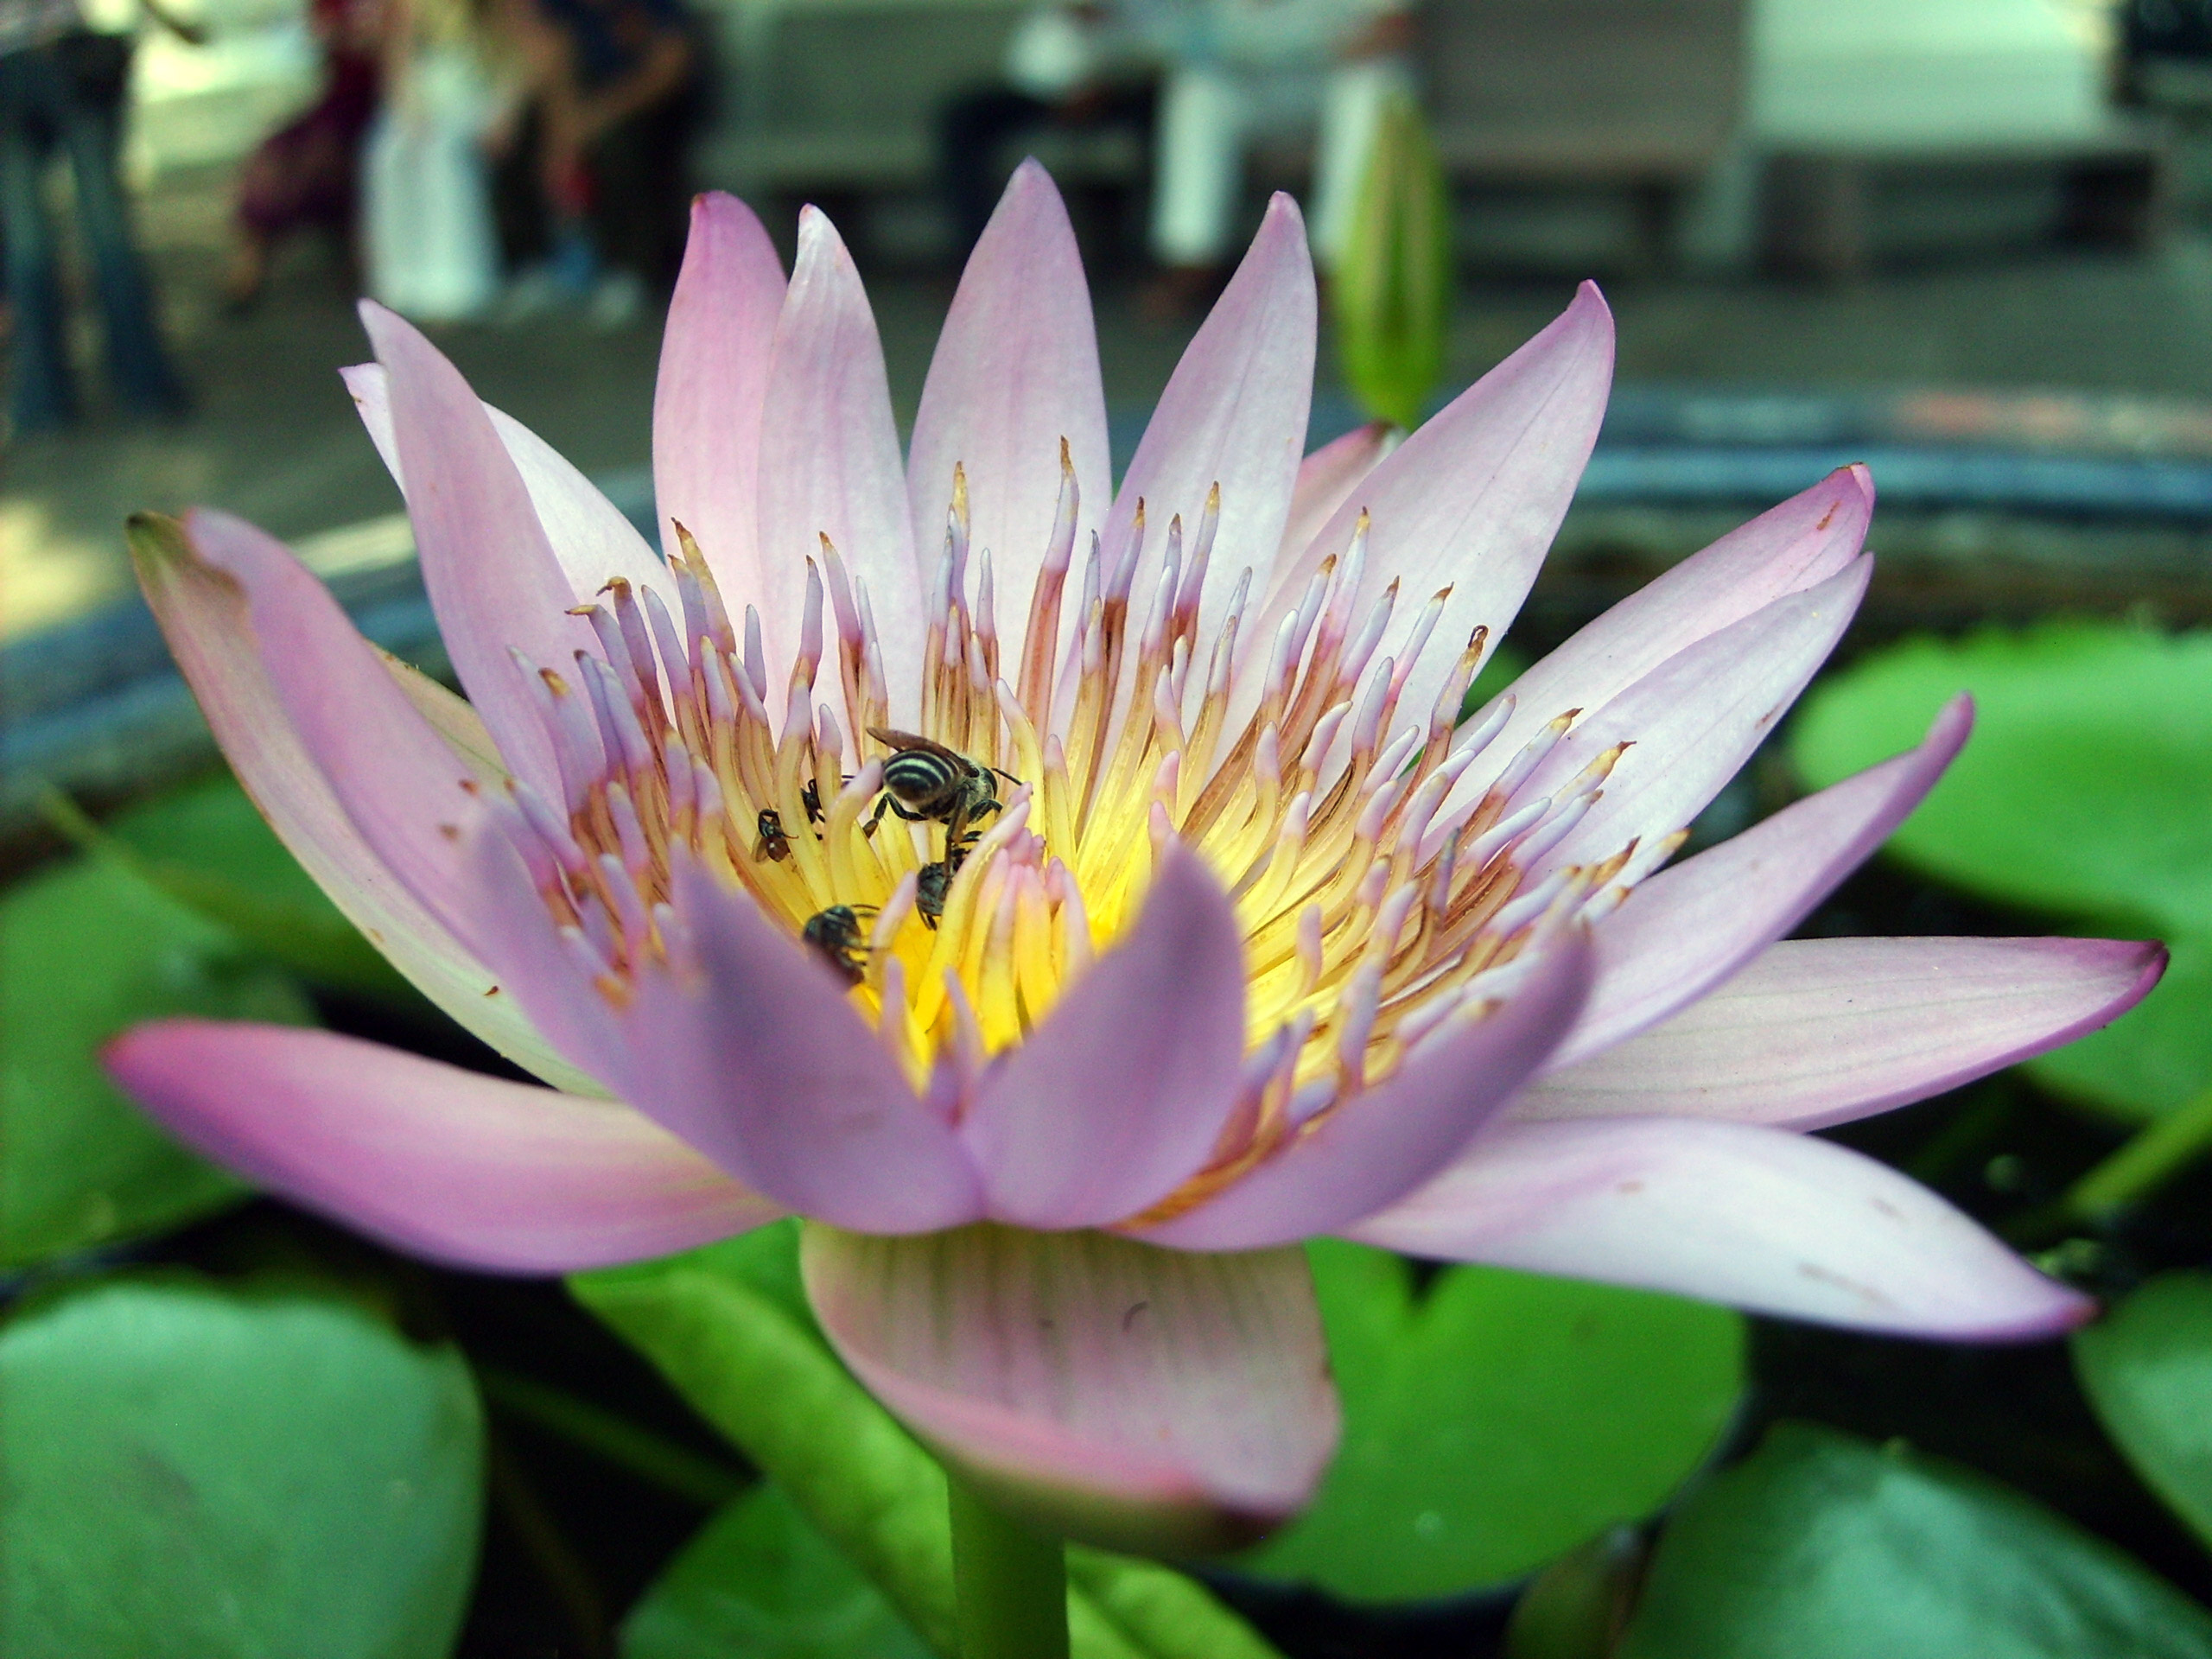
Welcome

Slide 2
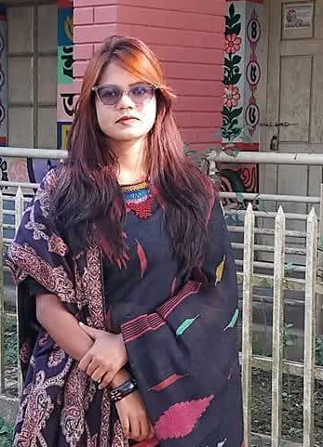
Teacher’sIntroduction
Beauti Rain paul
Head teacher
Pithitikor govt.primary school
Fenchugonj ,Sylhet.

Slide 3
At the library
Class:5 ,Subject:English
Activity:1.1,1.2 Unit:1 page:01

Slide 4
Learning outcome:
1.2.2 Get the specific information from conversations
3.4.1 Ask simple questions on familiar topics
3.4.2 Answer simple questions appropriately and confidently

Slide 5
Warm----up Activity

Slide 6
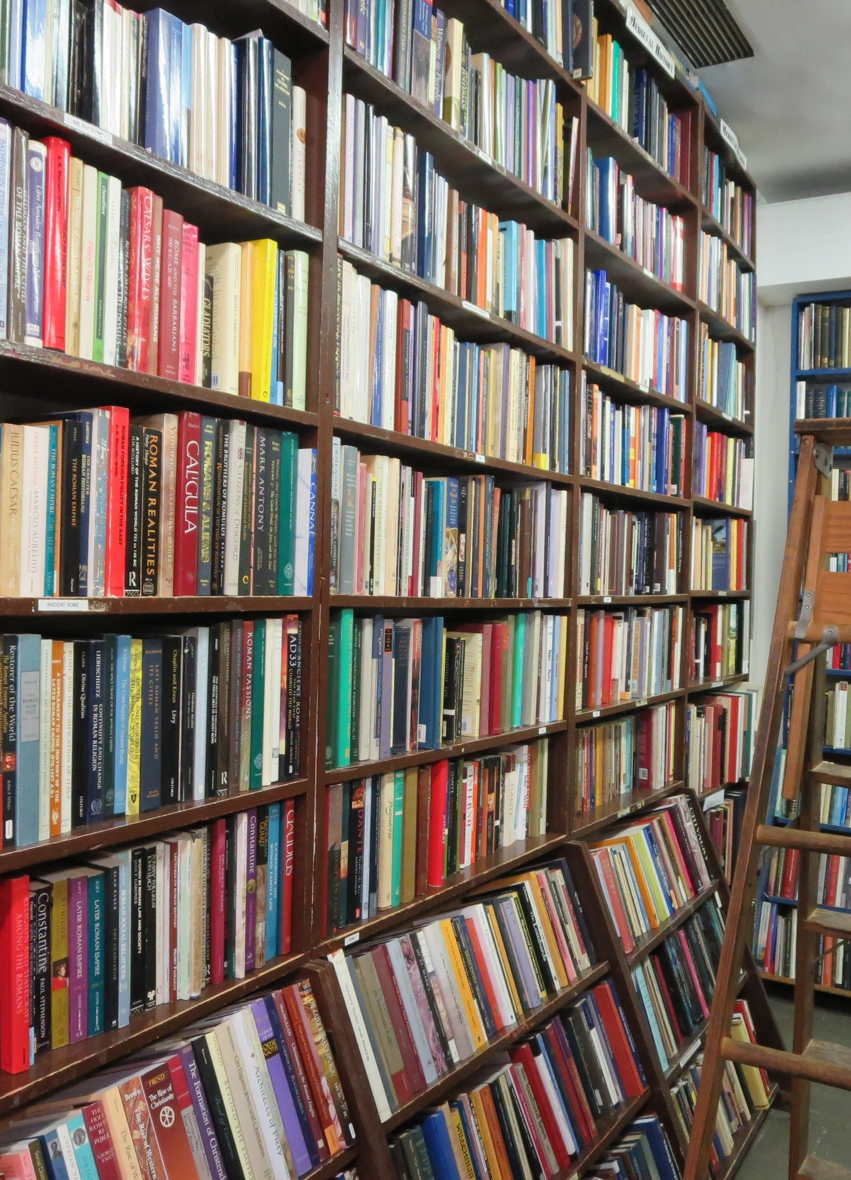
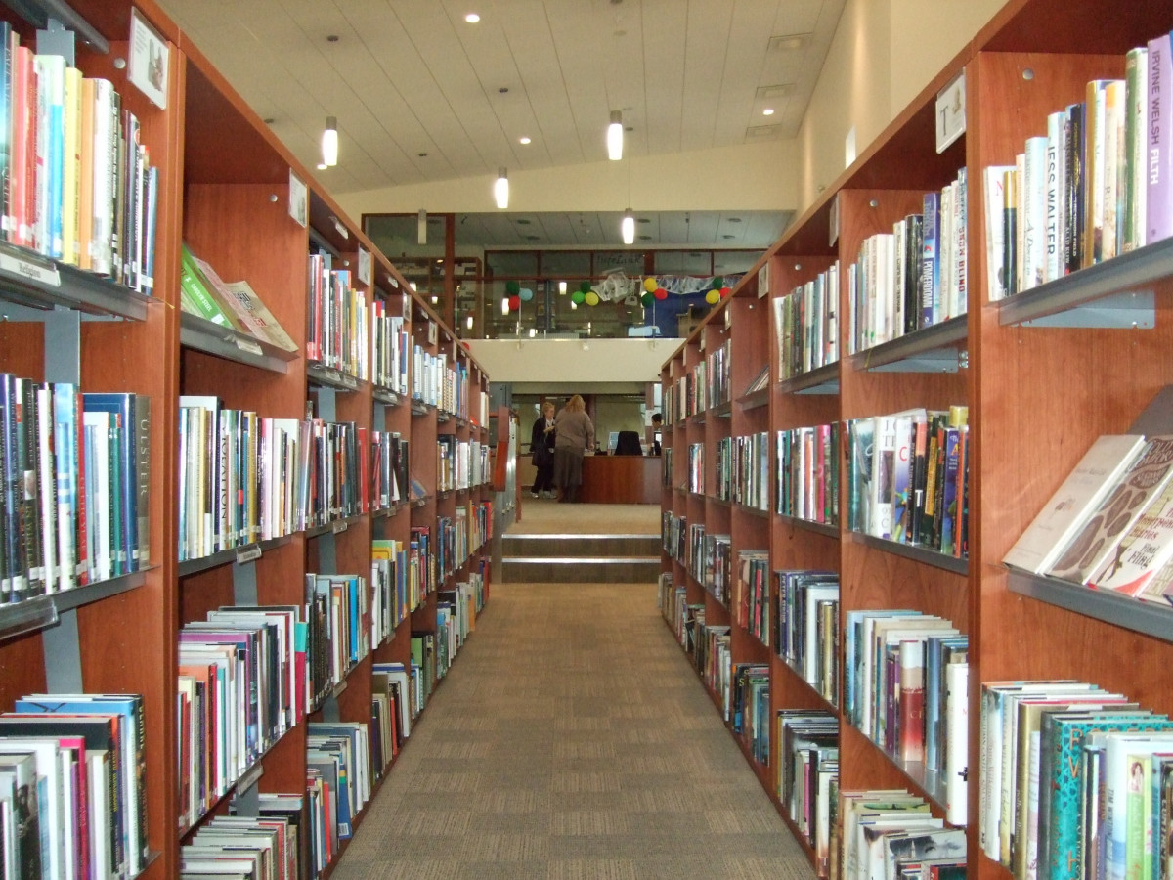
Discovering the library
In pairs,discuss:
Have you ever gone to a library?
What do you do in the library?
What kind of books do you like?

Slide 7
Vocabulary:
Library: গ্রন্থাগার
Borrow:ধার করা
Introduce: পরিচয় করানো
Conversation:আলাপচারিতা
Neighbourhood:পাড়া
Seem:মনে হওয়া
Biograpy: জীবনকাহিনী/জীবনী

Slide 8
Meet the characters
Who are they?
Rina and Omar: Friends visiting the public library to read and explore books.
Rupa: A new girl in the neighbourhood who also loves reading.

Slide 9
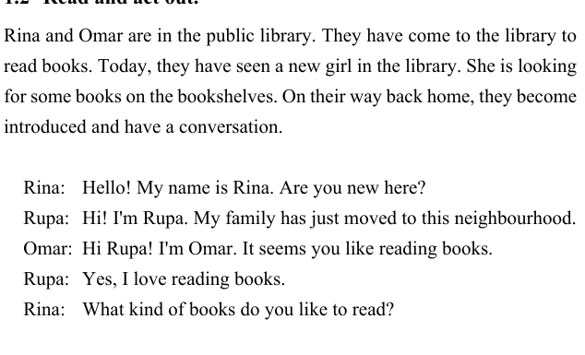
The teacher will read the text aloud.and the students will listen carefully:

Slide 10
GROUP WORK
The Students will read in a group.

Slide 11
Silent reading

Slide 12
Assessment
For assessing ,The teacher ask randomly to read the text and also give feedback if need.

Slide 13
Many Thanks

