Slide 1


Slide 2
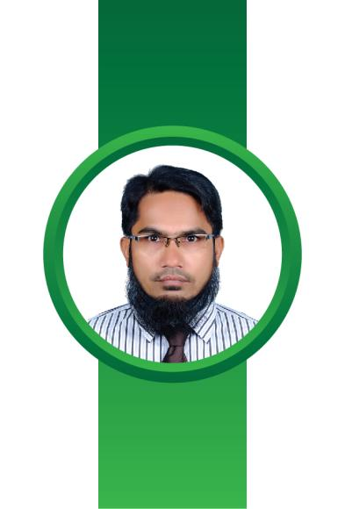


Gaziul Hassan
Assistant Teacher
Chatarpaiya Govt. Primary School.
Senbag, Noakhali.

Slide 3
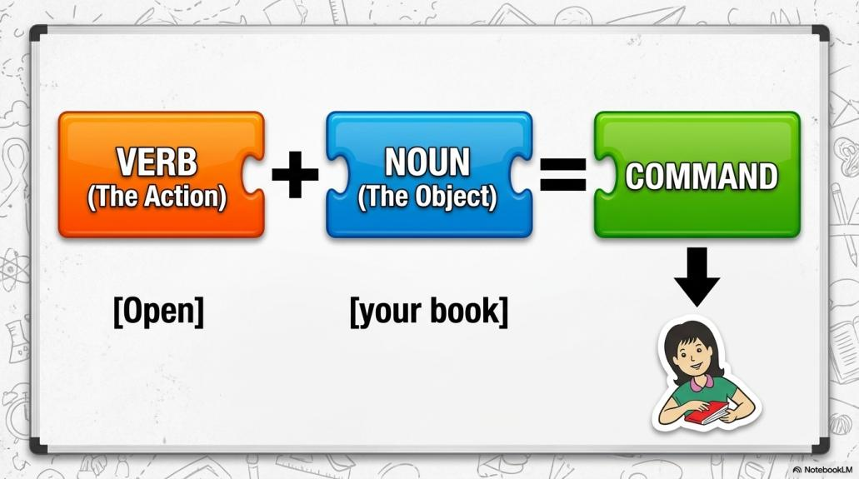

Slide 4
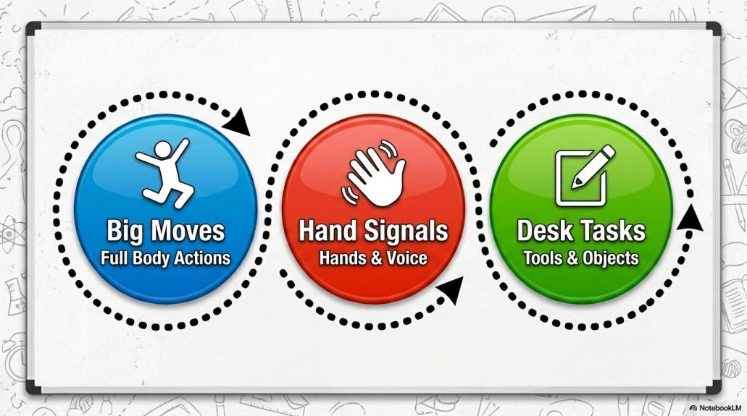

Slide 5


Slide 6


Slide 7


Slide 8


Slide 9


Slide 10
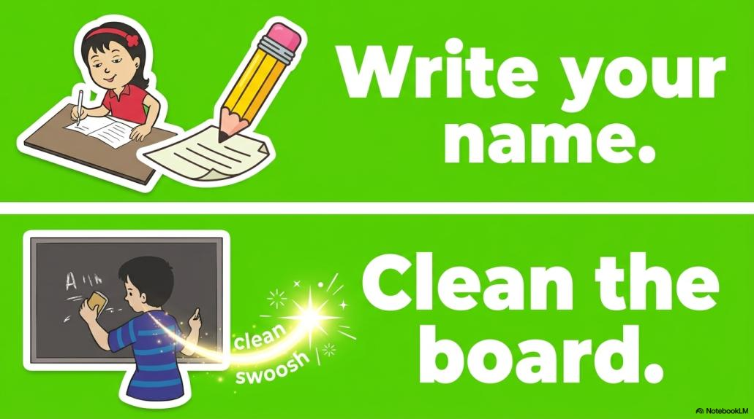

Slide 11
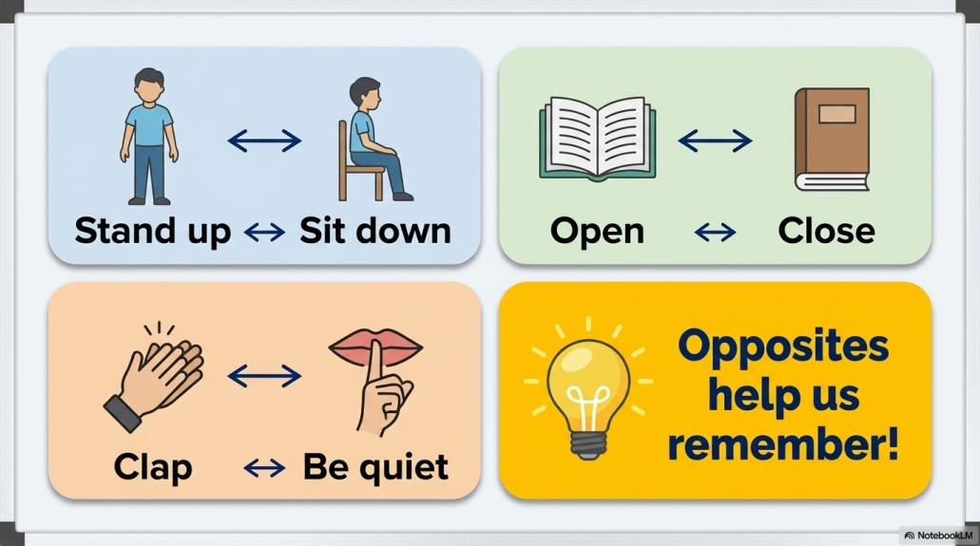

Slide 12
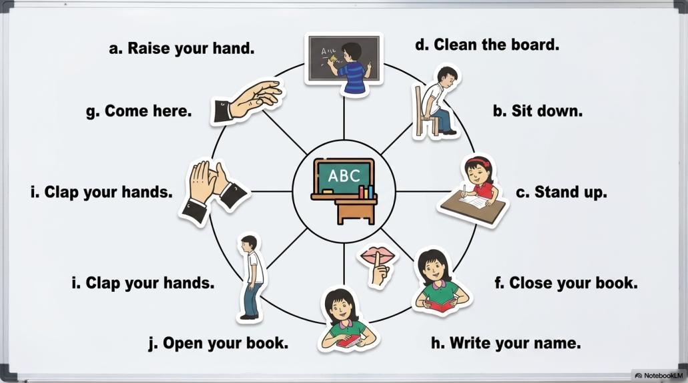

Slide 13


