Slide 1
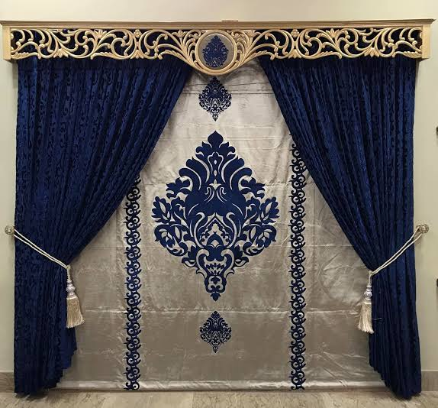

Slide 2

Wellcome to my class

Slide 3
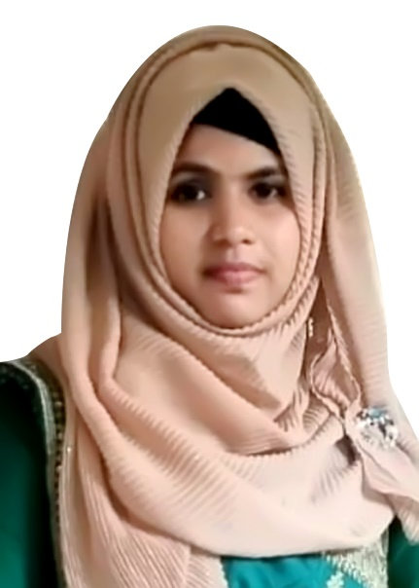
Teacher’s Introduction
Fateha Begum
Assistant Teacher,
Nuyagoan govt. praimary school.
Nabigonj,Hobigonj.

Slide 4
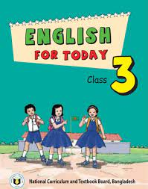
Lesson Introduction
Subject: English.
Class: Three.
Unit: 34
Lesson: 1-3, Page: 63
Lesson Title: My family.
Time: 45 minutes.

Slide 5
Learning outcomes
Listening:
4.3.1- Enjoy and understant simple stories.
Reading:
5.1.1- Read simple paragraph.

Slide 6
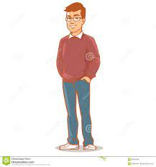
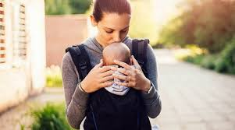

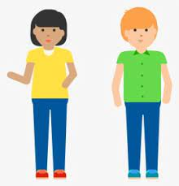

Let’s see some picture
Father
Mother
Sister
Brother

Slide 7
Let’s watch a video

Slide 8
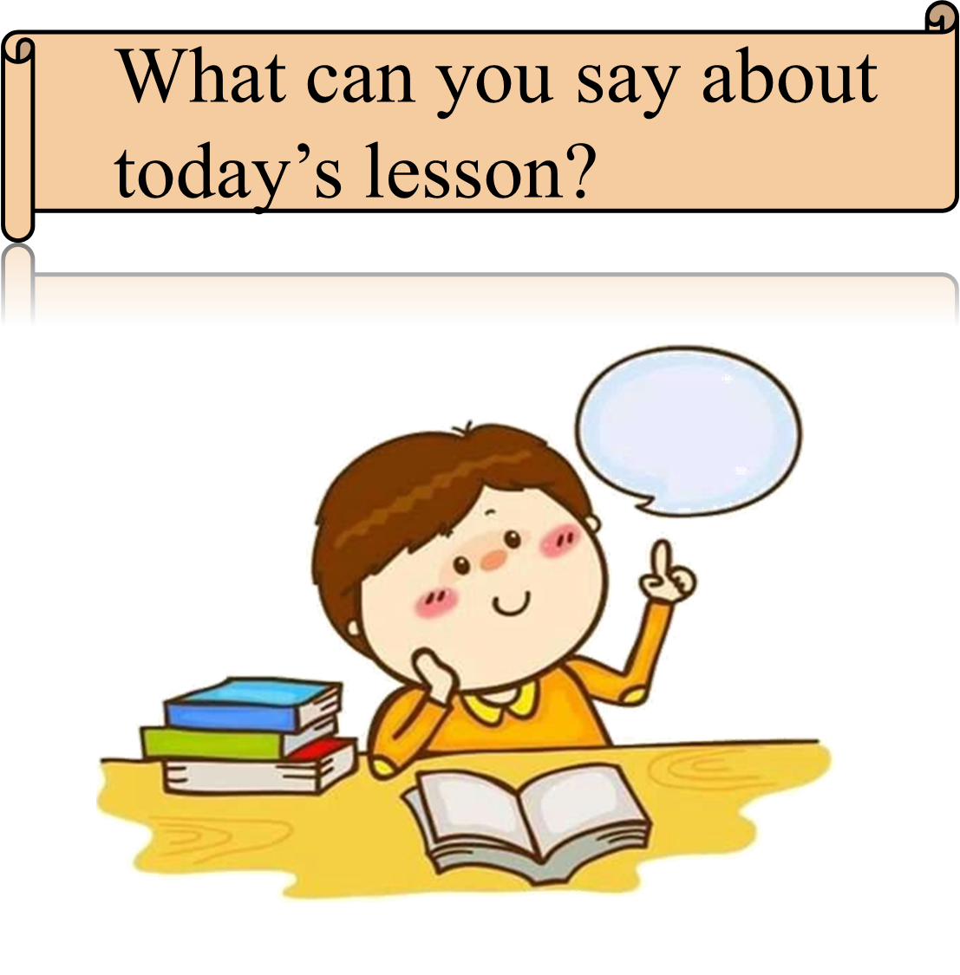

Slide 9
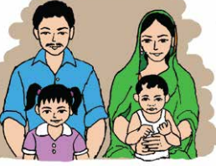
Today’s lesson
My Family

Slide 10

Teacher’s Reading
I’m Tisha. I’m a student. I’m in class 3.

Slide 11
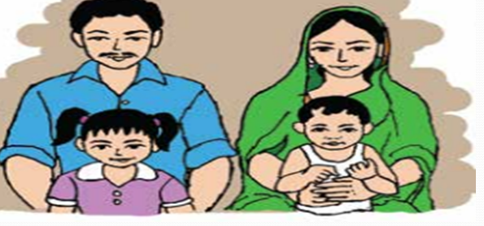
There are four people in my family.

Slide 12
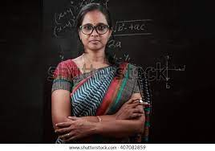
My mother is a teacher.

Slide 13

My father is a banker.

Slide 14
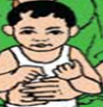
My brother is two years old.

Slide 15

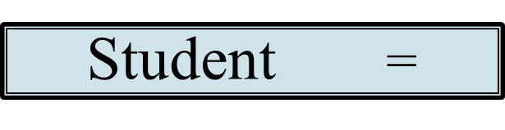
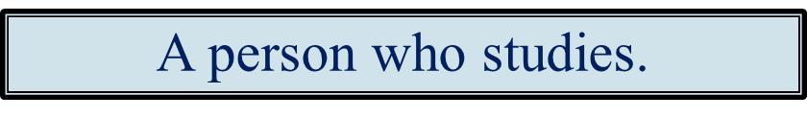
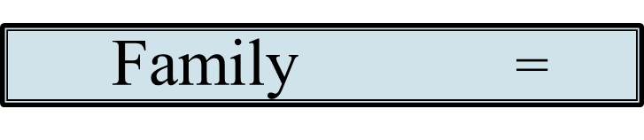
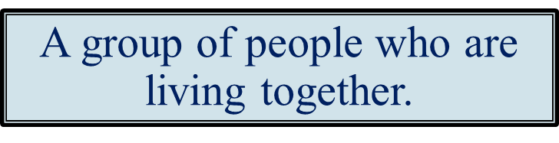
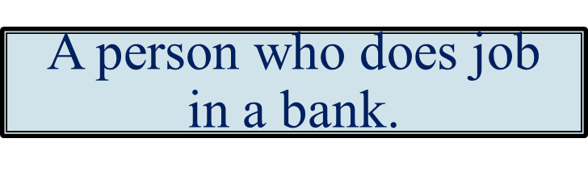
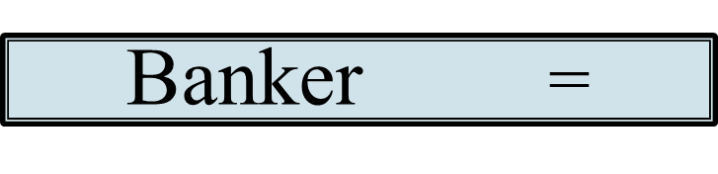

Slide 16
Kim’s Game
Father
Mother
People
Brother
Old
Sister

Slide 17
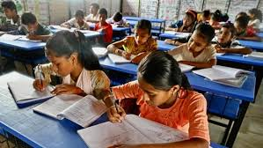
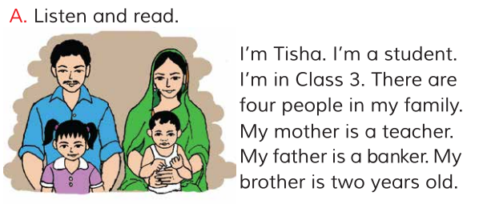
Students reading

Slide 18

Students say the bengali meanings of following words.
Father
বাবা
Mother
মা
Banker
ব্যাংকার
Old
বৃদ্ধ
People
লোক/মানুষ
Teacher
শিক্ষক
বৃদ্ধ

Slide 19
Group Work
Write Answer the following questions:
What does Tisha’s mother do?
What is Tisha’s father?
How old is Tisha’s brother?

Slide 20
Evaluation
What class are you in?
What is your name?
How many people are there in your family?

Slide 21

Home work
Everybody will Write three sentences about your family.

Slide 22

Thank you
Thank you

