Slide 1
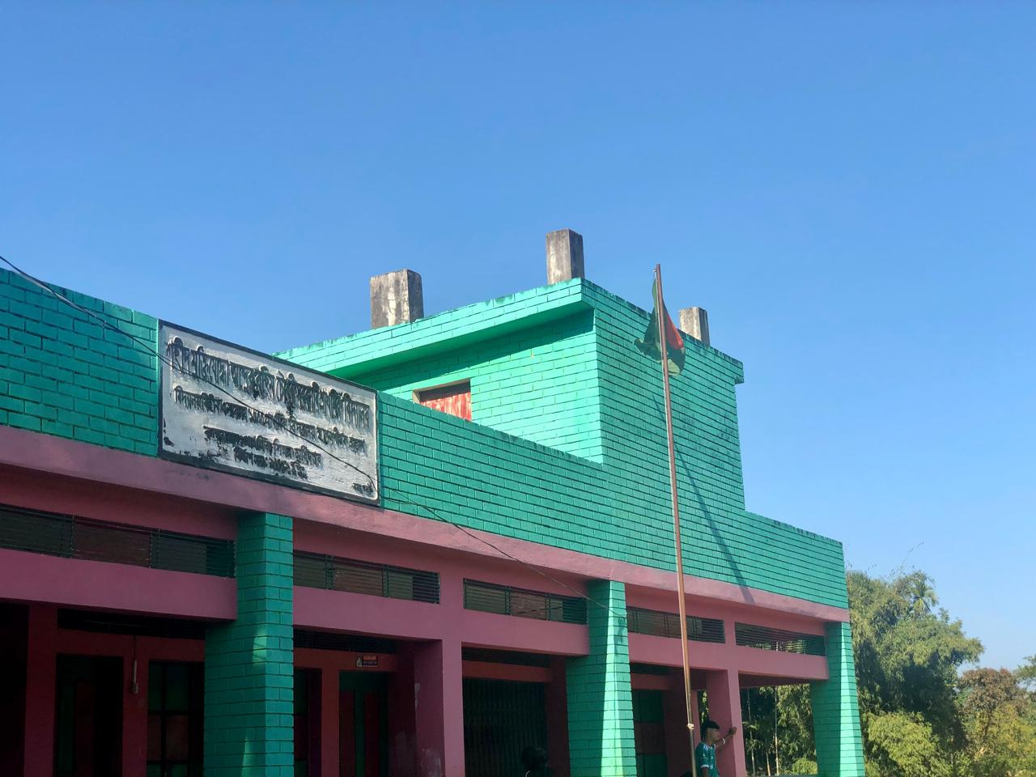


Slide 2

Introducing
Atikur Rahman
Assistant Teacher
Shahid Muktizuddha Abdur Rahim Chowdhury Govt.
Primary School
Juri, Moulvibazar

Slide 3

Class : One
Subject: English
Lesson: 6
Unit: 2
Date: 20.09.2025

Slide 4
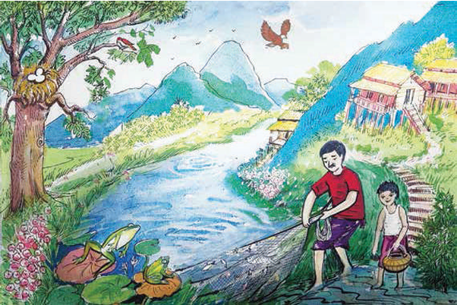
Look at the picture.
Eagle
Fish
Frog
Egg
Say the names of the animals.

Slide 5

Today's lesson
Ee Ff
Class-1
Subject-English
Lesson-6
Unit-2
Alphabet (Ee Ff)

Slide 6

Learning outcomes:
Students will be able to-
1.1.1 -recognize the sounds of the alphabet in familiar words.
3.1.1 - say proper sounds of the letters in familiar words.
4.1.1 - read the pictures of familiar objects and events.

Slide 7
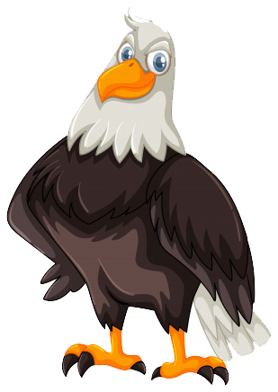
Look, listen and say.
E
e
eagle
Eagle

Slide 8
Look, listen and say.
e
eagle
E
Capital letter
Small letter

Slide 9
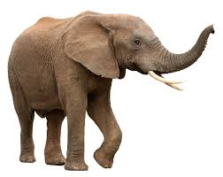
E
Look, listen and say.
e
elephant
Elephant

Slide 10
Look, listen and say.
e
elephant
E
Capital letter
Small letter

Slide 11
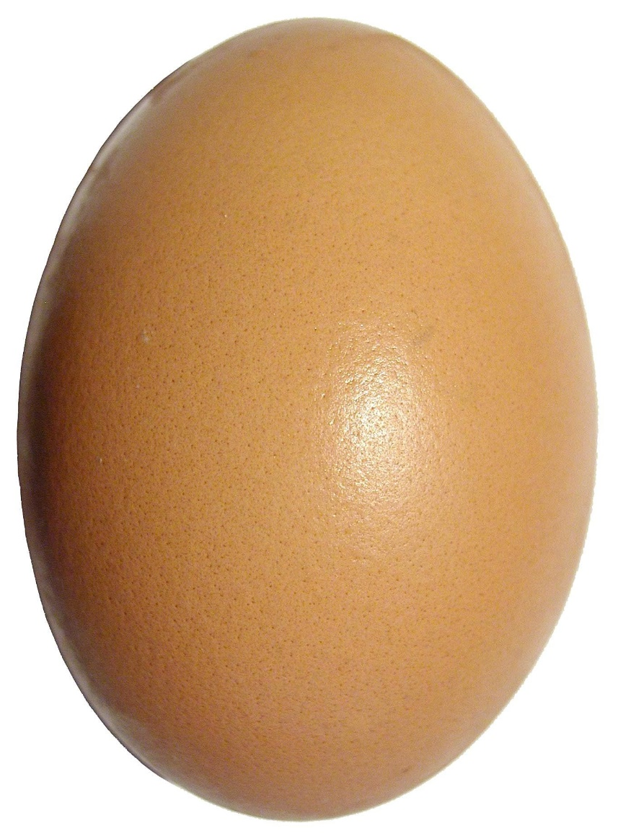
E
Look, listen and say.
e
egg
Egg

Slide 12

Look, listen and say.
e
egg
E
Small letter
Capital letter

Slide 13
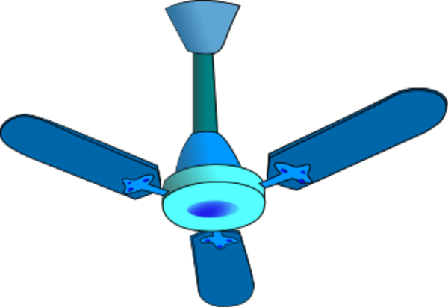
F
Look, listen and say.
f
fan
Fan

Slide 14
F
Look, listen and say.
f
fan
Fan

Slide 15
F
Look, listen and say.
f
fan
Fan

Slide 16
Look, listen and say.
f
fan
F
Capital letter
Small letter

Slide 17
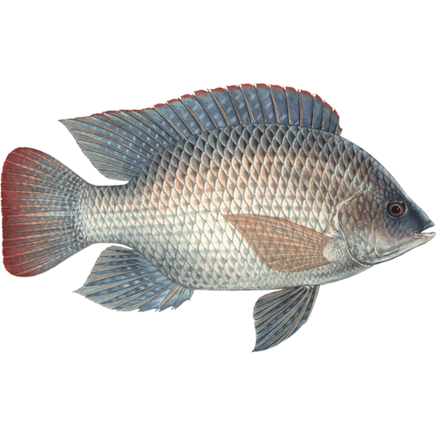
Look, listen and say.
F
f
fish
Fish

Slide 18
Look, listen and say.
f
fish
F
Small letter
Capital letter

Slide 19

Look, listen and say.
F
f
frog
Frog

Slide 20

Look, listen and say.
f
frog
F
Capital letter
Small letter

Slide 21

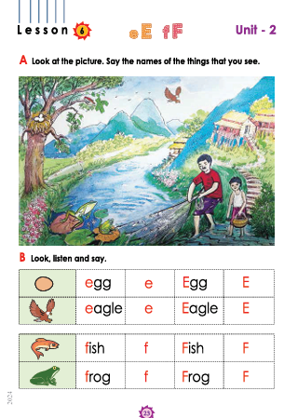
Now open your book page no 23

Slide 22
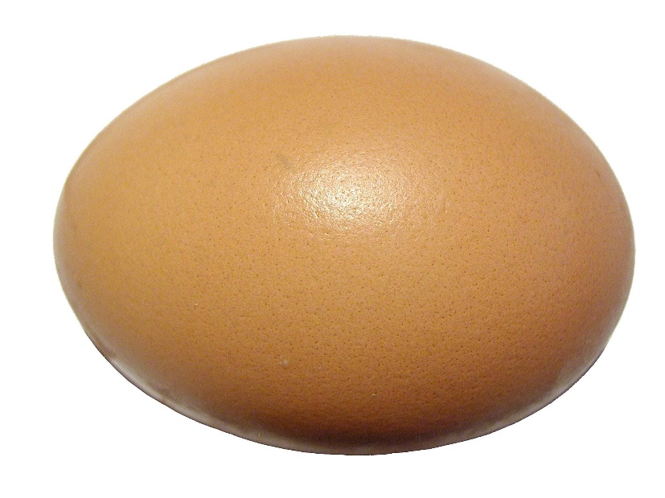

Loud reading by the teacher
WCW
E
Egg
e
egg

Slide 23
Loud reading by the teacher
WCW
F
Fish
f
fish

Slide 24
Evaluation
Say the letter name “ E ”.
Say the letter name “ F ”.

Slide 25
Evaluation
Say the letter name “ e ”.
Say the letter name “ f ”.

Slide 26
Match the letters by word ?
Evaluation
E
eagle
F
fish
e
Egg
f
Frog

Slide 27
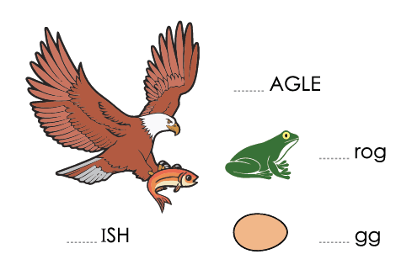
Fill in the blanks
Evaluation
E
f
F
e

Slide 28

Home work
Trace and write.
E
E
E
F
F
F
e
e
e
f
f
f

Slide 29


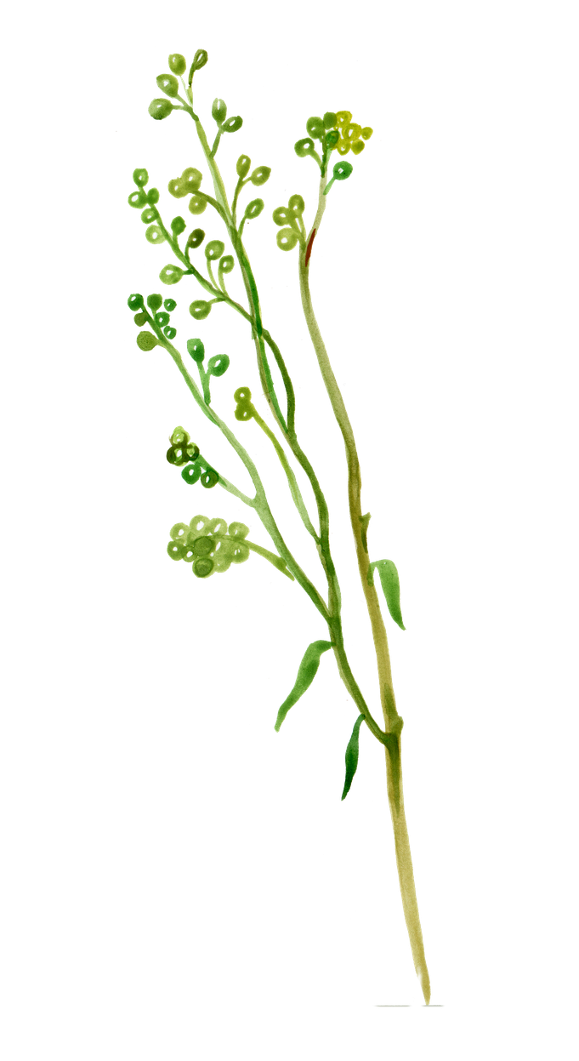


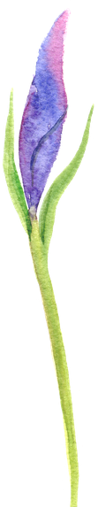

THANK YOU

