Slide 1
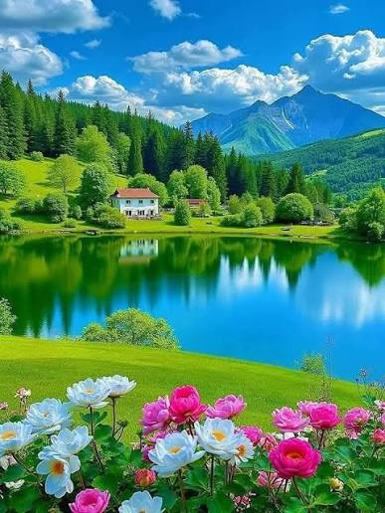
WELCOME

Slide 2
INTRODUCTION
Md. Samiul Islam
Assistant Teacher, English
Haji Jobeda Sunniya Dakhil Madrash
Chunarughat,Hobiganj
Class: Ten
Subject: English
Unit: Two (Climate Change)
Lesson: 01 (The Greed of The Mighty Rivers)
Time: 45 Minutes
Date: 22 June 2026

Slide 3
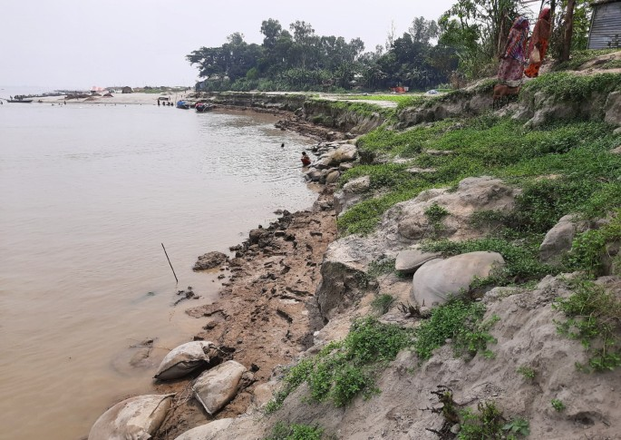
Notice the picture below and think what it is about….

Slide 4
Learning Outcomes
After we have studies this unit , we will be able to…..
Demonstrate understanding and summerise texts
Ask and answer questions
Take part in debates on given topics
Take part in role playing and conversations

Slide 5
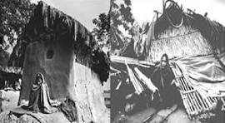
Read the following text and answer the following questions
Meherjan lives in a slum on the Sirajganj Town Protection Embankment. Her polythene roofed shelter looks like a cage. She is nearly 45 but looks more than her age. In front of her shelter, she is trying to make a fire to cook the day's only meal. Her weak hands tremble as she adds some fallen leaves and straw to the fire. The whispering wind from the river Jamuna makes the fire unsteady. The dancing flames remind Meherjan of the turmoil in her life. Not long ago Meherjan had everything a family, cultivable land and cattle. The erosion of the Jamuna gradually consumed all her landed properly. It finally claimed her only shelter during the last monsoon. It took the river only a day to devour Meher's house, trees, vegetable garden and the bamboo bush. She had a happy family once. Over the years, she lost her husband and her family to diseases that cruel hunger and poverty brought to the family. Now, she is the only one left to live on with the loss and the pain. The greedy Jamuna has shattered her dreams and happiness. There are thousand others waiting to share the same fate like Meherjan. Bangladesh is a land of rivers, some of whose banks overflow or erode during monsoon. Erosion is a harsh reality for the people living along the river banks. During each monsoon many more village are threatened by the mighty rivers like the Jamuna, the Padma and the Meghna. It is estimated that river erosion makes at least 1,00,000 people homeless every year in Bangladesh. Infact, river erosion is one of the main dangers caused by climate change. If we can't take prompt actions to adapt to climate change, there will be thousand of more Meherjans in our towns and villages every year.

Slide 6
Choose the correct answer from the following alternatives:
What does the expression 'the turmoil in her life' in the first paragraph mean?
(i) The happiness of her life (ii) The memorable events of her life
(iii) The plans of her life (iv) The anxiety and confusion of her life.
b) How many rivers are mentioned in the passage?
(i) one (ii) two (iii) three (iv) four
c) What was Meherjan's previous family condition?
(i) very luxurious (ii) pathetic (iii) impoverished (iv) solvent
d) Meherjan lost her permanent shelter due to?
(i) cyclone (ii) river erosion (iii) poverty (iv) flood
e) Meherjan looks older than her age because of ?
(i) poverty (ii) poverty and malnutrition (iii) tension (iv) working hard

Slide 7
Answer the following question in pairs
Where does Meherjan live?
What makes the fire unsteady?
What does the dancing of the flames remind Meherjan?
In which season does river erosion take a devastating turn?
What is river erosion caused by?
Meherjan lives in a slum on the Town Protection Embankment in Sirajganj.
The whispering wind from the river Jamuna makes the fire unsteady .
The dancing of the flames reminds Meherjan of the turmoil in her life.
River erosion takes a devastating turn in the rainy season.
River erosion is caused by unusual climate change.

Slide 8
Homework
Write a dialogue about the effects of climate change in our life .

Slide 9

Thank you

