Slide 1

Welcome, Let’s learn English with confidence…..

Slide 2
Teacher Introduction Lesson Introduction
Jinat Sumaiya Chowdhury
Assistant English Teacher
Gatabola Dakhil Madrasa
Chunarughat, Hobiganj
Topic: Loneliness
Class: 10
Subject: English 1st paper
Chapter: 13
Lesson Title: Loneliness
Duration: 45 minutes
Date: 22-06-2026

Slide 3
Topic: Loneliness
Presented by Jinat Sumaiya Chowdhury
The greatest loneliness is not being alone, but feeling disconnected from others.

Slide 4
Learning Outcomes:
By the end of the lesson, students will be able to-
Define loneliness.
Explain the difference between loneliness and being alone.
Identify the causes of loneliness.
Discuss ways to cope with and prevent loneliness.
Answer comprehension questions based the texts.

Slide 5
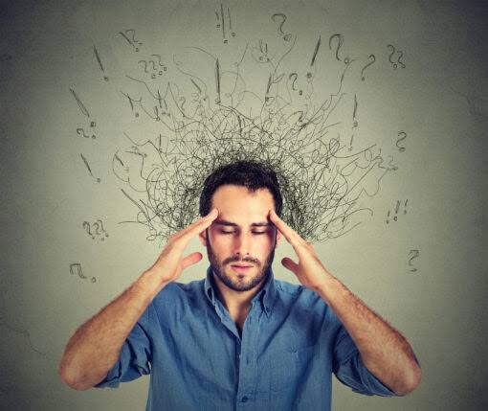

PREVIOUS KNOWLEDGE : CHECK
Let's Think….
Answer the following questions:
Have you ever felt lonely?
What does loneliness mean to you?
Can a person feel lonely even when surrounded by others?
Is being alone the same as being lonely?

Slide 6
LESSON ANNOUNCEMENT
Today's Lesson
Loneliness: Causes, Effects and Prevention
We will learn:
What loneliness is
Causes of loneliness
Effects of loneliness
Prevention strategies
Vocabulary from the text

Slide 7

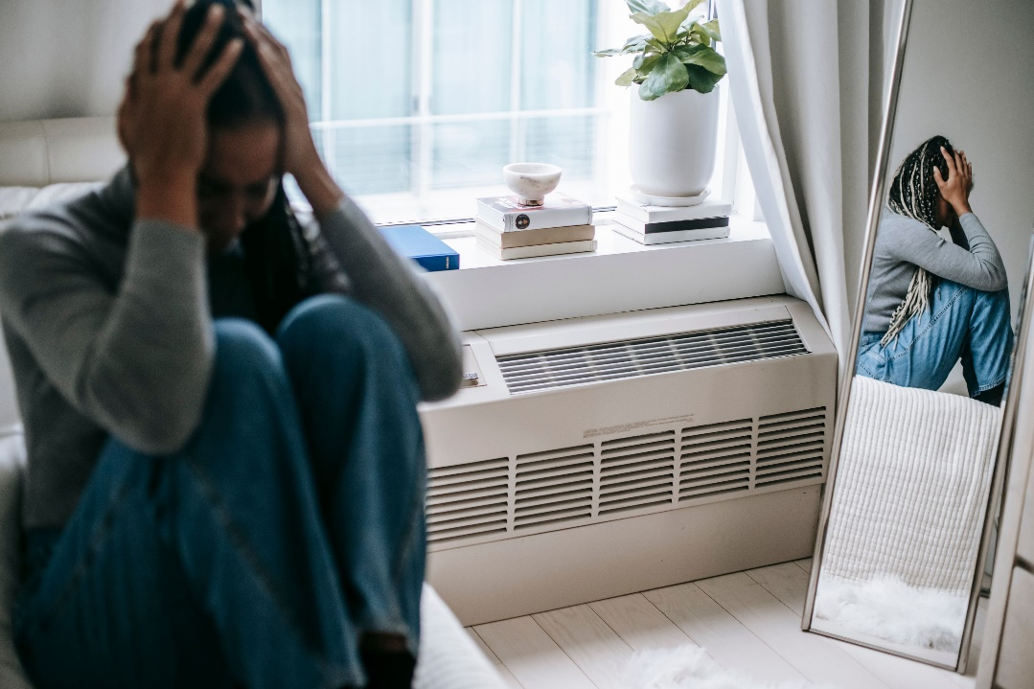
LEAD-IN ACTIVITY
Look at the Pictures and Discuss
How might the person feel?
Possible emotions:
Sad
Isolated
Anxious
Hopeless
Unwanted
Depressed
Pair Discussion:
Why do people sometimes feel lonely?

Slide 8
WHAT IS LONELINESS?
Definition of Loneliness
According to the American Psychological Association (APA),
In Simple Words:
Loneliness is the feeling that your social and emotional needs are not being met.
Loneliness is the emotional discomfort or uneasiness caused by feeling alone or disconnected from others.

Slide 9
LONELINESS VS BEING ALONE
Are They the Same?
Loneliness | Being Alone
A feeling | A situation
Often painful | Not necessarily negative
Can happen in a crowd | May be peaceful
Emotional state | Physical condition
Key Idea:
A person may be alone without feeling lonely, and may feel lonely even among many people.

Slide 10

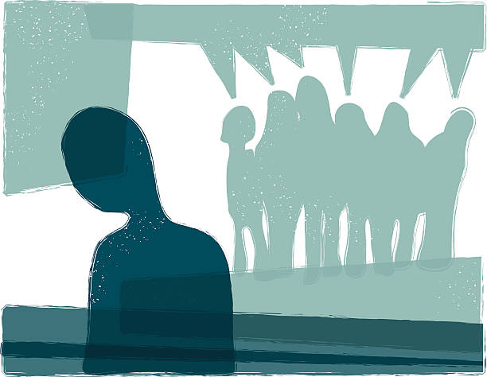


CAUSES OF LONELINESS
What Causes Loneliness
Some common causes include:
Death of a close friend or family member
Physical isolation
Living alone
Moving away from family and friends
Illness or disability
Retirement
Working alone

Slide 11
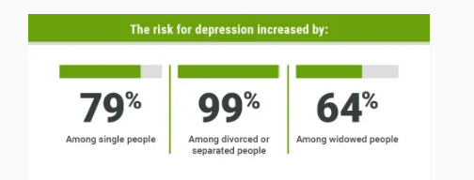
PEOPLE AT HIGHER RISK
Who May Feel Lonelier?
According to the text:
Young adults
Mothers with young children
Elderly people
Immigrants
People experiencing major life changes
People from cultures or backgrounds with high stigma around mental health
Those raised in families that do not acknowledge emotional struggles
Public figures such as celebrities or politicians

Slide 12
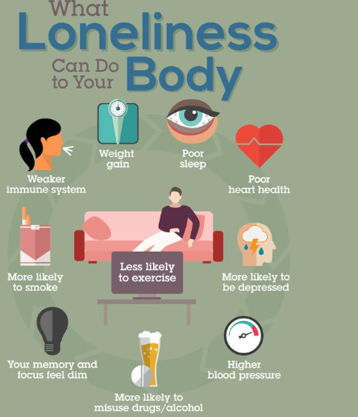
EFFECTS OF LONELINESS
Loneliness may lead to:
Stress
Anxiety
Depression
Low self-esteem
Emotional distress
Reduced social interaction
Discussion Question:
How can loneliness affect a person's daily life?

Slide 13
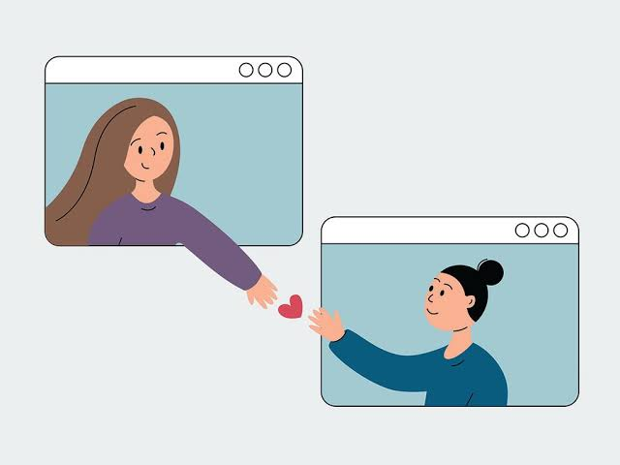
HOW TO COPE WITH LONELINESS
Ways to Overcome Loneliness
Find hobbies you enjoy
Volunteer for an organization
Maintain regular contact with family and friends
Seek support when needed
Serving Others as a Remedy for Loneliness
Prayer and Meditation on Scripture
Prevention Strategies
Build healthy relationships
Exercise regularly
Maintain a healthy lifestyle

Slide 14
VOCABULARY DEVELOPMENT
New Words
Word | Meaning
Loneliness | Feeling of isolation
Pervasive | Widespread
Volunteer | Work without payment
Isolation | Separation from others
Connection | Relationship with others
Emotional | Related to feelings

Slide 15

PAIR / GROUP WORK
Group Activity
Discuss the following questions:
What is loneliness?
What causes loneliness?
How can people prevent loneliness?
Why is social connection important?
Present your group's answers.

Slide 16
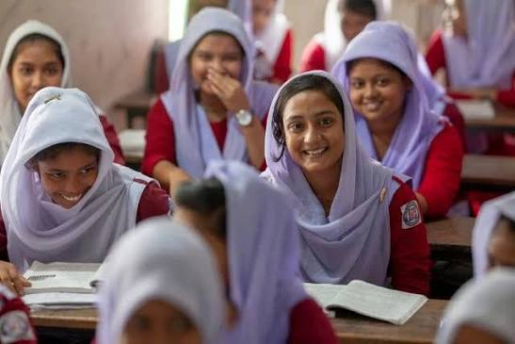
INDIVIDUAL WORK
Answer the Questions
Define loneliness in your own words.
Mention three causes of loneliness.
State two ways to prevent loneliness.
Explain the difference between loneliness and being alone.

Slide 17

HOME ASSIGNMENT
Write a paragraph (150–200 words) on:
"How Can We Prevent Loneliness in Modern Society?“
Use at least:
5 new vocabulary words from the lesson.
2 suggestions for preventing loneliness.

Slide 18


THANK YOU
Any Questions?
"Human connection is one of the most powerful remedies for loneliness.“
Stay Connected. Stay Positive. 🌷

