Slide 1

Welcome

Slide 2
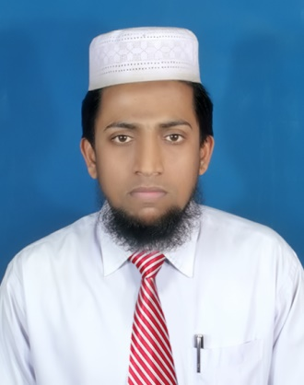
Introduction
Subject : English
Class : Seven
Unit : 5
Lesson : 1
Time : 50 minutes
Date :15/03/2026
Md.Azizur Rahman
Assistant Teacher, English
Sangalshi Hazipara Alim Madrasah
Sadar, Nilphamari
01728-463371
azizurrahman348@gmail.com

Slide 3
Tell the names of some famous women in Bangladesh

Slide 4
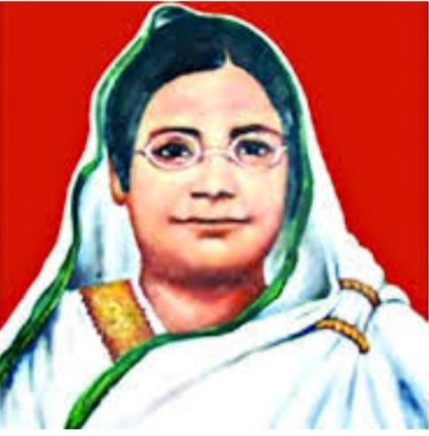
Today’s our topic: Begum Rokeya
Open at page 49

Slide 5
Learning outcomes
After studying this lesson, we will be able to
ask and answer the questions
talk about people
read and understand the text

Slide 6
Section: A
Look at the picture. Ask and answer these questions in pair
Who is the woman?
What do you know about her?
Time: 5 minutes

Slide 7
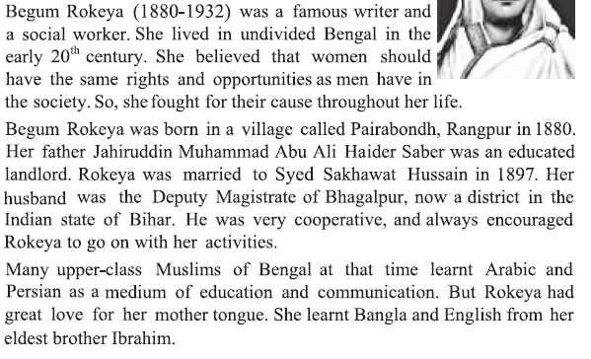
SRead the text aloud for correct pronunciation (10 minutes)

Slide 8
Read the text silently and identify unknown words from the text (10 minutes)

Slide 9
New words identified by the students
Century
Century
Undivided
Cooperative
Married

Slide 10

Century
a.Scoring 100 runs by a batsman in cricket
b.100 years
Watson scored a century in T20 match
We are living in 21st century

Slide 11

Undivided
We are undivided

Slide 12

Cooperative
Students are working together and helping one another in the picture.
So they are cooperative

Slide 13
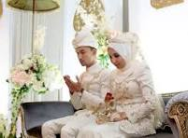
Married
Both are married persons

Slide 14
Section-C
Read MCQ carefully and tick the correct answer
Correct Answer
c. women’s right's
a. village
b. Bangla
b.Bhagalpur
c. Bihar
Time: 5 minutes

Slide 15
Section-D
Time: 5 minutes
Students will complete the chart individually and share
Begum Rokeya
Occupation | Born in | Married in | Family | Language
Writer and social worker
Begum Rokeya
Occupation | Born in | Married in | Family | Language
Writer and social worker | 1880 | 1897 | Landlord | Bangla, English, Arabic and Persian

Slide 16
Section-E
Time: 15 minutes
Read the text silently and
answer the following questions in group
Answers
Begum Rokeya’s belief was that women should have same rights and opportunities like men in the society
She fought for women’s rights
She came from a Muslim’s landlord family
Many upper class Muslims learnt Arabic and Persian as a medium of education and communication
She learnt Bangla for great attraction of her mother tongue

Slide 17

Thank you , everyone
for
your active participation in this lesson

