Slide 1







Slide 2


Introduction
Teacher’s Introduction
Class : Five
Unit: 3
Page: 12-13
Time: 40 Minutes
Topic: Be Quiet, Please
Md. Shaifullah
BBA, MBA (Finance)
Jagannath University.
Assistant Teacher,
Moddho Gayanpara Govt. Primary School.
Patharghata, Barguna.
Writer : Children’s Literature & Education System

Slide 3
Learning Outcomes
Listening: Listen to and understand simple requests and instructions in everyday contexts.​
Speaking: Speak politely using "please" and participate in short conversations with correct stress and intonation.
​Reading: Read and comprehend short dialogues and identify the use of opposite words (antonyms).
​Writing: Write simple sentences using appropriate adjectives and their antonyms correctly.

Slide 4
How are you today?
Are you happy today?
Do you like English?
Are you ready for the English class?

Slide 5
4.4 Imagine, you are visiting a farm or a zoo. Write 4 sentences in describing what you see. Use common nouns and collective nouns in your sentences. Underline the common nouns and circle the collective nouns.Example:
A herd of cows is grazing in the green field.
a)
b)

Slide 6
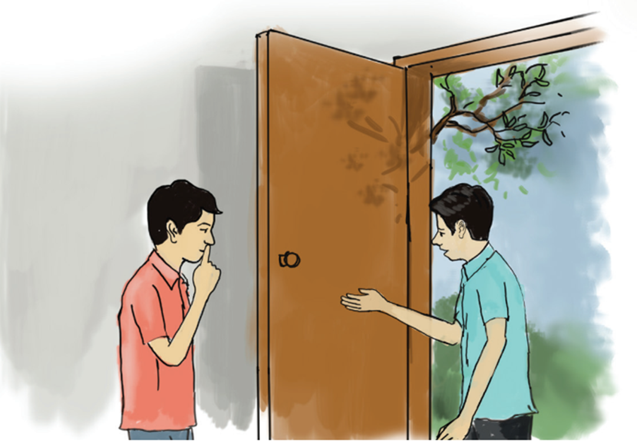
open page 12.
look at the pictures in the text given in Activity 1.1.
Have you ever gone to your friend’s house to play?
b) What kinds of play do you like to games for watch?

Slide 7
open page 12.
Declarations
We are going to read a text/act out a dialogue about
Be Quiet, Please.

Slide 8




Before reading out the text, pre-teach the vocabulary-
say the word aloud first, then spell the word, say or explain the meaning of the word, and then use the word in the sentences.
Quiet-শান্ত
Loud-জোরে
vocabulary
Please be quiet.
Don’t be too loud sound
low voice-নিচু স্বরে
Noisy-কোলাহলপূর্ণ
Market is a Noisy place.
Speak in low voice-

Slide 9
AT FIRST
WE SEE OUR ENGLISH BOOK.

Slide 10
Look at the words in the box (2.1) at page 13
Read aloud the words in box one by one and tell them to say the opposite words.
Read the chart 3/4 times .
dark | weak | Near | clean | far | warm
dirty | quiet | loud | cold | strong | light
Column A | Column B
dark | light
weak | strong
Near | far
clean | dirty
warm | cold
quiet | loud

Slide 11
Now, write the sentences by using opposite words.
cold, healthy, stop, happy and quickly
Word | Opposite
cold | warm / hot
healthy | sick
stop | go
happy | sad
quickly | slowly

Slide 12
Cold vs. Warm: "The ice cream is cold, but the cocoa is warm."
Healthy vs. Sick: "I eat apples to stay healthy, but I stay in bed when I am sick."
Stop vs. Go: "The red light means stop, and the green light means go."
Happy vs. Sad: "I feel happy when I play, but I feel sad when I drop my toy."
Quickly vs. Slowly: "The bunny hops quickly, but the turtle crawls slowly."

Slide 13
2.2 Make sentences using the antonyms (opposite meaning) of the underlined words. The first one is done for you.
a) This water is cold.
b) The boy is healthy.
c) Stop writing, please.
d) Rayan is happy today.
e) He writes quickly.
This water is warm.
The boy is sick.
Start writing, please.
Rayan is sad today.
He writes slowly.

Slide 14
2.2 Make sentences using the antonyms (opposite meaning) of the underlined words. The first one is done for you.
This water is cold.
b) The boy is healthy.
c) Stop writing, please.
d) Rayan is happy today.
e) He writes quickly.
This water is warm.
Thank you all
The boy is sick.
Start writing, please.
Rayan is sad today.
He writes slowly.

Slide 15
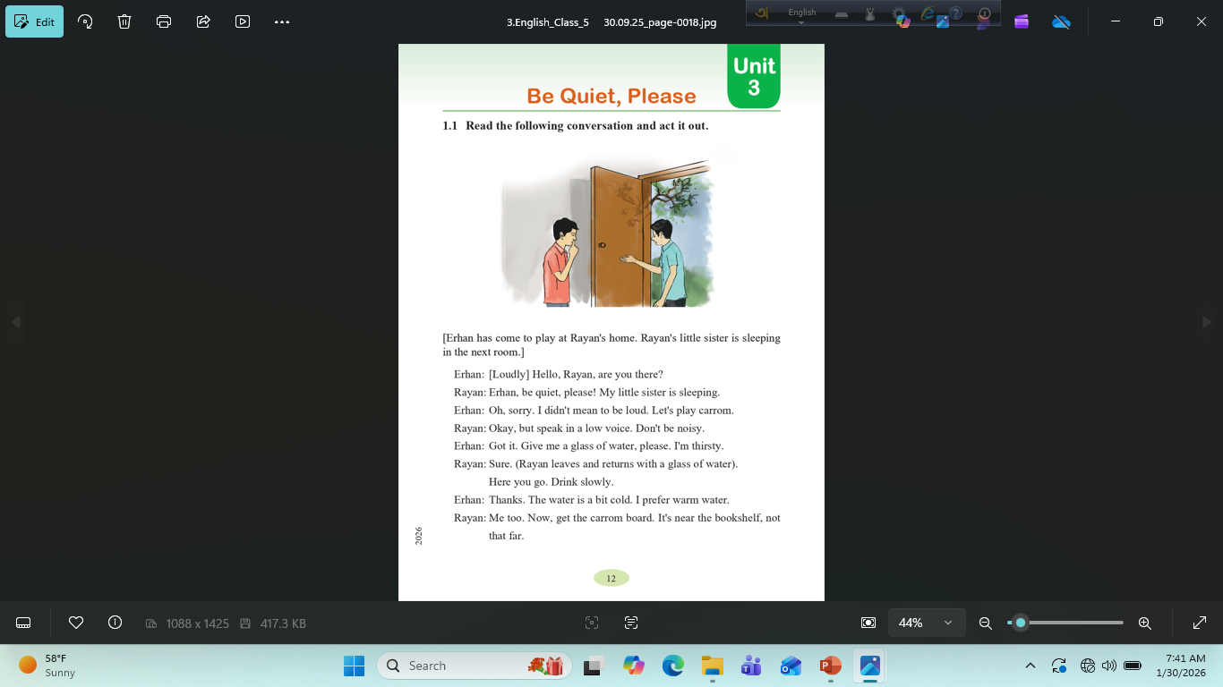
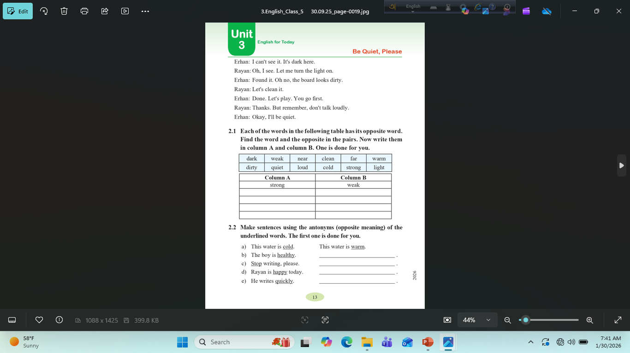
Now open your English book at page number 12 & 13.

Slide 18

Thank You

