Slide 1
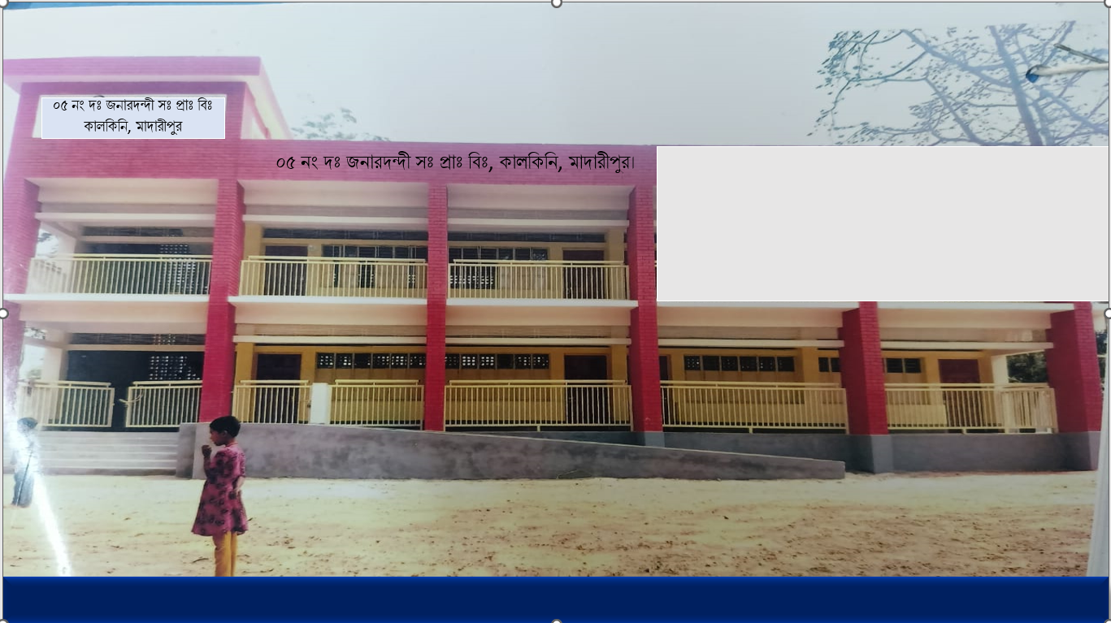



WEL COME
Class - Four
Subject - English
Unit - 17
I want
to join
English class
*05 No South Jonardondi GPS* * Kalkini, Madaripur. *

Slide 2
Introducing
Belayet Hossain
Assistant Teacher
05 No South Jonardondi GPS
Kalkini, Madaripur.
Gmail : belayet01715205765@gmail.com

Slide 3
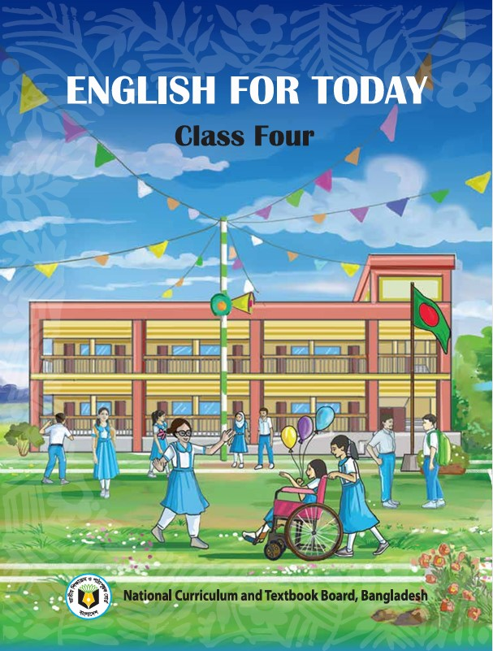
INTRODUCING
Class : Four
Subject : English
Unit : 17
The Land of Mountains
Activity : 1.1, 1.2
Page : 78.
Time : 45 minutes

Slide 4
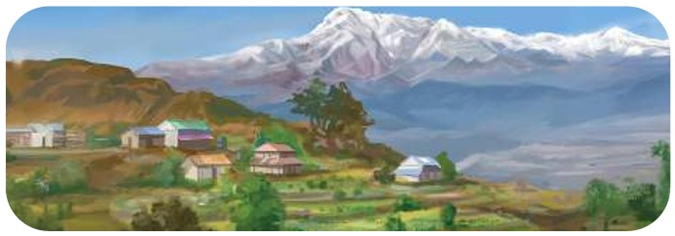
Can you guess what is our today's lesson?
What is the relationship between them?

Slide 5
Today's Our Lesson
The Land of Mountains
Unit - 17.
1.1, 1.2

Slide 6
Learning Outcomes
Students will be able to:-
Listening:-
4.3.1 - enjoy and understand simple stories.
Speaking:-
3.1.1 - ask and answer Wh questions.
Reading:-
5.1.1 - read simple paragraphs.
Writing:-
8.1.3 - write sentence from the text book or model.
10.1.1 - write short and simple paragraphs answering a
set of questions.

Slide 7
Who can you see in the picture?
New Words
Country
Where people live in peace.
In the capital city, Kathmandu, there are many old buildings, palaces and temples. They are very colourful. Nepalese like to dance and enjoy music in most Of their festivals. They take a variety of foods during festivals. Nepal is truly a wonderful country.

Slide 8
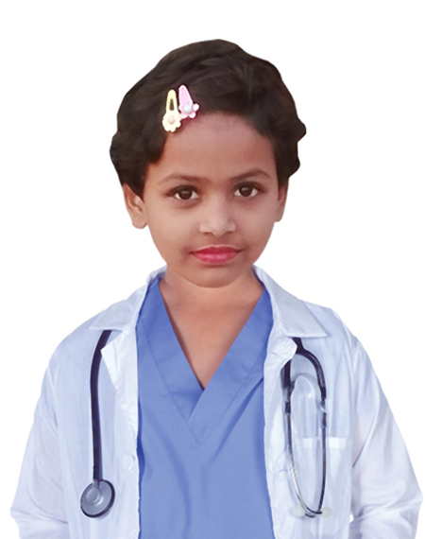
The Land of Mountains
In the capital city, Kathmandu, there are many old buildings, palaces and temples. They are very colourful. Nepalese like to dance and enjoy music in most Of their festivals. They take a variety of foods during festivals. Nepal is truly a wonderful country.

Slide 9
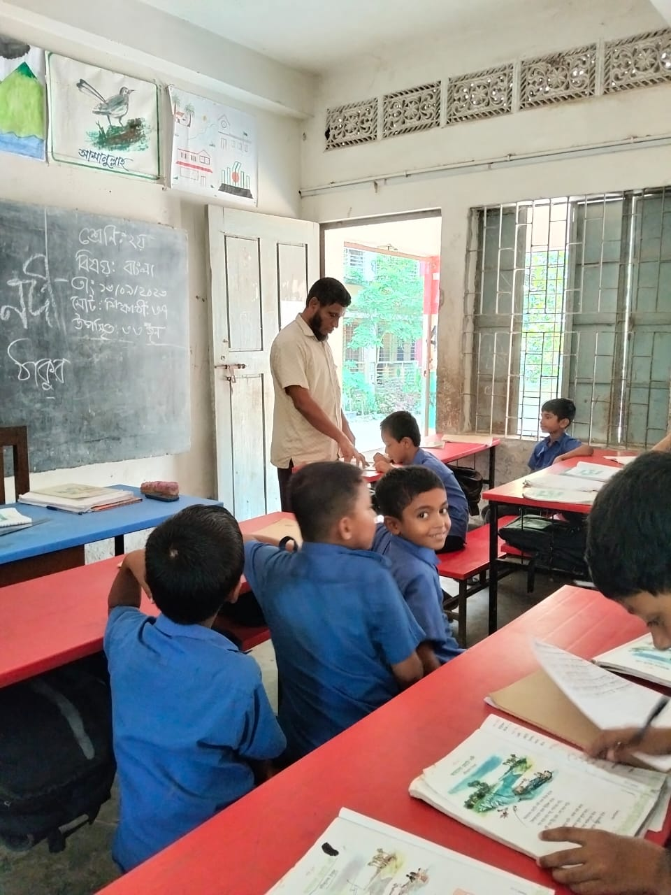
Teacher’s reading

Slide 10
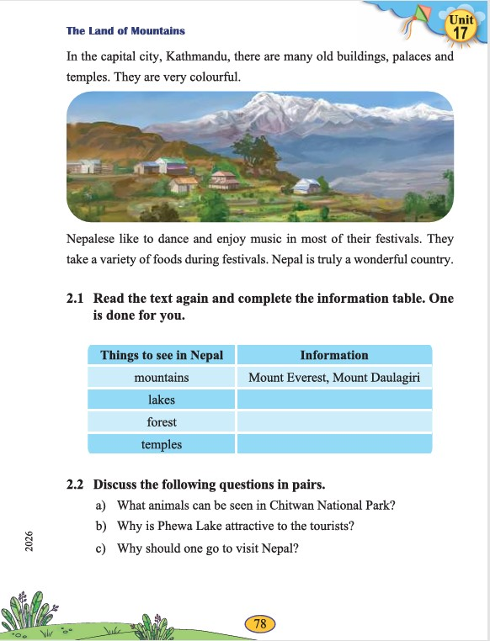
Open your English book at page - 78.

Slide 11
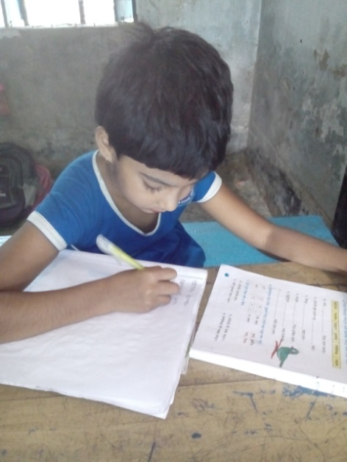
Individual Work
Make sentence by the words:
Capital
Colourful
Country

Slide 12
In the capital city, Kathmandu, there are many old buildings, palaces and temples. They are very colourful. Nepalese like to dance and enjoy music in most Of their festivals. They take a variety of foods during festivals. Nepal is truly a wonderful country.
How kind of city is Kathmandu?
Where are many old buildings?
How are the buildings look like?
Who are like to dance and enjoys music?
Which is truly a wonderful country?
Answer
Please click answer button for answer
Pair Work
Answer
Time: 5 minute's
Answer
Answer
Answer

Slide 13
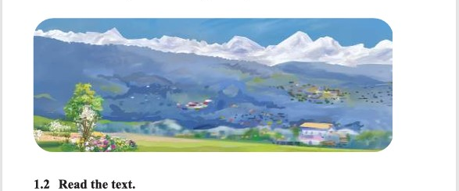

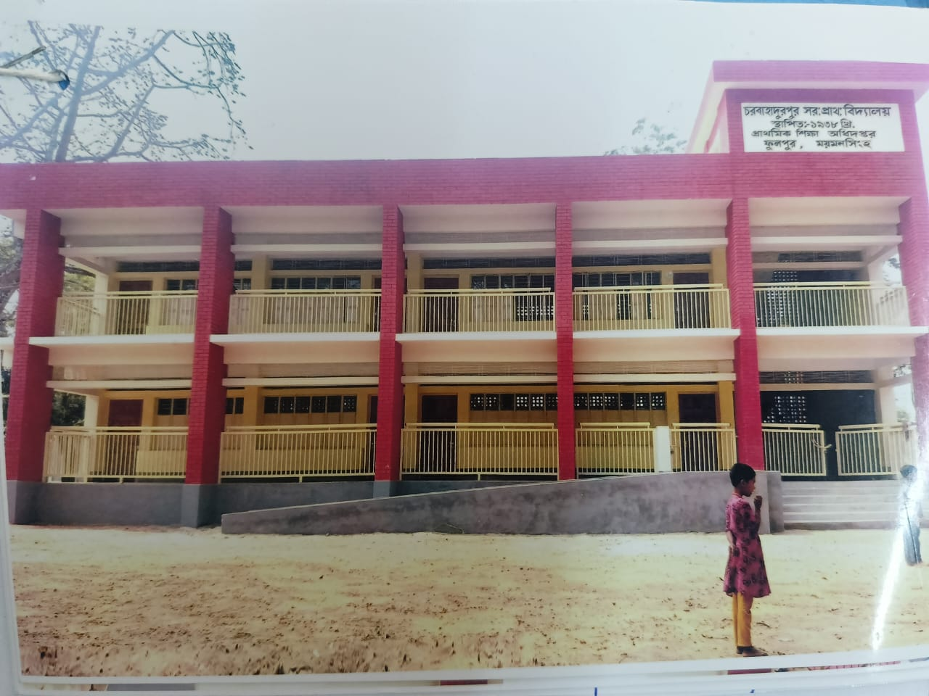
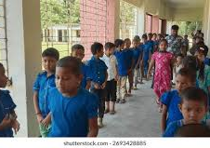
Group Work
Time: 10 minute's
The Land of Mountains

Slide 14
Individual Work
Read the sentences. Write T for True and F for False.
Kathmandu, there are many old buildings.____
They are very colourful.____
Nepalese dislike to dance._____
They take a variety of foods during festivals.____
Nepal is truly a wonderful country.___
T
T
F
T
T

Slide 15
Pair Work
Ask and answer.
What is the story about?
What animals can be seen in Chitwan National Park?
Why is Phewa Lake attractive to the tourists?
Why should one go to visit Nepal?
Which kinds of animal does Chitwan National Park found?

Slide 16
Evaluation
Look attentively. Now we play a game. Everybody close your eyes.
Which word is missing?
Open your eyes.
Capital
Colourful
Country

Slide 17
Evaluation
Write three sentences about The Land of Mountains.

Slide 18
Thanks to All

