Slide 1

Good Morning Students
Welcome to today’s class

Slide 2

Teacher’s Identity
Md. Azim Uddin. Latifpur Government Primary School .

Slide 3


Lesson Identity
Subject: English
Class: Five
Unit: 10, Poem: The Swing.
Activity: 1.1
Page: 52

Slide 4
Learning Outcomes
6.1.1 Read rhymes and poems and recite with joy.
6.1.2 Comprehend and express the main ideas of rhymes and poems through reading.

Slide 5
Title of the lesson
We will recite a poem names
The Swing
Written by
Robert Louis Stevenson

Slide 6
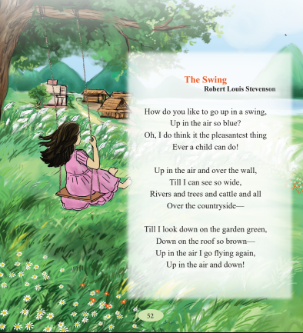
What do you see in the picture?
I can see –
A girl
The swing
Blue sky
Rivers
Trees
Cattle
Brown roof
Green garden
Colourful flowers

Slide 7
Pre-teach the vocabulary
swing – দোল
pleasantest – আনন্দদায়ক
cattle – অন্বেষণ করা
countryside - গ্রাম এলাকা

Slide 8
Words and meanings
swing– a type of bench that moves back and forth
pleasantest – agreeable above all others
Cattle – a group of domestic animals.
Countryside – village area/ rural area.

Slide 9
Let’s recite the poem

Slide 10

Practice with Chain drill
One will read the poem aloud first, and the other will listen. Change their roles in turns.

Slide 11

Write down the rhyming words from the poem.
___________ and __________
__________ and ___________
__________ and ___________
____________ and __________
Swing
Thing
Blue
Do
wall
all
brown
Down

Slide 12
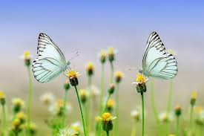
Discuss in pairs
What is the poem about?
Ans: The poem is about a child enjoying swinging high in the air and seeing beautiful things around
b) What does the speaker see when the swing goes up?
Ans: The speaker sees rivers, trees, cattle, gardens and houses all over the countryside.
c) How does the speaker feel while swinging?
Ans: The speaker feels very happy and excited. He thinks it is the most pleasant thing a child can do.
d) Do you have a swing at school or home? What do you see from it?
Ans: Yes, I have one at home. When I swing, I see the sky, trees and flowers in our garden.

Slide 13

Evaluation
What is the poem name?
Who wrote this poem?
What is the bangla meaning of countryside?

Slide 14



