Slide 1
Dear students,
Welcome today our
English First Paper Class

Slide 2
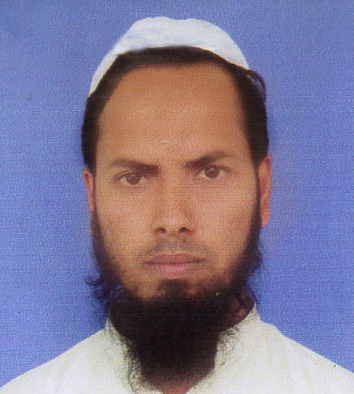
Teacher’s Identity
Md Nizam uddin ( Assistant Teacher)
Ranigonj High School
Ranigonj Bazar, Jagannathpur
Sunamgonj.

Slide 3
Class test – 29
Unseen passage-02
Abraham Lincoln
Questions no- 04,05
Marks – 15

Slide 4
Abraham Lincoln was the 16th President of the USA. He is famous for his Gettysburg Address. It was delivered by him during the American Civil War on November 19, 1863. Abraham Lincoln was born on February 12, 1809 in Kentucky, the USA. His parents were from Virginia. In 1818, his mother died. Then his father moved to Indiana State. He grew up there. He was a captain in the Black Hawk War. He got the nomination for president in 1860. Then he became the president of the USA in 1861. Lincoln declared a ban on slavery in America on January 1, 1863. He was re-elected President in 1864. On Good Friday, April 14,1865, he was assassinated at ‘Ford’s Theatre in Washington.

Slide 5
4. Complete the table with information from the above passage.
Who / What | Event | Place | Year / Time | Contribution
Abraham Lincoln | was born | USA | i)……………
He | was elected first President |  | ii)…………..
He declared | iii)…………… |  | January 1,1863.
He is | famous for his |  |  | iv)………..
Death |  |  | v)…………..
5. Write a summary of the above passage in your own words.

Slide 6
Matching with answer
On February 12, 1809
in 1861
a ban on slavery in America
Gettysburg Address
April 14,1865

Slide 7
Dear students,
Thank you
For joining our
English First Paper Class

